Slide 1
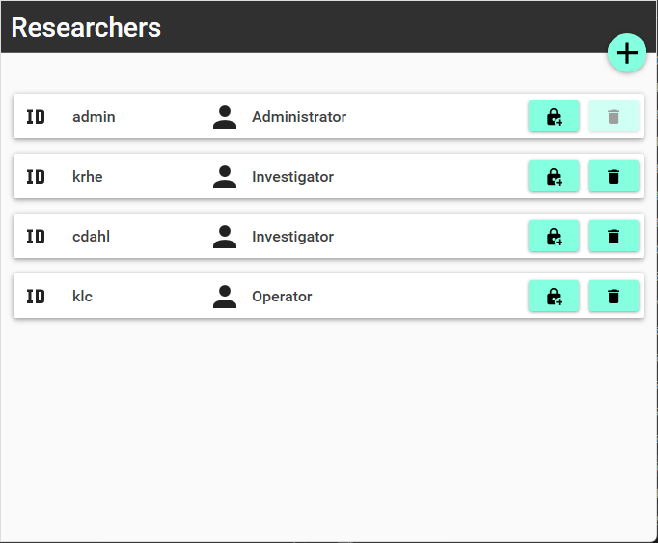
Add researcher
Change password
Delete researcher
Notes:
Joystick

Slide 2
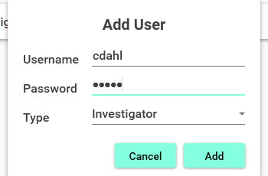
Notes:
LabBench I/O

