Slide 1
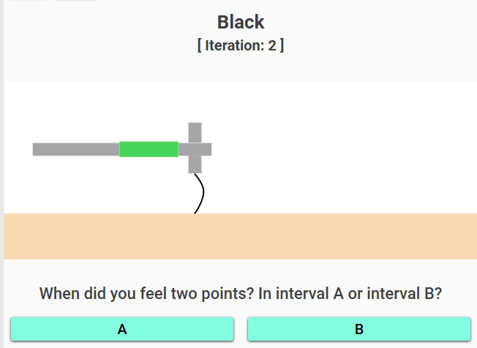
Intensity
Progress
Options
Response question
Answer
Notes:
Joystick

Slide 2
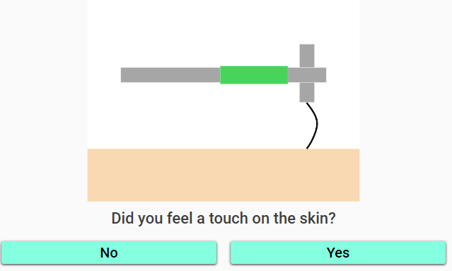
Notes:
Yes/No Response Task

Slide 3
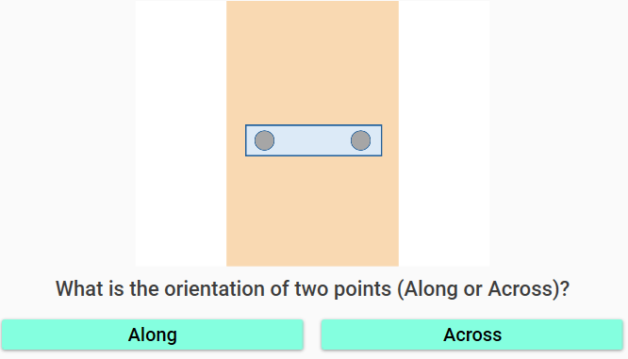
Notes:
One Interval Forced Choice

Slide 4
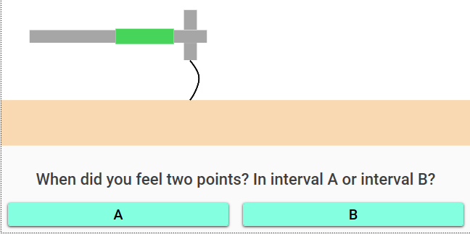
Notes:
Two Interval Forced Choice Response Task

