Slide 1
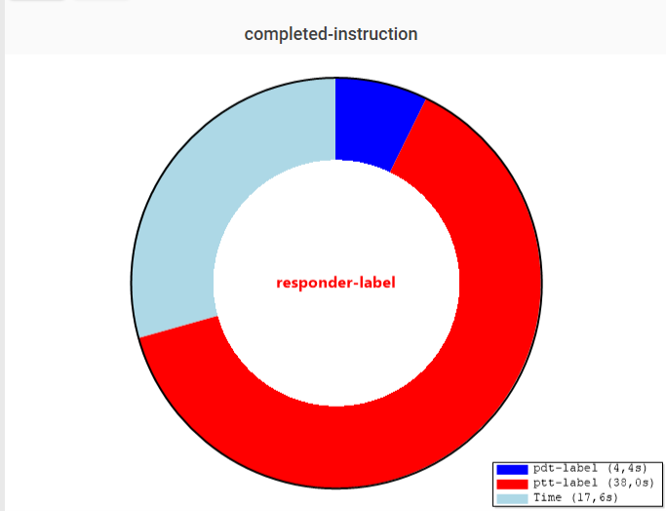
Operator instruction
Timing display
Timing information
Notes:
Joystick

