Slide 1
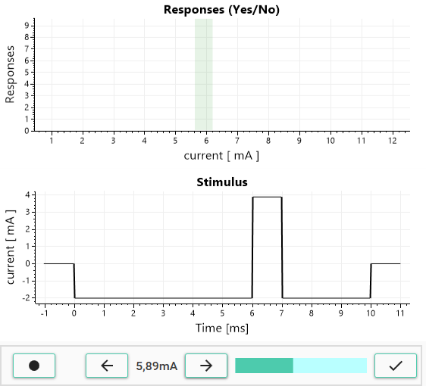
Responses
Stimulus display
Stimulation and intensity control
Accept the result
Increase intensity
Decrease intensity
Stimulate
Notes:
Joystick

