Slide 1
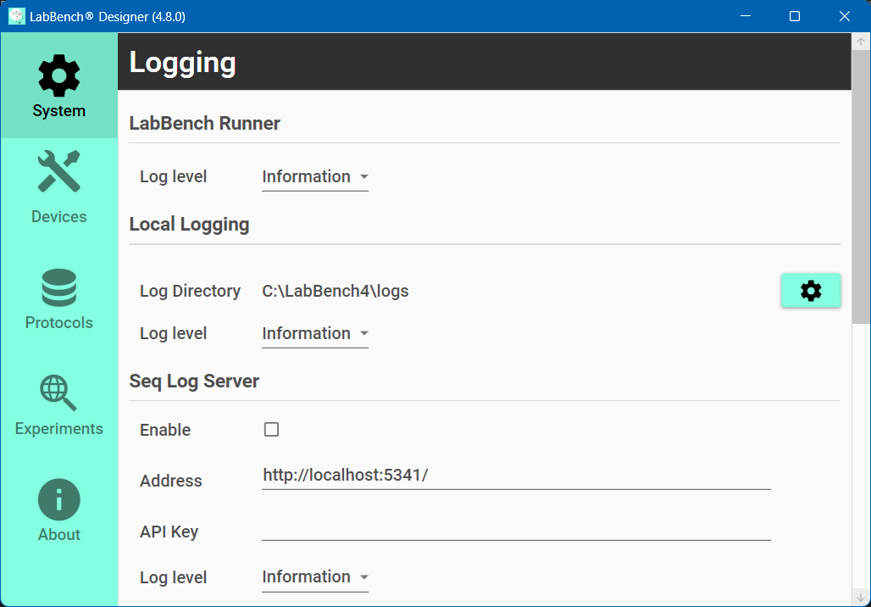

Slide 2
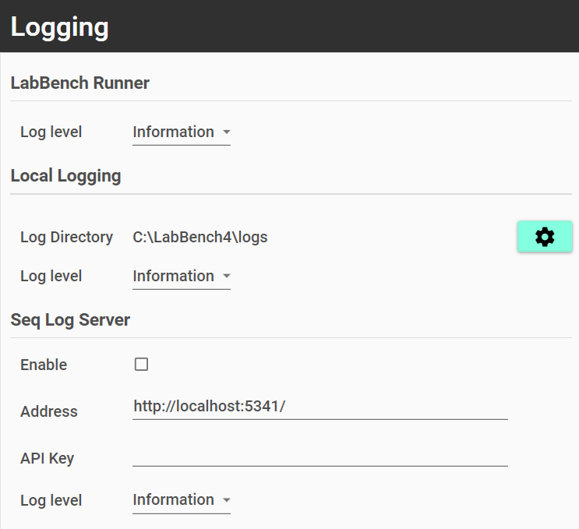

Slide 3
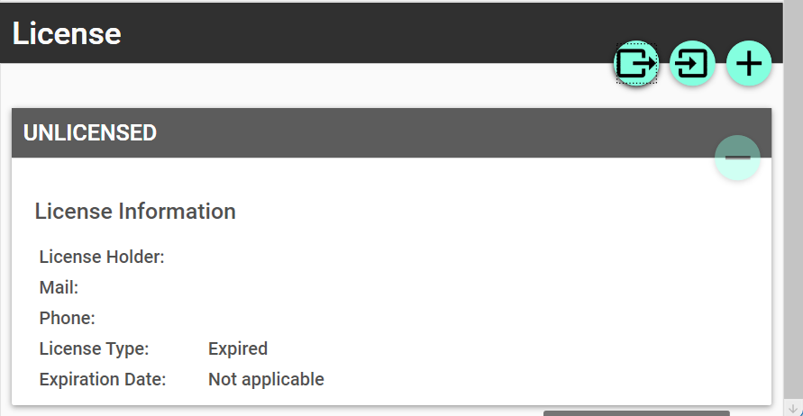
Offline registration request
Offline registration
Online registration

Slide 4
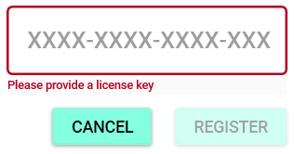
Enter license key

Slide 5
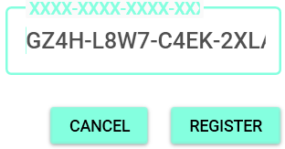
XXXX-XXXX-XXXX-XXXX
Register license key

Slide 6
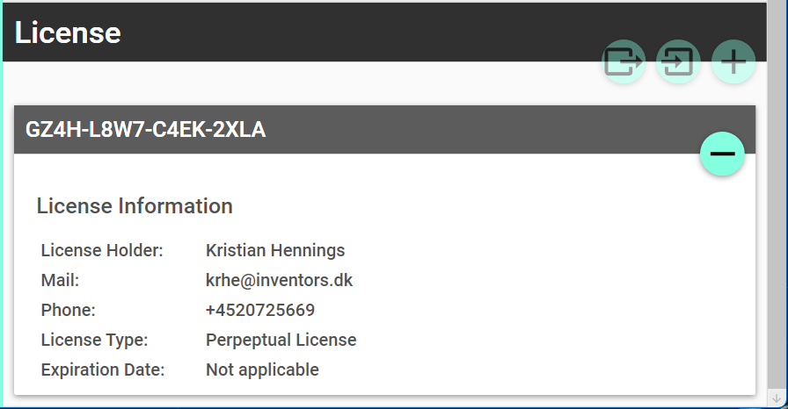
XXXX-XXXX-XXXX-XXX
Deregistration

Slide 7
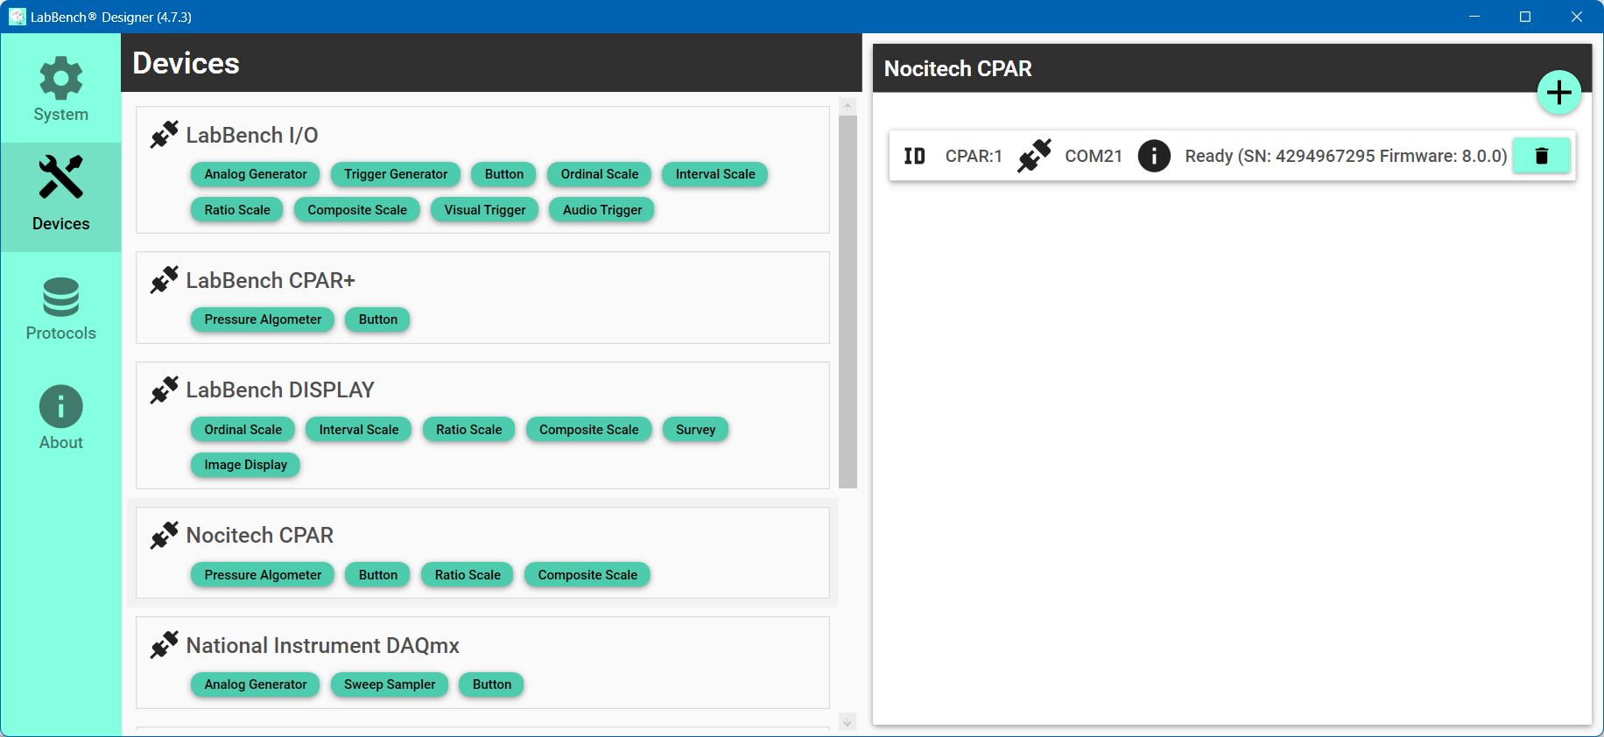
Add devices
Select type of device
List of added devices
Remove device

Slide 8
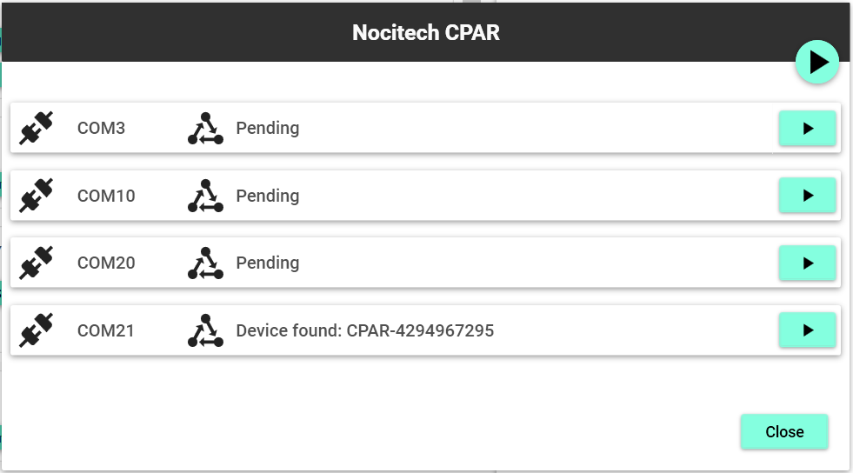
Scan all ports
Scan port

Slide 9
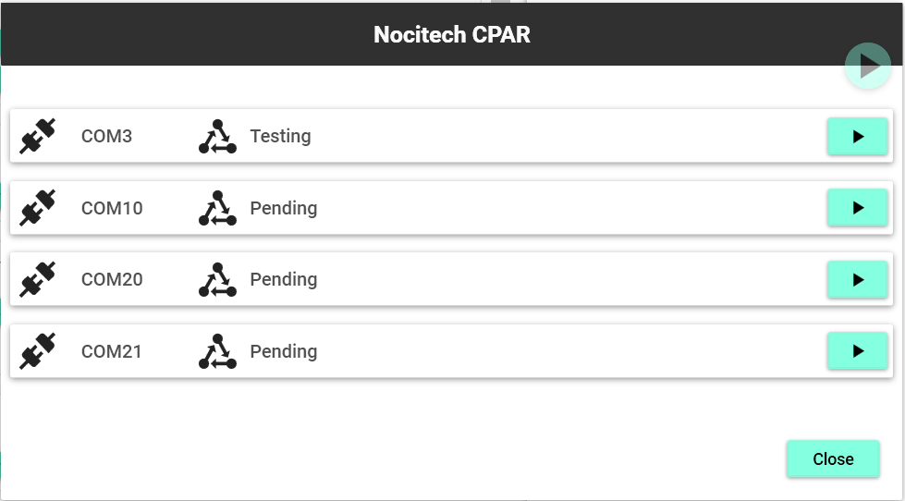
Notes:
Bluetooth Serial Port Error

Slide 10
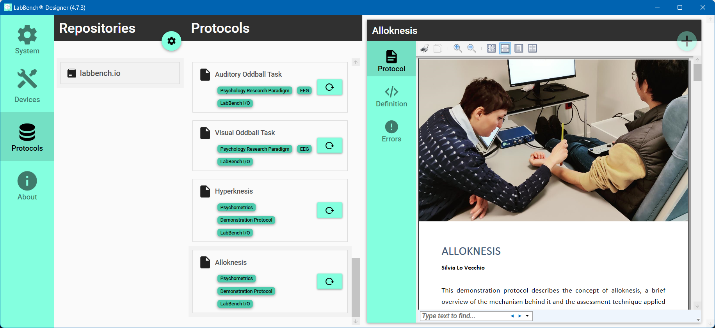
List of repositories
Create experiment
Configure repositories
Selected protocol
Selected repository

Slide 11
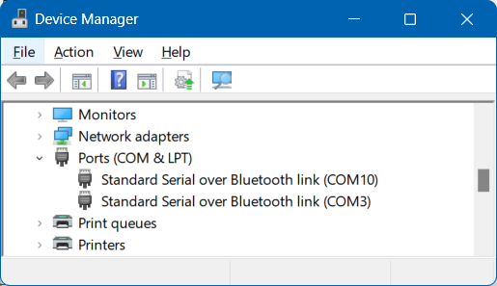

Slide 12
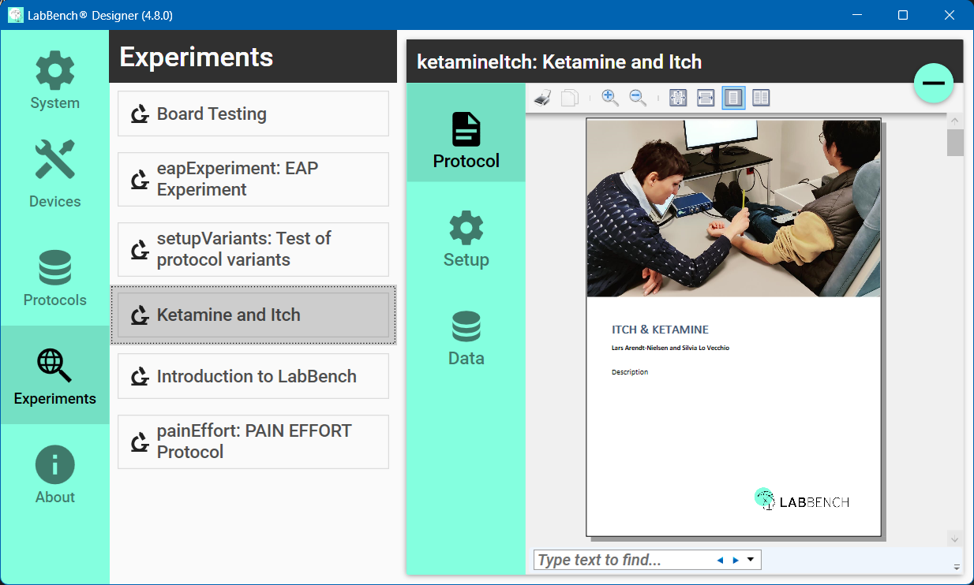
List of experiments
Delete experiment
Experiment Panel

Slide 13
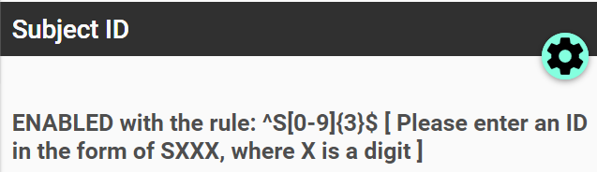
Configure validation

Slide 14
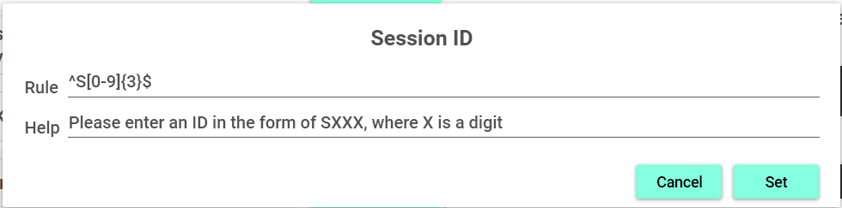

Slide 15
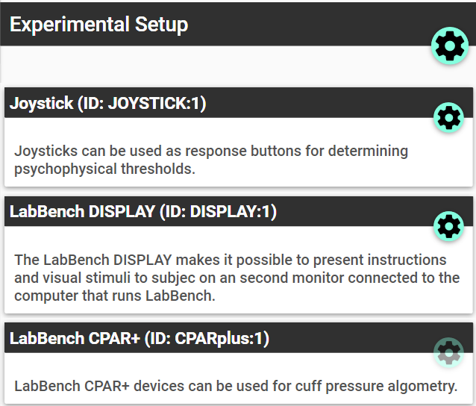
Assign devices
Configure device

Slide 16
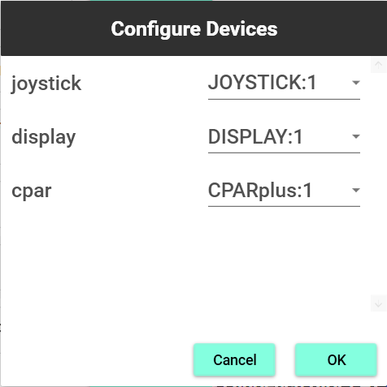

Slide 17
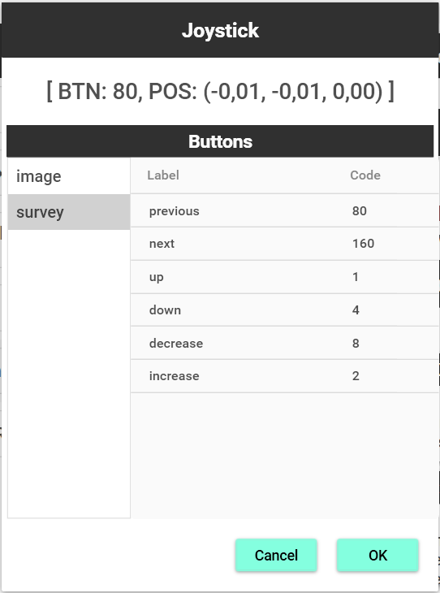
Joystick state
Button map
Assign code

Slide 18
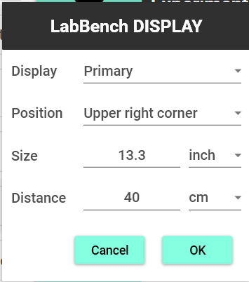

Slide 19
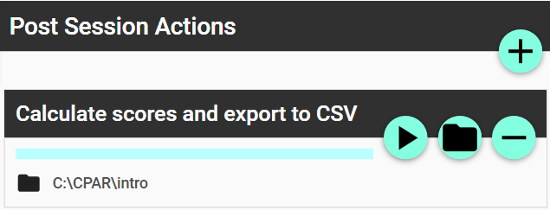
Run action
Set output directory

Slide 20
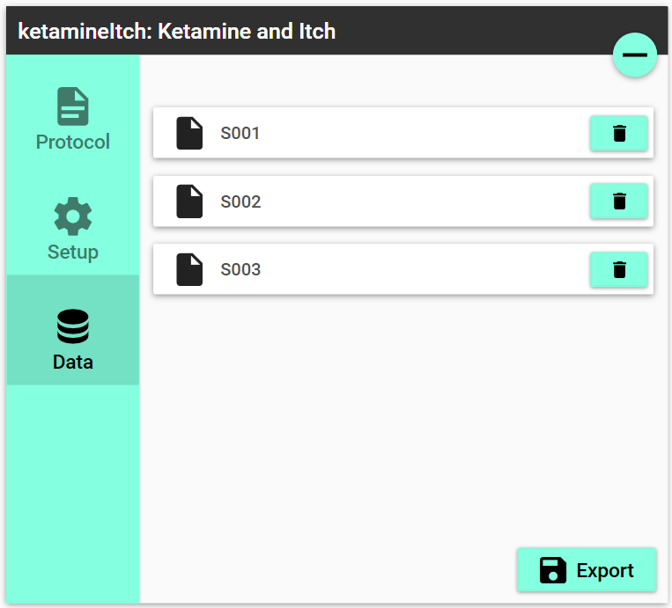
Delete subject
Export all subjects

Slide 21
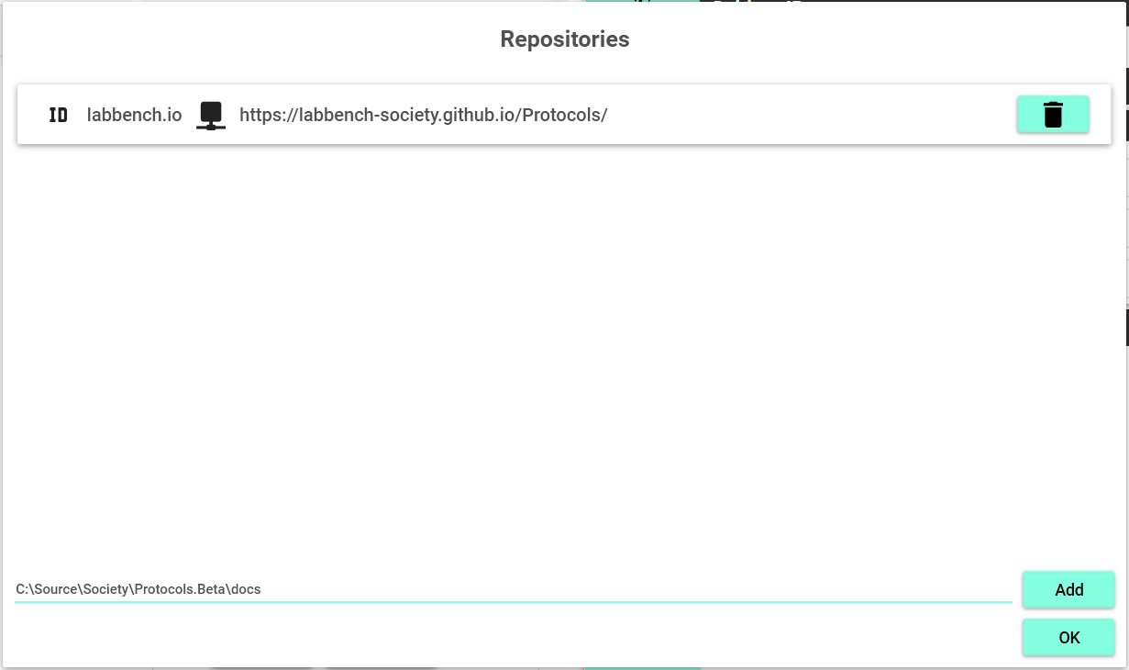
Delete repository
Add repository
Location of repository to add

Slide 22
