Slide 1
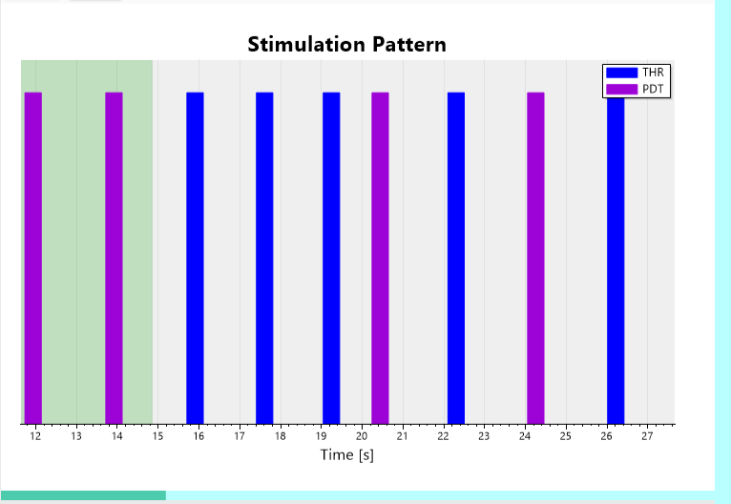
Stimulation sequence
Stimulation progress
Notes:
Joystick

