Slide 1
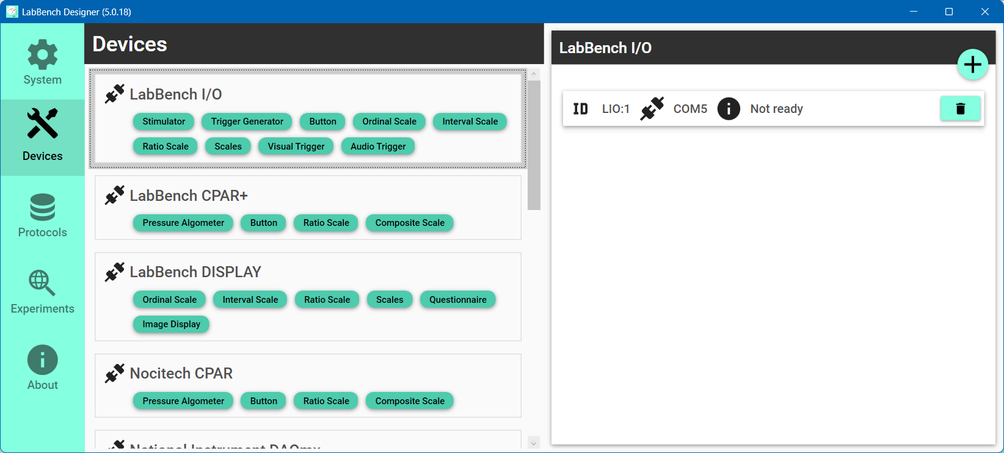

Slide 2
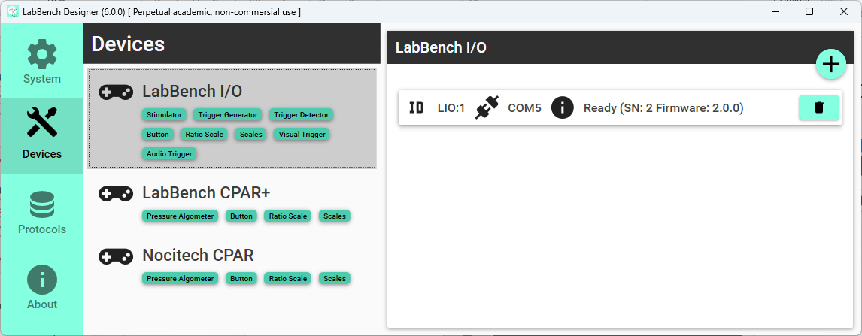
Select the type of instrument to add
Select the Devices page
Click the “Scan and add” button

Slide 3
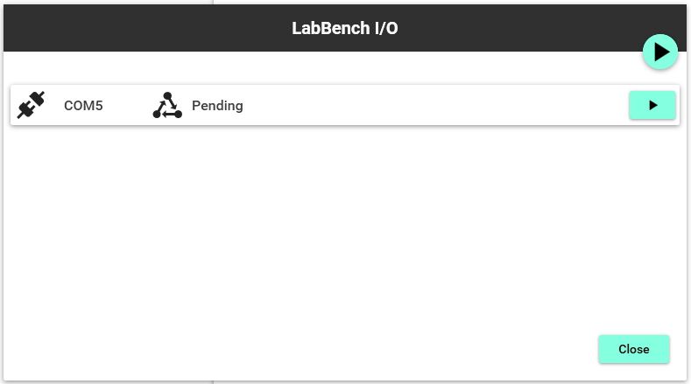
“Scan all connections” button
“Scan connection” button

Slide 4
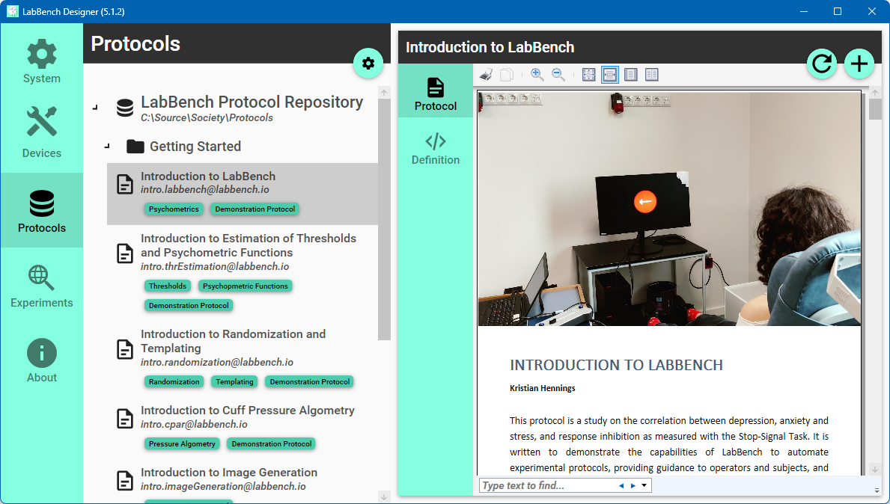
Select the LabBench Protocol Repository
Select the Protocols page
Click the “Install protocol” button
Select Introduction to LabBench
Notes:
Figure3

Slide 5
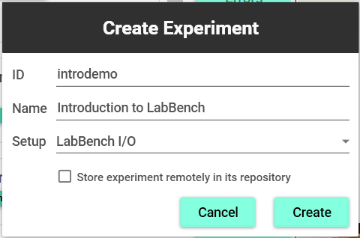
ID of the experiment that must be unique
Name that is displayed to the experimenter
Experimental setup variant
Store the protocol in the repository
Click to create the experiment

Slide 6
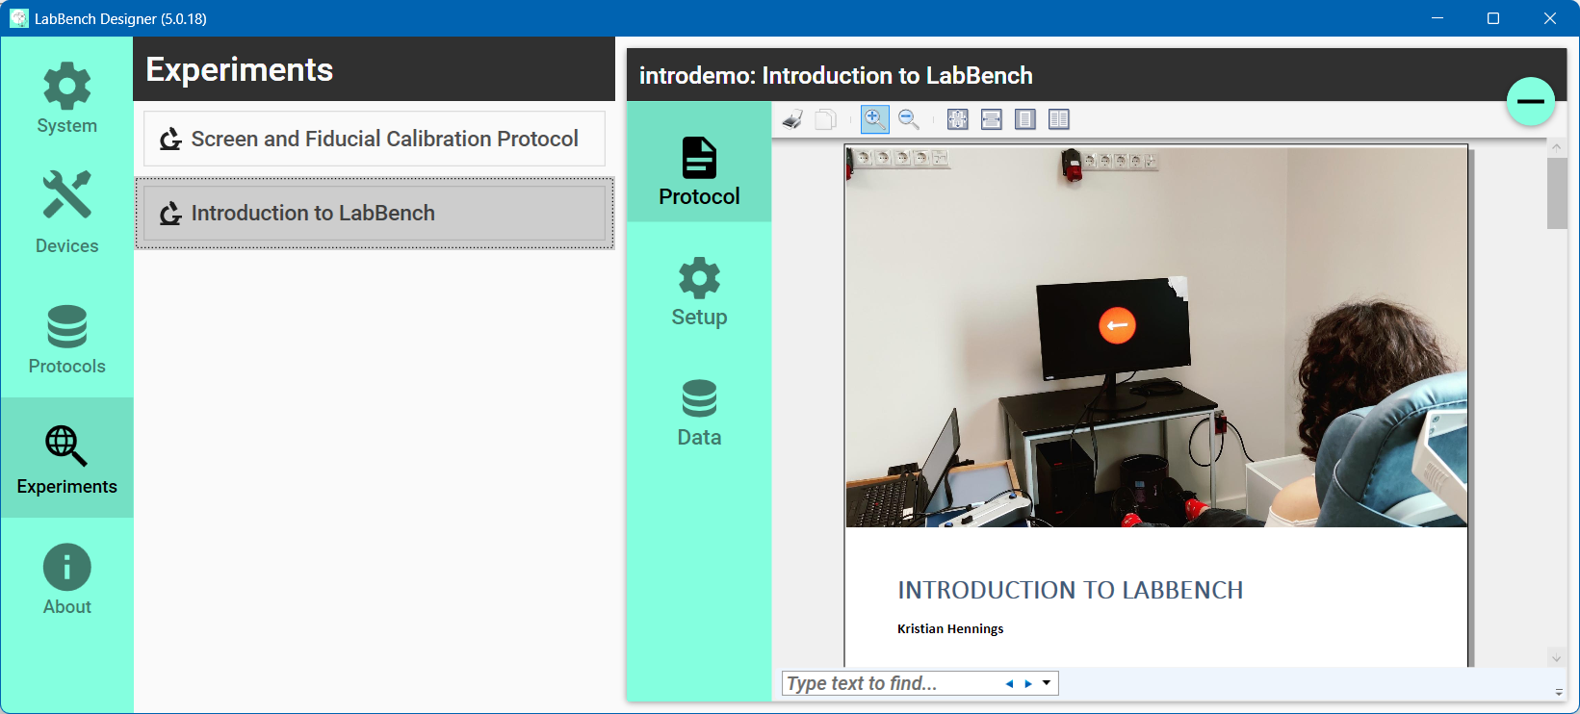
Select the experiment to manage
Select the Experiments page
Content of experiment page
Select experiment page

Slide 7
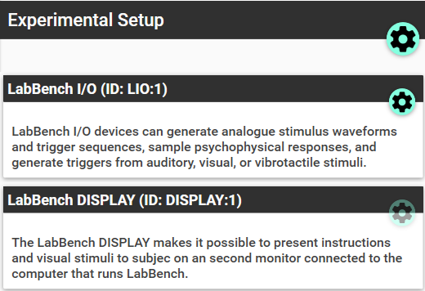
Assign equipment
Configure device

Slide 8
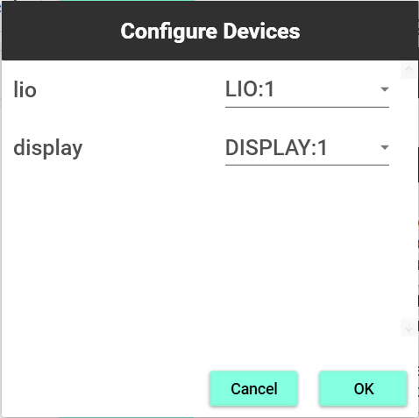
ID of the device in the protocol
Equipment ID from the Devices Page

Slide 9
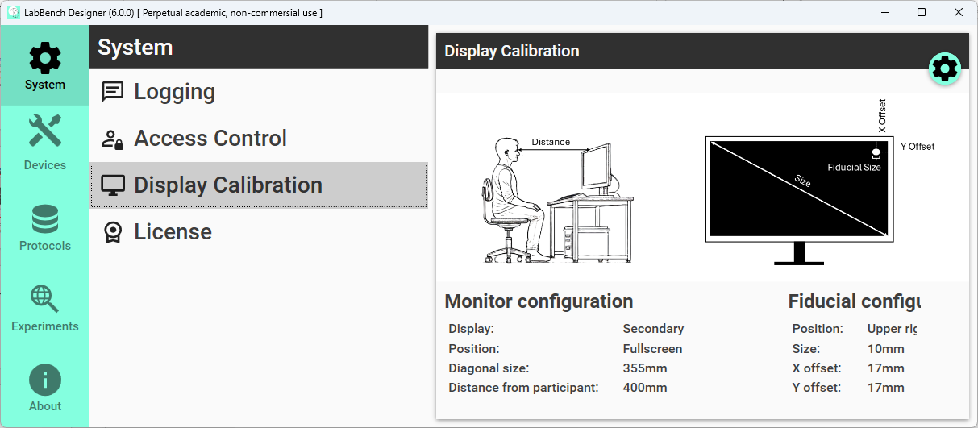
Calibrate display

Slide 10
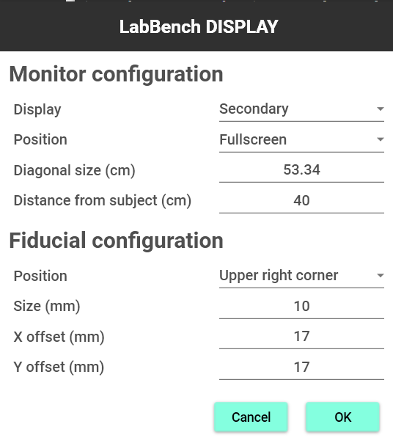

Slide 11
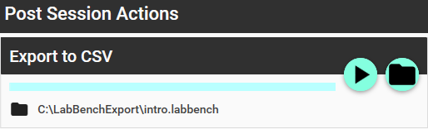
Rerun action
Change output directory

Slide 12
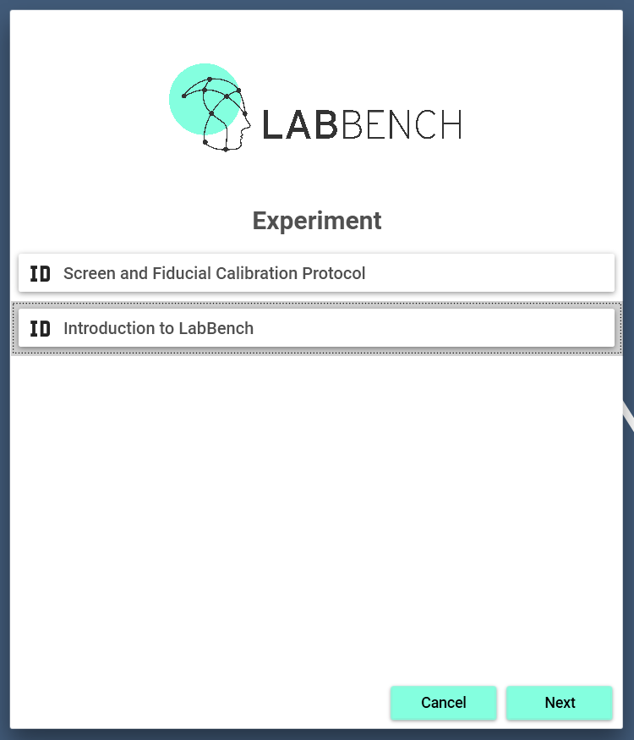
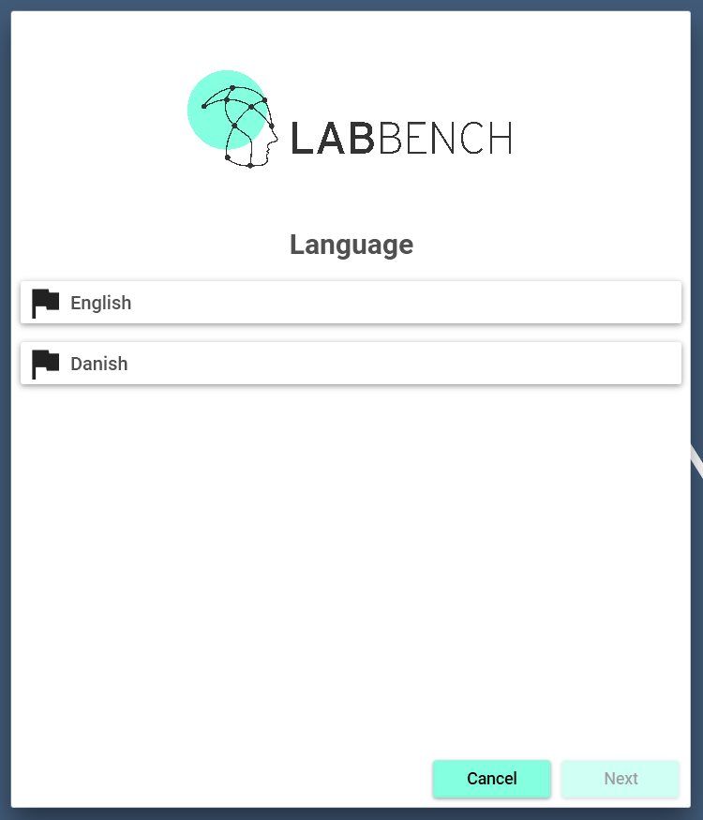
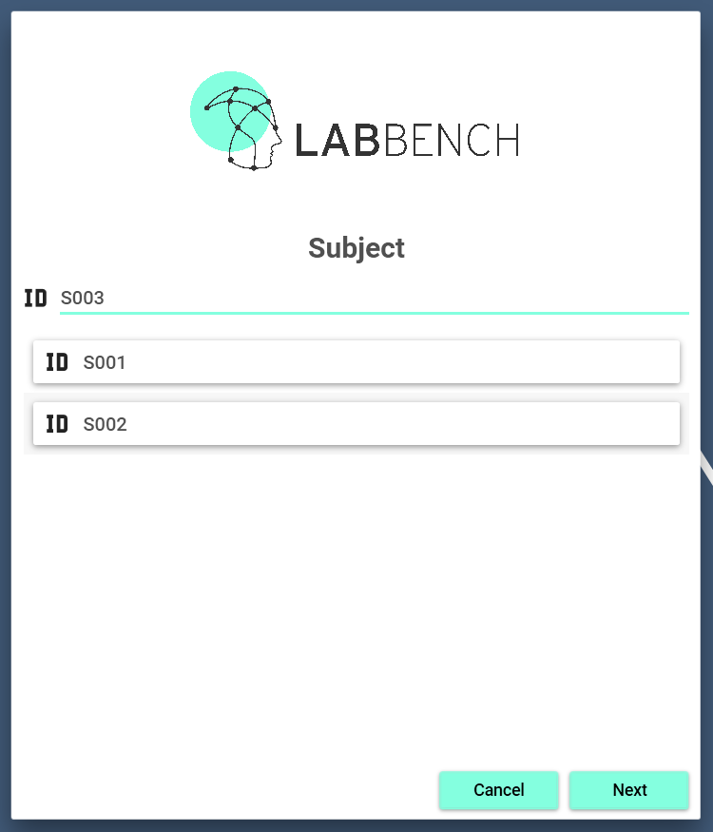
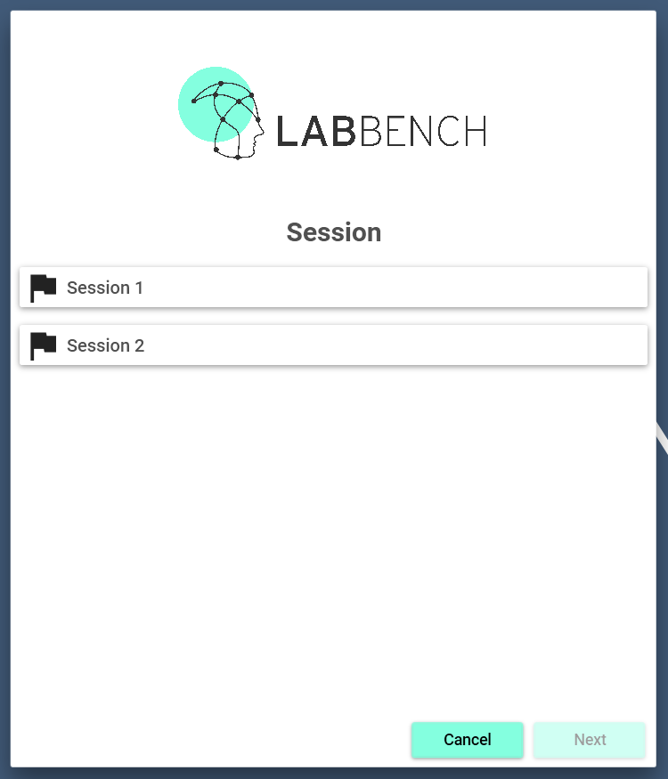
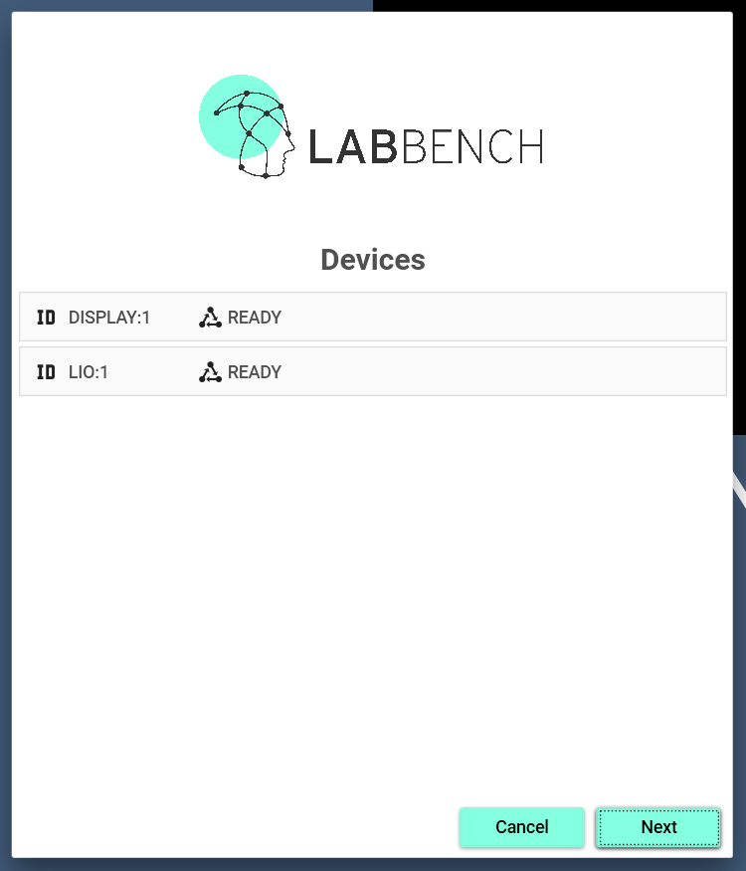
Experiment
Language
(Optional)
Participant
Session
(Optional)
Devices
(Optional)
Start
Is it localized?
Is it multi-session?
Does it use
devices?
LabBench Runner
Yes
Decision about the progress in the Startup Wizard.
No

Slide 13
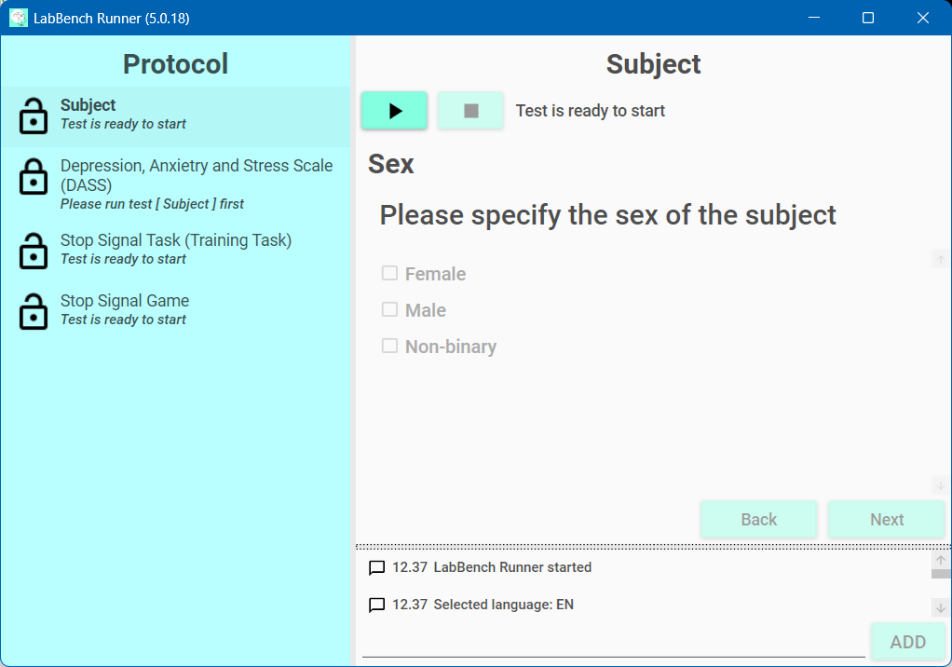
Procedure control and information panel
Protocol
Procedure panel
Log window

Slide 14
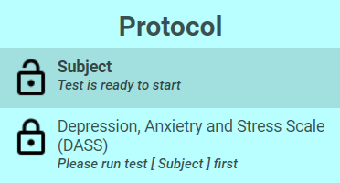
Procedure name
State icon
Procedure status

Slide 15
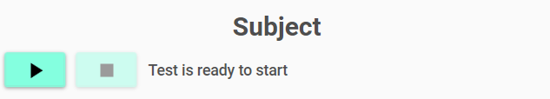
Procedure name
Procedure status
Abort the procedure
Start the procedure

Slide 16
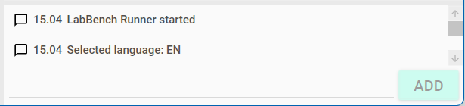
Log entries
Manual log entry
Add manual log entry

Slide 17
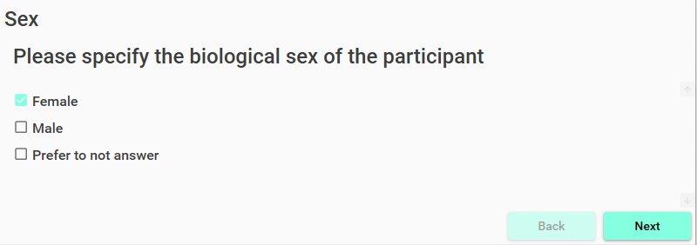
Manual procedure controls

Slide 18
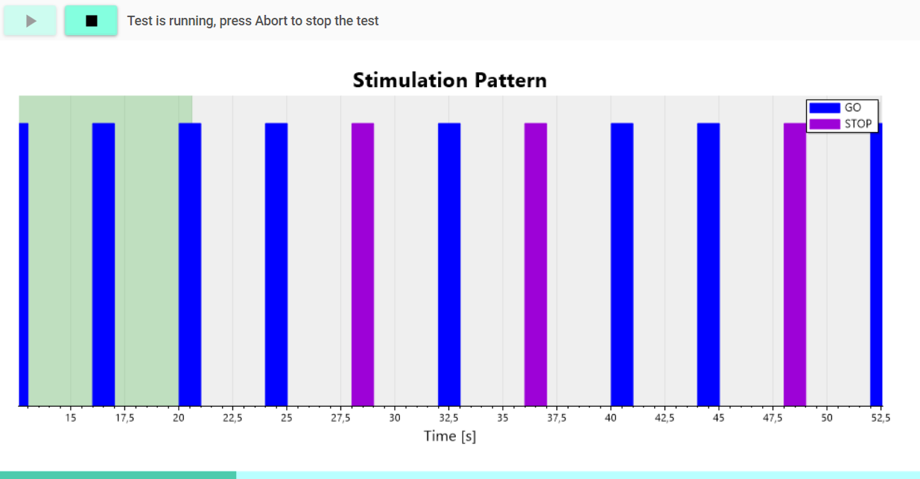

Slide 19
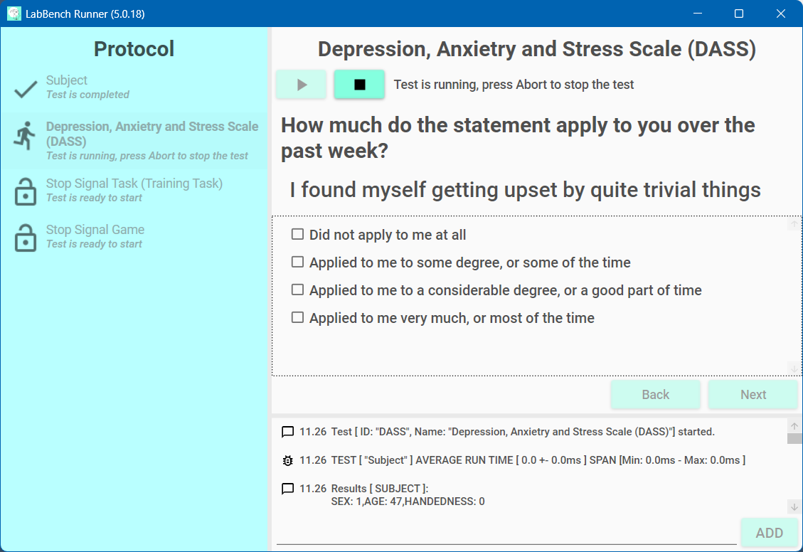
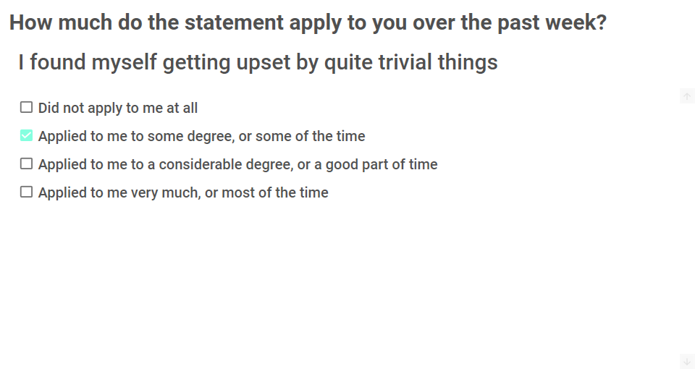
Primary Screen
Secondary Screen (LabBench Display)

Slide 20
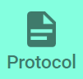
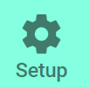

The Protocol tab is only visible if a Protocol Description is available for an experiment.
The Setup tab is always visible and will allow you to configure an experiment.
The Data tab is always visible and will allow you to export data from the experiment and delete individual subjects.
Notes:
Table1

Slide 21





 | Locked When a procedure is locked it means that it depends on the results of one or more procedures that have not yet been completed. In that case the Procedure Instruction will inform you as to which procedures need to be completed to Unlock the procedure so it can be started.
 | Unlocked When a procedure is unlocked it means that it is ready to run but has not yet been started.
 | Running When a procedure is running it means that it has been started in the Procedure Panel and is currently active in collecting the data required for its completion.
 | Completed When a procedure has been completed it means that it has been successfully run and that the required data set has been collected.
 | Excluded When a procedure is excluded, it means that results of previously executed procedures mean that it is impossible to run the procedure. In the present protocol this is the case if the subject does not fulfill the inclusion criteria for the inclusion in the study.
Notes:
Table 2

Slide 22


Start
This will start the procedure, so it enters its Running state. Once a procedure starts it will run until either:
The procedure has collected the required data automatically, or
The operator has performed the required actions for the data collection that allow the procedure to be completed.
If the procedure can collect the data automatically, the procedure will automatically enter the Completed State without requiring an intervention by the operator.
If the procedure requires manual actions by the operator to collect the required data, the procedure will never enter the Completed State automatically. Instead, the procedure must be explicitly Completed by the operator with the buttons that will be available in the Procedure Controls part of the Procedure Panel.
Abort
If a procedure needs to be aborted, then the Abort button must be clicked. Please be aware that this represents an abnormal situation that invalidates the currently recorded data. When the Abort button is pressed the procedure is aborted and the state of the protocol is restored to the state it had just before the procedure was started.
Notes:
Table 3

