Slide 1
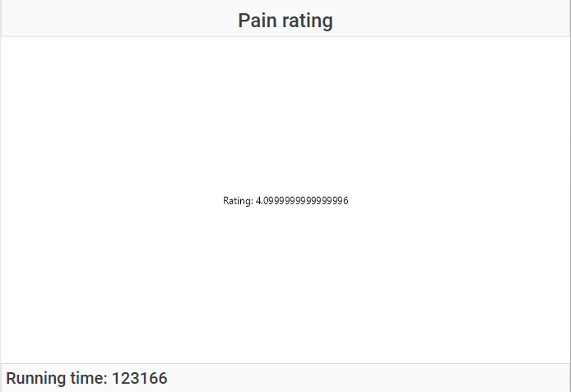
State name
Information panel
Status
Notes:
Joystick

