Slide 1
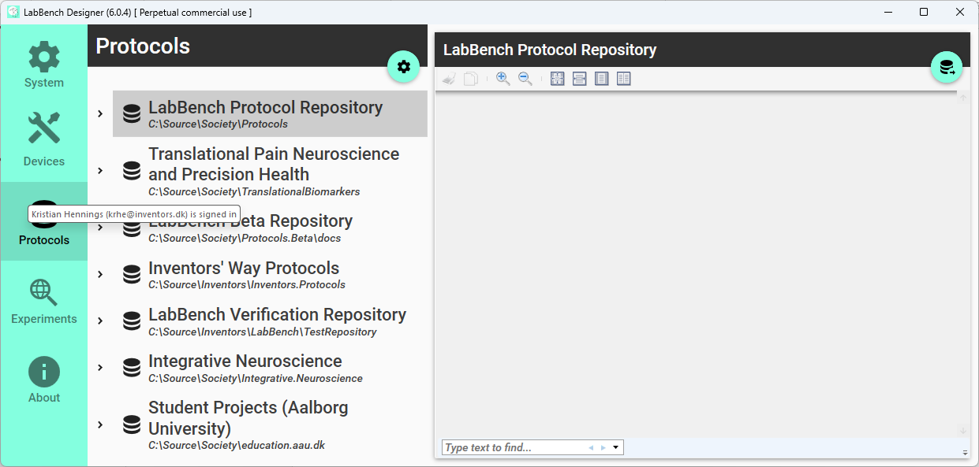
Build the repository
Notes:
Joystick

