Slide 1
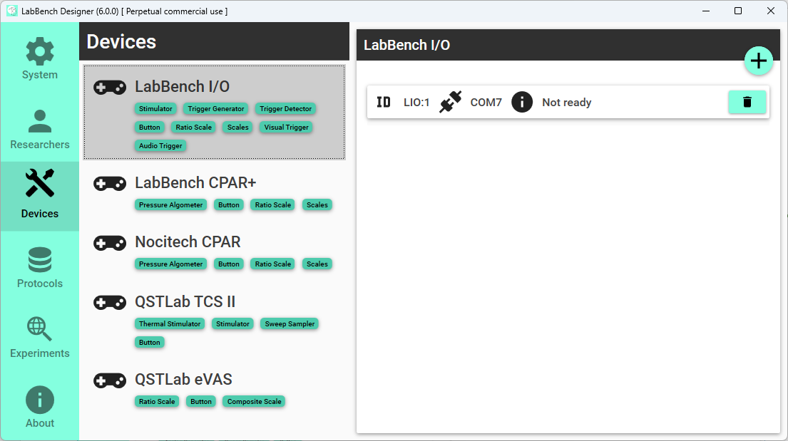
Select type of device
List of added devices
Add devices
Remove device
Notes:
Joystick

Slide 2
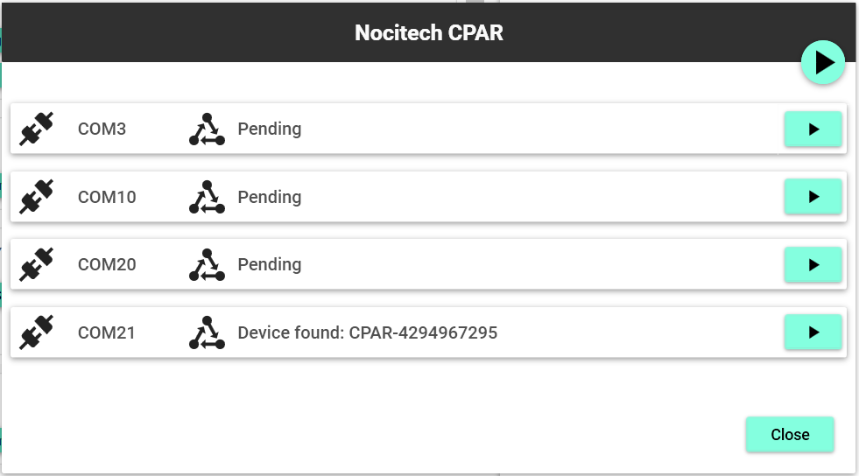
Scan all ports
Scan port
Notes:
LabBench I/O

Slide 3
