Slide 1
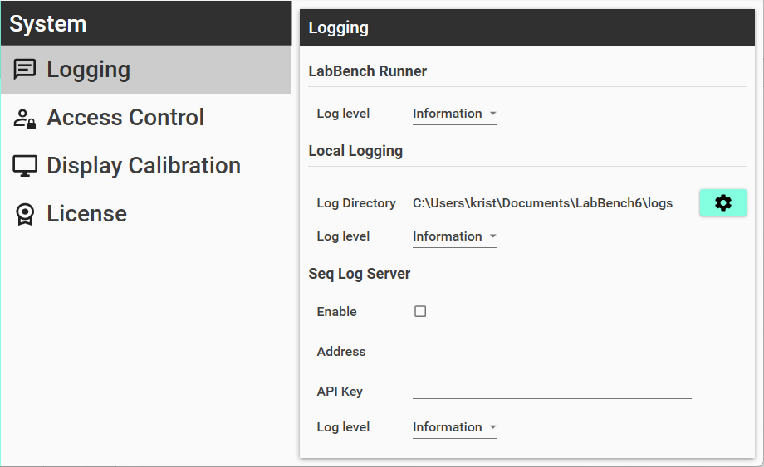
Notes:
Joystick

Slide 2



 | Debug Debug level messages are relevant for debugging errors in a protocol and for understanding error level messages.
 | Information Information level messages that are relevant for the operator while they are performing a study. These log messages provide information about the normal execution of protocols.
 | Error Error level messages that are vital are vital for the operator while they are performing a study. These log messages provide information about events that are abnormal and which prevents the protocol to be performed correctly.

Slide 3
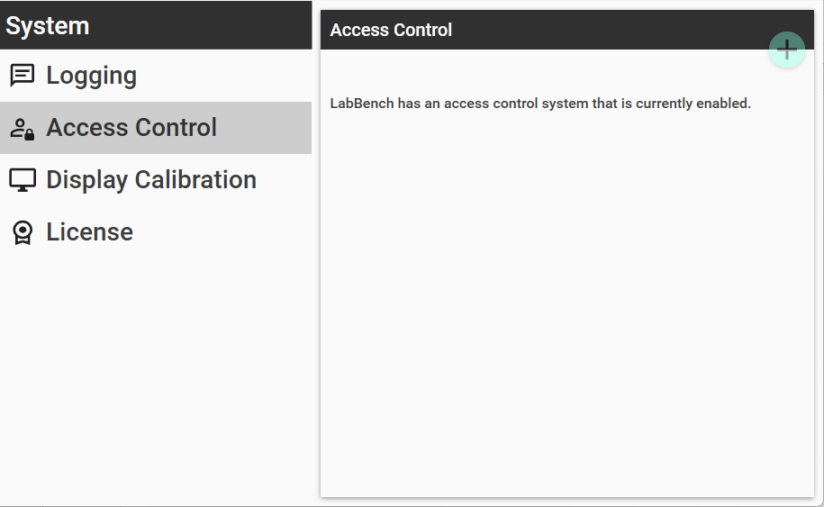

Slide 4
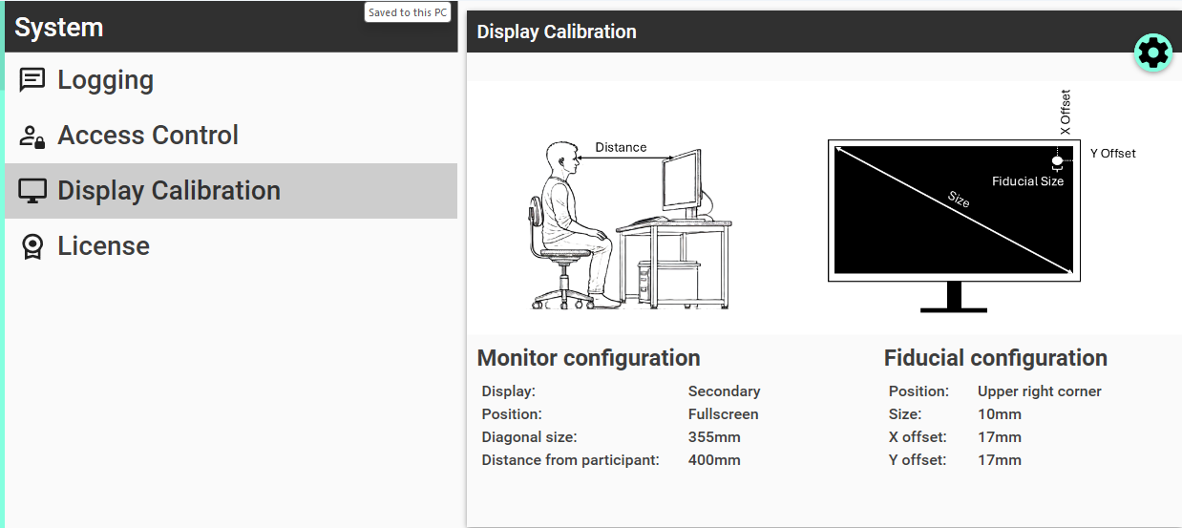
Calibrate display

Slide 5
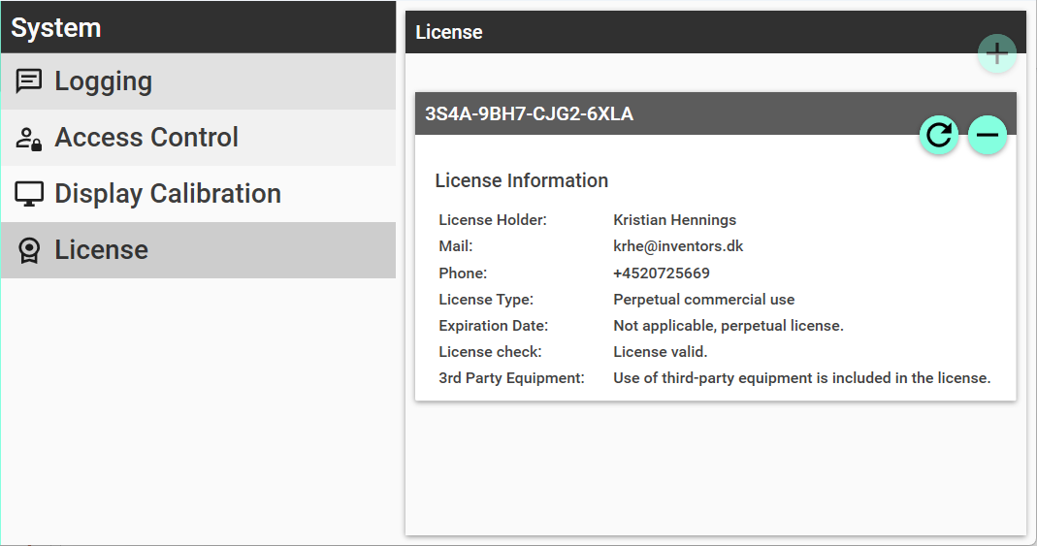
Register license
Deregister license
Refresh license

