Slide 1
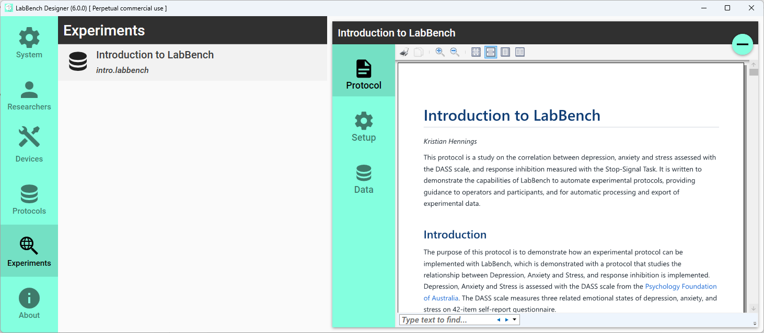
List of experiments
Experiment Page
Delete experiment
Panel selection
Notes:
Joystick

Slide 2
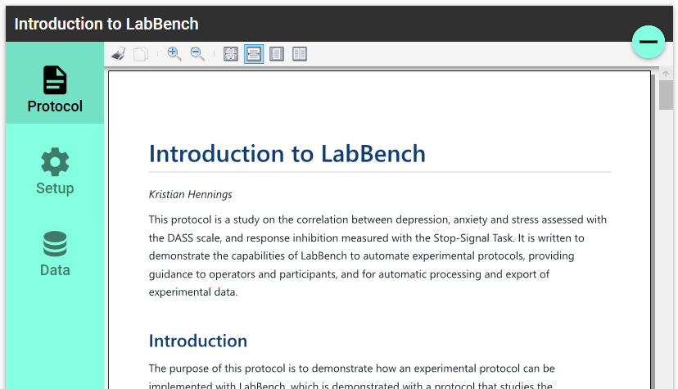
Print and view controls

Slide 3
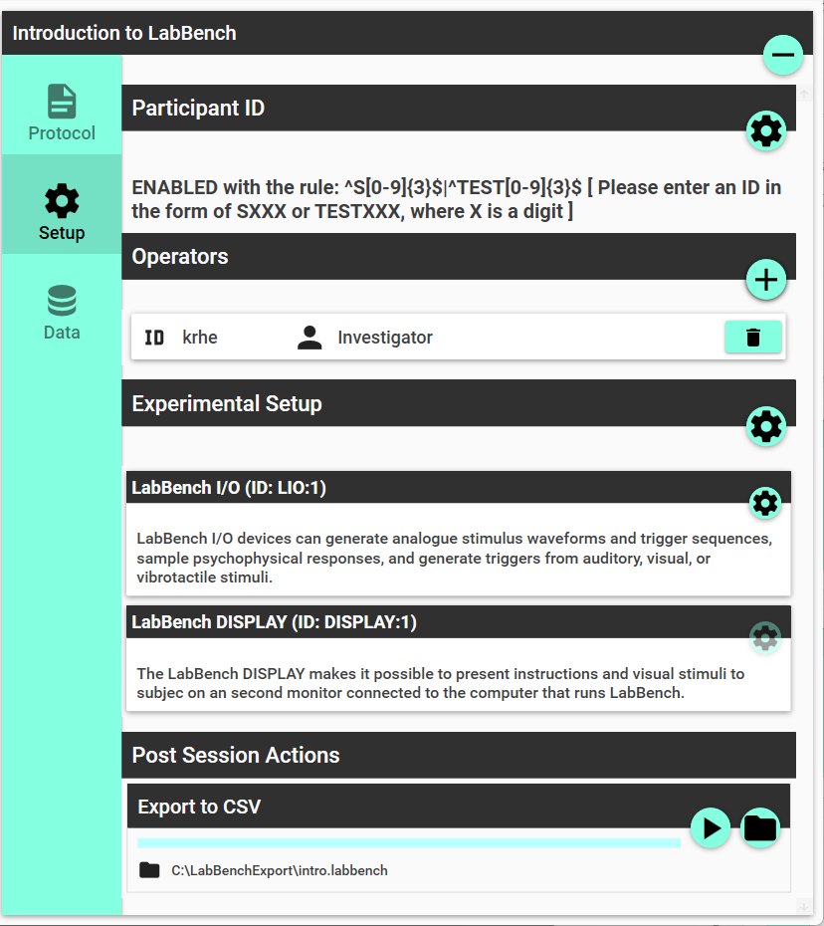
Configure participant validation
Add researcher
Remove researcher
Assign devices
Configure device
Set output directory
Rerun all post-session actions

Slide 4
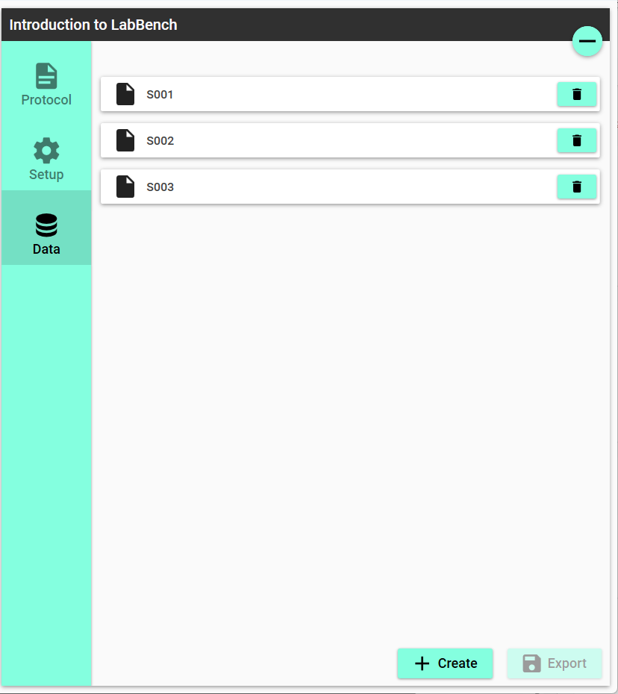
Delete participant
Export data
Create participant

Slide 5
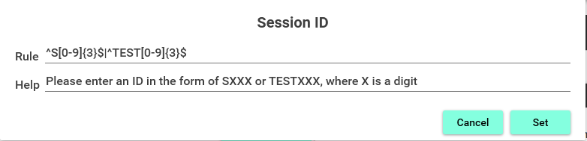

Slide 6
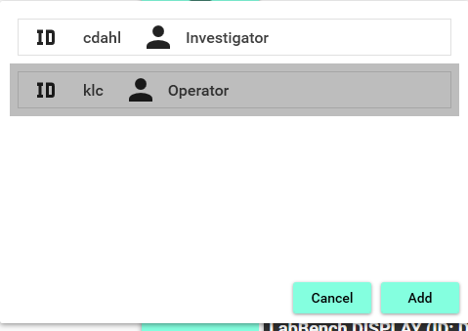

Slide 7
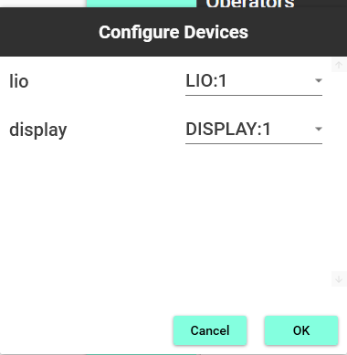

Slide 8
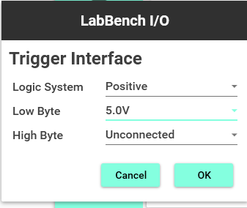

Slide 9
