Slide 1
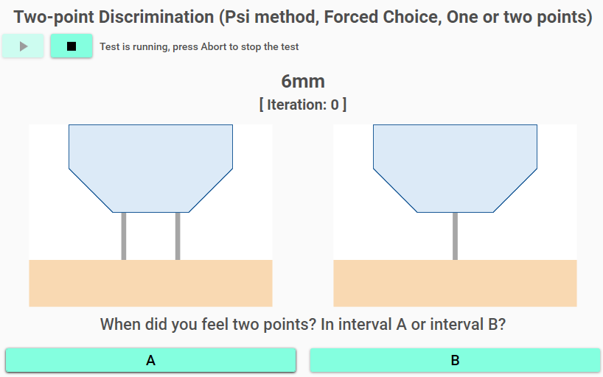
Psychometric Function
Responses

Slide 2
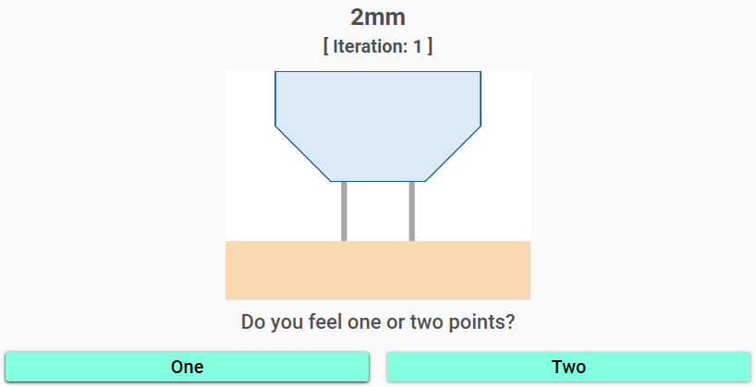
Notes:
Yes/No

Slide 3
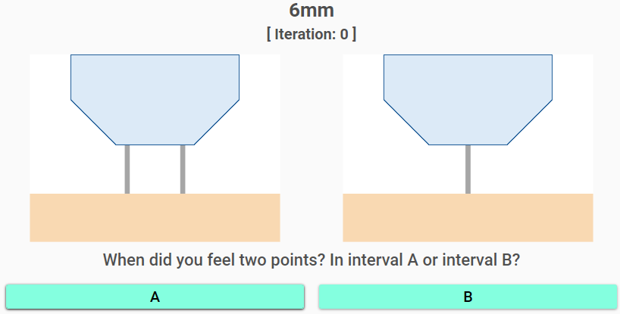
Notes:
Interval Forced Choice

Slide 4
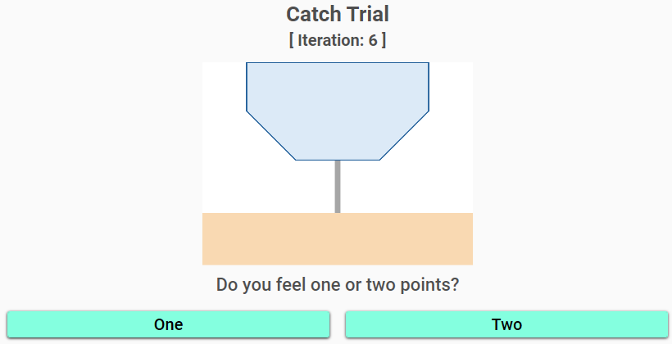
Notes:
Catch Trial

Slide 5
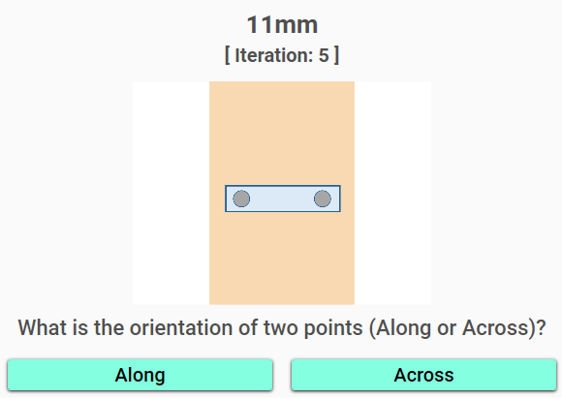
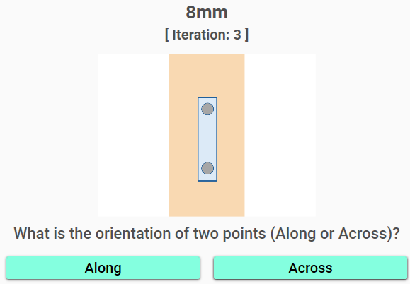
Alternative A
Alternative B

