Slide 1
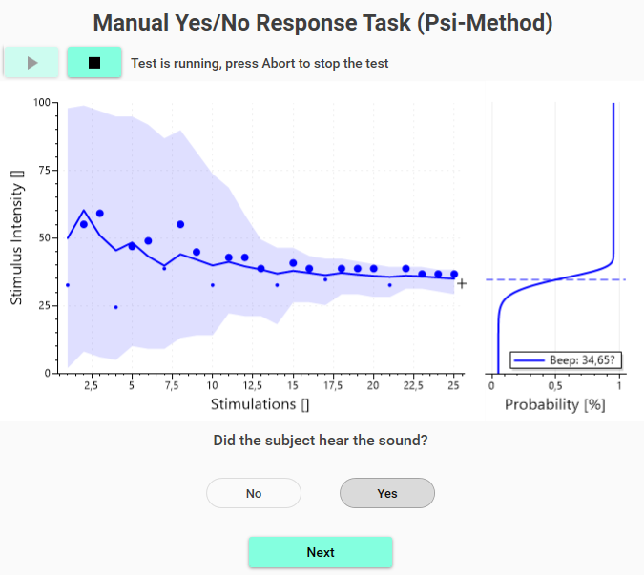
Recorded responses
Psychometric Function
Manual response task

