Slide 1
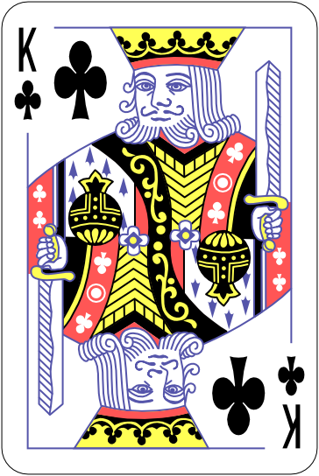
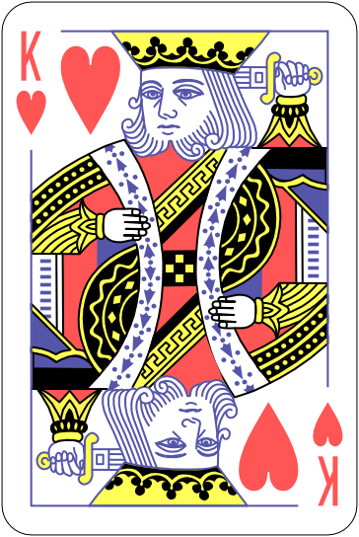
Notes:
Cue

Slide 2
Notes:
Cue01

Slide 3
Notes:
Cue02

Slide 4

Notes:
Stimulating

