Slide 1
Notes:
Blank

Slide 2
Please complete the following Questionnaires for
Motivation | Boredom | Fatigue
Notes:
QuestionnaireInstruction

Slide 3
Before the trial you will be asked to complete a maximal voluntary contraction.
The researcher will give an instruction here for you to squeeze the handgrip as hard as you can for 3 seconds.
Please keep your body still during this maximal contraction.
Are you ready?
Notes:
MVCInstruction

Slide 4
You are now about to commence the main task.
During this, you will be asked to intermittently squeeze the handgrip at a fixed perceived effort of 50 - ‘hard/heavy’.
The scale to calibrate your effort will be presented on the screen throughout the fixed perceived effort task.
Every contraction must be performed at this level of your perceived effort.
Notes:
PainEffortInstruction01

Slide 5
You will be given a countdown of 3 – 2 – 1, then hear “GO”
The audio instruction “GO” is your prompt to contract/squeeze.
The audio instruction “STOP” is your prompt to relax.
Each contraction/squeeze will be for 3 seconds.
Each relaxation will be for 3 seconds.
Please adhere to the GO – STOP cues as closely as possible.
Notes:
PainEffortInstruction02

Slide 6
No feedback will be given during the trial.
After each 5 contractions there will be a short break.
During this break, the researcher will ask you to provide your pain ratings for each limb on the 0-100 scale.
You must keep your limbs (except the one which is contracting) still during the trial.
Notes:
PainEffortInstruction03

Slide 7
Are you ready?
Notes:
Ready

Slide 8
3
Notes:
CUE3

Slide 9
2
Notes:
CUE2

Slide 10
1
Notes:
Cue1

Slide 11
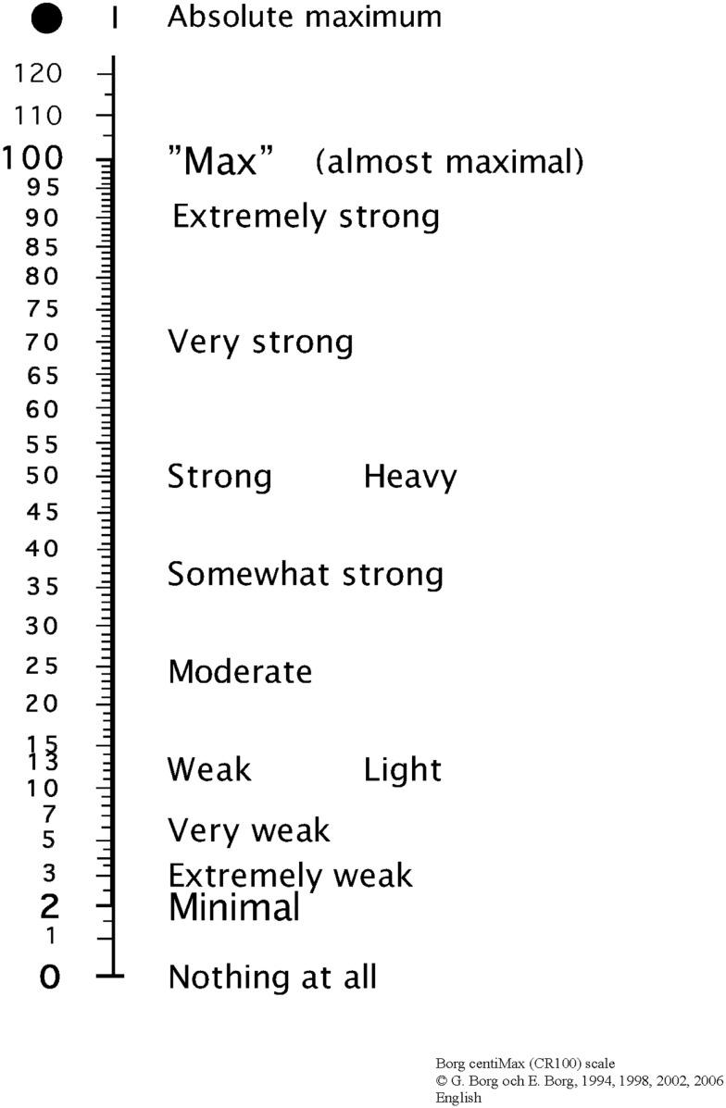
Notes:
BOUT 1 – ROUND 1 – please do not include this title in the main programme

Slide 12
You will be asked to complete another maximal voluntary contraction.
Please listen to the researcher’s instruction.

Slide 13
2-MIN
REST

Slide 14
COMPLETE

Slide 15
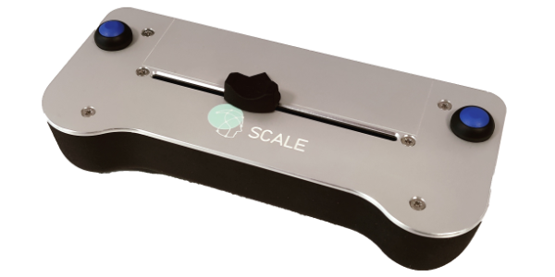
RATE PAIN IN YOUR RIGHT ARM
Notes:
TEMPLATE

Slide 16
RATE PAIN IN YOUR LEFT ARM
Notes:
TEMPLATE

Slide 17
Pain Detection and Pain Tolerance Thresholds
Non-Dominant Arm
Instructions to the subject
In this test, the pressure on the cuff on your non-dominant arm will gradually increase. I would like you to rate the pressure sensation with the scale in your hand. The scale goes from No Pain to Maximal Pain. When you rate the pain, it is important that you start rating the moment you feel the slightest hint of pain. The Maximal Pain is the worst pain you can endure and when you reach this level the pressure will automatically stop.

Slide 18
Pain Detection and Pain Tolerance Thresholds
Dominant Arm
Instructions to the subject
In this test, the pressure on the cuff on your dominant arm will gradually increase. I would like you to rate the pressure sensation with the scale in your hand. Please rate this pressure sensation in the same way as before.

Slide 19
Temporal Summation
Instructions the subject
This is a new test that is a bit different from the ones before. In this test you will feel pressure squeezes one after another. For each squeeze rate the pressure sensation as quickly as possible with the rating scale in your hand. After you rated the sensation just leave the slider where it is until you feel the next squeeze. The squeezes comes fast and there is no right or wrong answer, just provide your immediate rating of the sensation as fast as possible.

Slide 20
Conditioned Pain Modulation
Instructions to the subject
In this test you will feel an intense painful pressure squeeze on your dominant arm while the pressure on the cuff on your non-dominant leg will gradually increase. I would like you to rate the pain you feel on the non-dominant arm only with the scale in your hand. The scale goes from No Pain to Maximal Pain. When you rate the pain, it is important that you start rating the moment you feel the slightest hint of pain. The Maximal Pain is the worst pain you can endure and when you reach this level the pressure will automatically stop.

