Slide 1
Notes:
Blank

Slide 2
Please complete the following Questionnaires for
Motivation | Boredom | Fatigue
Notes:
QuestionnaireInstruction

Slide 3
Before the trial you will be asked to complete a maximal voluntary contraction.
The researcher will give an instruction here for you to try and extend your knee as hard as you can for up to 5 seconds.
Please keep your body still during this maximal contraction.
Are you ready?
Notes:
MVCInstruction

Slide 4
You are now about to commence the main task.
During this, you will be asked to intermittently extend your knee at a fixed perceived effort of 50 - ‘hard/heavy’.
The scale to calibrate your effort will be presented on the screen throughout the fixed perceived effort task.
Every contraction must be performed at this level of your perceived effort.
Notes:
PainEffortInstruction01

Slide 5
You will be given a countdown of 3 – 2 – 1, then hear “GO”
The audio instruction “GO” is your prompt to extend/contract.
The audio instruction “STOP” is your prompt to relax.
Each extension/contraction will be for 3 seconds.
Each relaxation will be for 3 seconds.
Please adhere to the GO – STOP cues as closely as possible.
Notes:
PainEffortInstruction02

Slide 6
No feedback will be given during the trial.
After each 5 contractions there will be a short break.
During this break, the researcher will ask you to provide your pain ratings for each limb on the VAS scale in your hand.
You must keep the rest of your body as still you can during the trial.
Notes:
PainEffortInstruction03

Slide 7
Are you ready?
Notes:
Ready

Slide 8
3
Notes:
CUE3

Slide 9
2
Notes:
CUE2

Slide 10
1
Notes:
Cue1

Slide 11
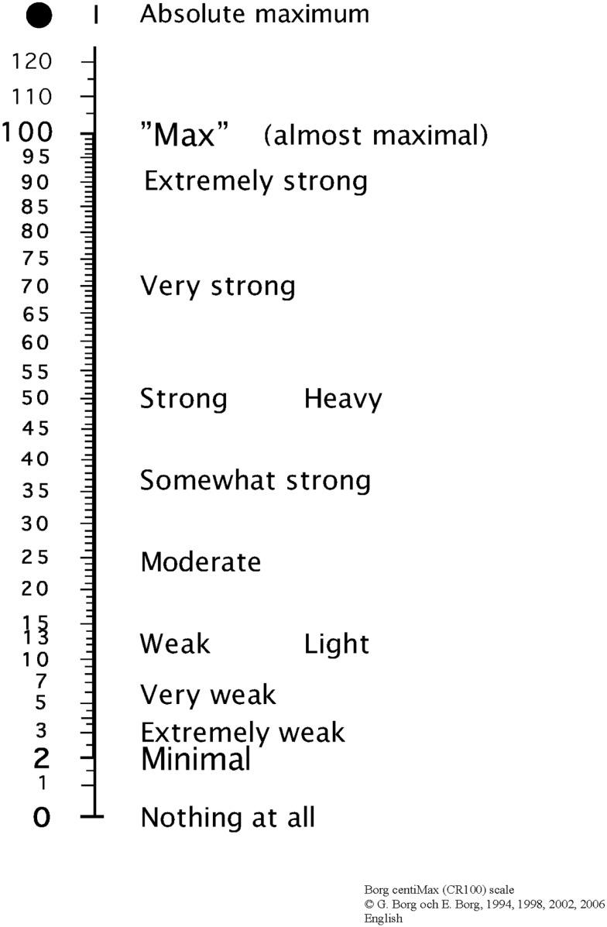
Notes:
BOUT 1 – ROUND 1 – please do not include this title in the main programme

Slide 12
You will be asked to complete another maximal voluntary contraction.
Please listen to the researcher’s instruction.

Slide 13
2-MIN
REST

Slide 14
COMPLETE

Slide 15
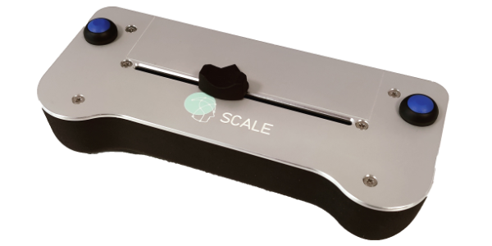
RATE PAIN IN YOUR DOMINANT LEG
(THE ONE YOU ARE TRYING TO EXTEND)
Notes:
TEMPLATE

Slide 16
RATE PAIN IN YOUR NON-DOMINANT LEG
(THE ONE WITH THE CUFF ON)
Notes:
TEMPLATE

Slide 17
Pain Detection and Pain Tolerance Thresholds
Non-Dominant Leg
Instructions to the participant
In this test, the pressure on the cuff on your non-dominant leg will gradually increase. I would like you to rate the pressure sensation with the scale in your hand. The scale goes from No Pain (left) to Maximal Pain (right). When you rate the pain, it is important that you start rating the moment you feel the slightest hint of pain. The Maximal Pain is the worst pain you can endure and when you reach this level, the pressure will automatically stop.

Slide 18
Pain Detection and Pain Tolerance Thresholds
Dominant Leg
Instructions to the participant
In this test, the pressure on the cuff on your dominant leg will gradually increase. I would like you to rate your perception of pain with the scale in your hand. Please rate this pain in the same way as previous tests ranging from No Pain (left) to Maximal Pain (right).

Slide 19
Temporal Summation
Instructions to the participant
This is a new test that is a bit different from the ones before. In this test you will feel a succession of squeezes from the cuff. For each squeeze, please rate your perception of pain (if there is any) as quickly as possible with the rating scale in your hand. After you have rated the pain just leave the slider where it is until you feel the next squeeze. The squeezes comes fast and there is no right or wrong answer, just provide your immediate rating of the pain as fast as possible.

Slide 20
Conditioned Pain Modulation
Instructions to the participant
In this test you will feel a continuous squeeze on your dominant leg while the pressure on the cuff on your non-dominant leg will gradually increase. I would like you to rate the pain you feel on the non-dominant leg with the scale in your hand. The scale goes from No Pain (left) to Maximal Pain (right). When you rate the pain, it is important that you start rating the moment you feel the slightest hint of pain. The Maximal Pain is the worst pain you can endure and when you reach this level the pressure will automatically stop.

