Slide 1
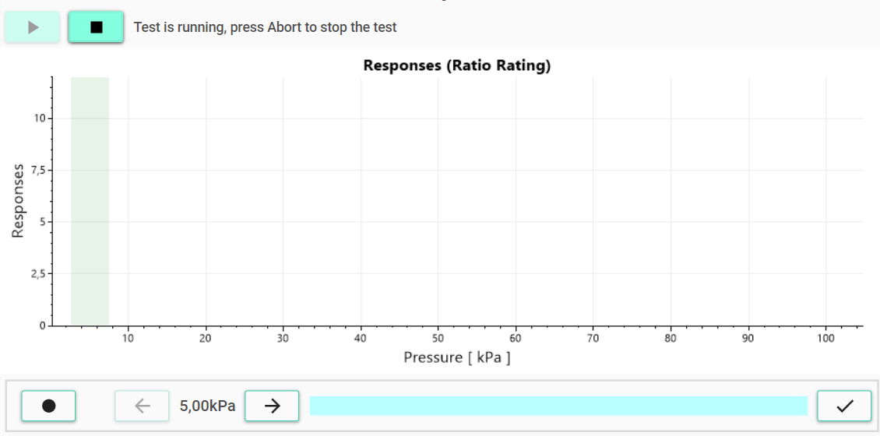
Current intensity
Accept current intensity and finish the test
Decrease intensity
Increase intensity
Stimulate with the current intensity

