Slide 1
Notes:
BLANK

Slide 2
Notes:
BLANK WITH FIDUCIAL MARKER

Slide 3
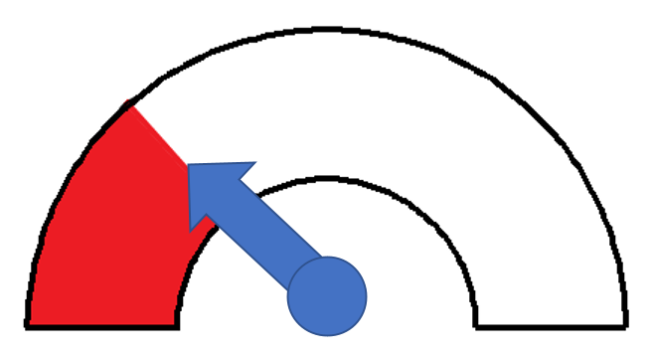
Notes:
LOW 27

Slide 4
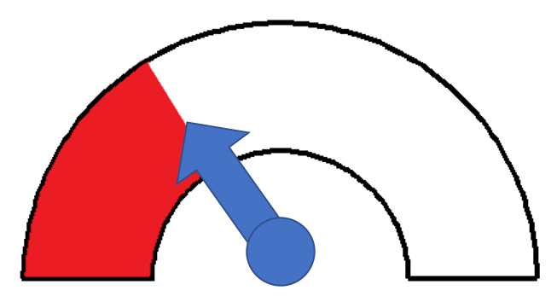
Notes:
LOW 32

Slide 5
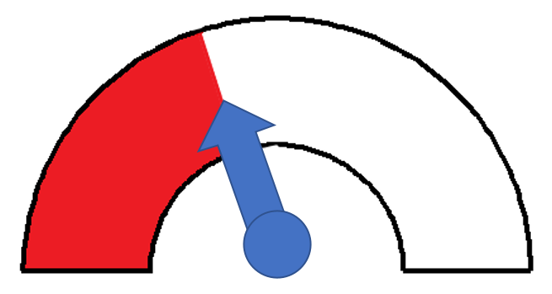
Notes:
LOW 40

Slide 6
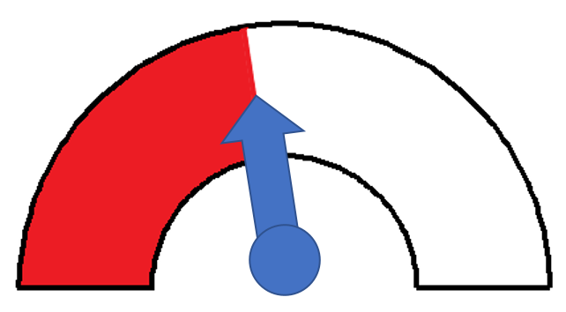
Notes:
LOW 45

Slide 7
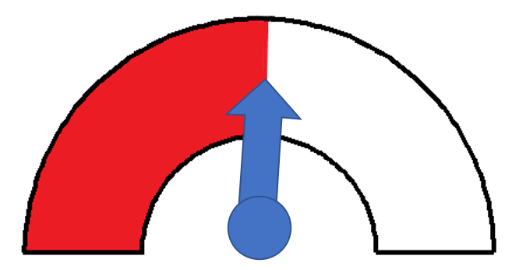
Notes:
LOW 51

Slide 8

Notes:
HIGH 73

Slide 9
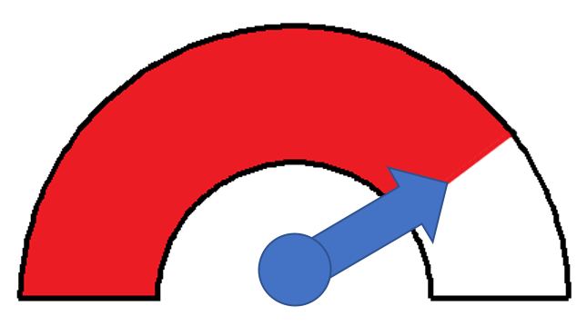
Notes:
HIGH 79

Slide 10

Notes:
HIGH 84

Slide 11
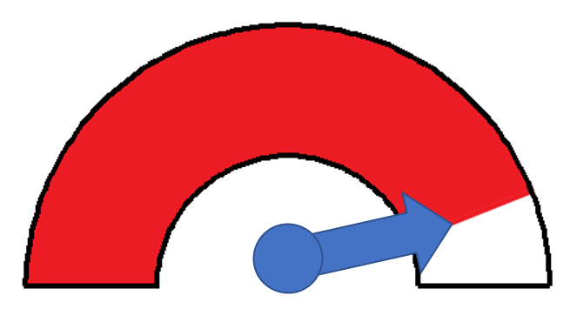
Notes:
HIGH 88

Slide 12
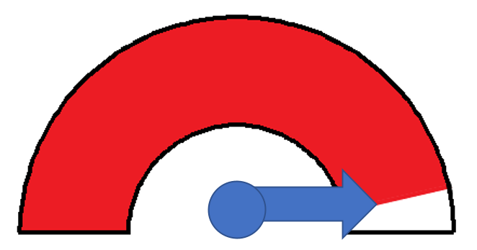
Notes:
HIGH 93

Slide 13
1 Kein Schmerz
Maximaler Schmerz 100
1 No Pain
Maximal Pain 100
Notes:
TEMPLATE

Slide 14
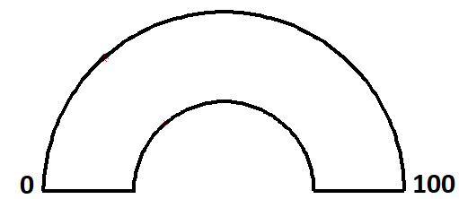
RATE EXPECTED PAIN
1 No Pain
Maximal Pain 100
Notes:
TEMPLATE

Slide 15
ERWARTETE SCHMERZEN BEWERTEN
1 Kein Schmerz
Maximaler Schmerz 100
Notes:
TEMPLATE

Slide 16
RATE EXPECTED PAIN
1 No Pain
Maximal Pain 100
Notes:
TEMPLATE

Slide 17
ERWARTETE SCHMERZEN BEWERTEN
1 No Pain
Maximal Pain 100
Notes:
TEMPLATE

Slide 18
RATE PAIN
1 No Pain
Maximal Pain 100
Notes:
TEMPLATE

Slide 19
SCHMERZ BEWERTEN
1 No Pain
Maximal Pain 100
Notes:
TEMPLATE

Slide 20
Notes:
CUE

Slide 21
Notes:
CUE

Slide 22

Notes:
LOW CUE 2

Slide 23

Notes:
LOW CUE 1

Slide 24

Notes:
HIGH CUE 2

Slide 25

Notes:
HIGH CUE 1

