Slide 1

WITH DISTRACTION

Slide 2
NO DISTRACTION

Slide 3
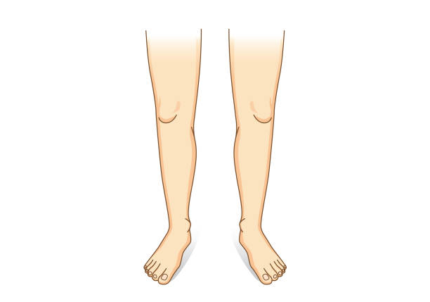
WITH DISTRACTION

Slide 4
NO DISTRACTION

