Slide 1




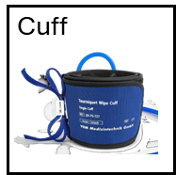
Nocitech CPAR
FRONT PANEL
USB
1
2
RESP
Right Arm
Left Arm
Notes:
LeftCuff

Slide 2
Nocitech CPAR
FRONT PANEL
USB
1
2
RESP
Left Arm
Right Arm
Notes:
RightCuff

