Slide 1
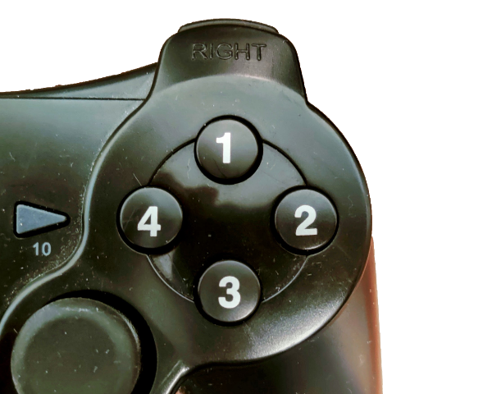
You will see a series of circles in red, green, blue or yellow. Press the button that correspond to the colour of the circle.
In this case press the RED button, because the circle is red.
Notes:
NeutralStroopJoystick.png

Slide 2
You will see a series of words written in red, green, blue or yellow. Press the button that correspond to the colour the word is written in.
In this case press the RED button, because the word is written in red.
GREEN
Notes:
StroopJoystick.png

Slide 3
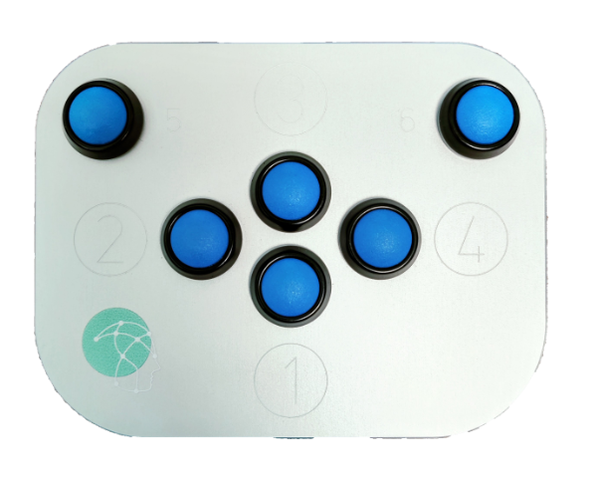
You will see a series of circles in red, green, blue or yellow. Press the button that correspond to the colour of the circle.
In this case press the RED button, because the circle is red.
Notes:
NeutralStroopPAD.png

Slide 4
You will see a series of words written in red, green, blue or yellow. Press the button that correspond to the colour the word is written in.
In this case press the RED button, because the word is written in red.
GREEN
Notes:
StroopPAD.png

