Slide 1
Notes:
blank

Slide 2
Notes:
normal

Slide 3
Notes:
oddball

Slide 4
+1
Notes:
countingTask

Slide 5
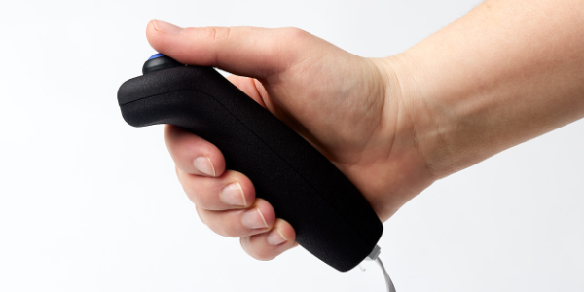
Notes:
responseTask

Slide 6

Notes:
cross

