Slide 1

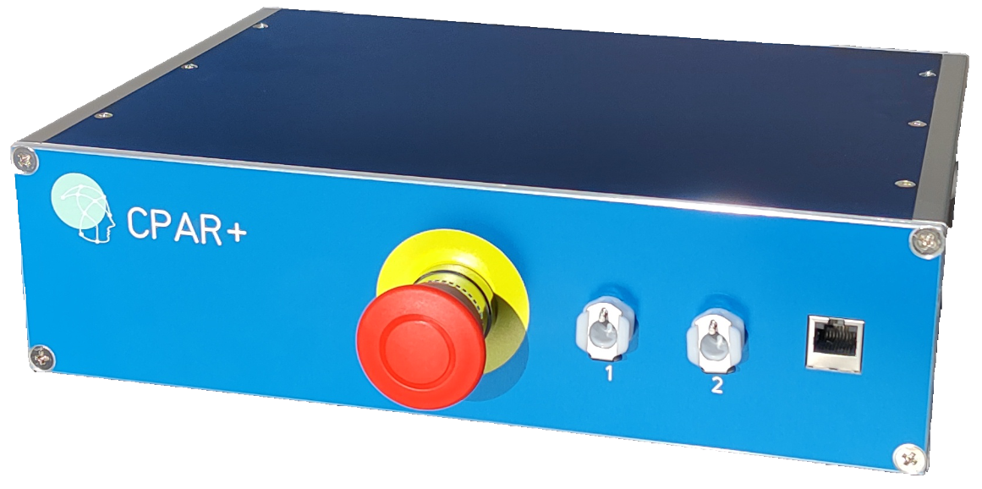
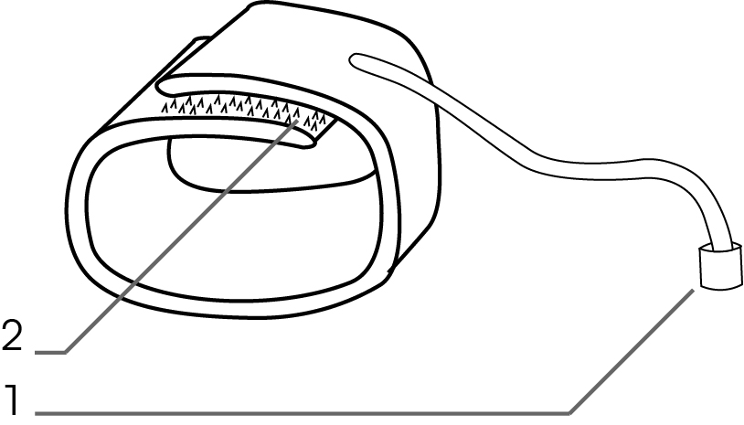
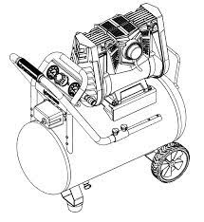
Experimental Setup
LabBench CPAR+
Cuff 2
Cuff 1
LabBench
Running the ctscpm@labbench.io protocol
Device Under Test (DUT)

