Slide 1

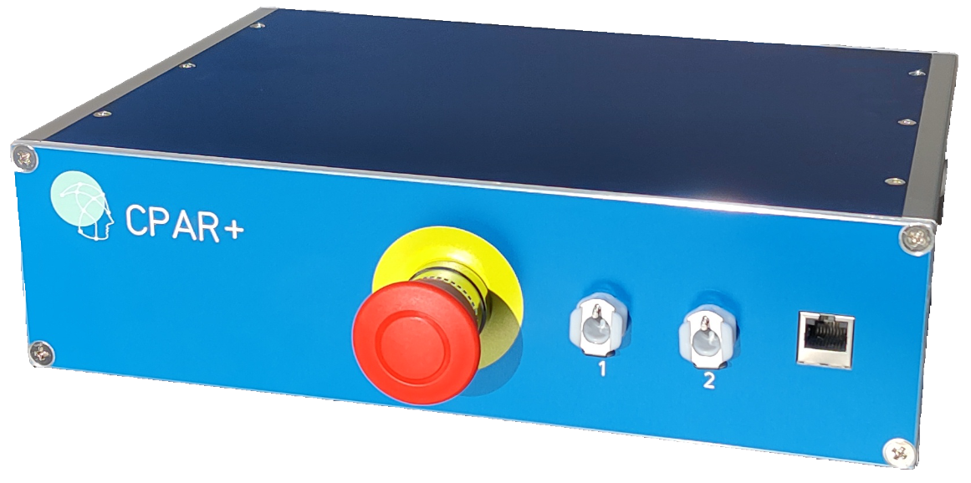
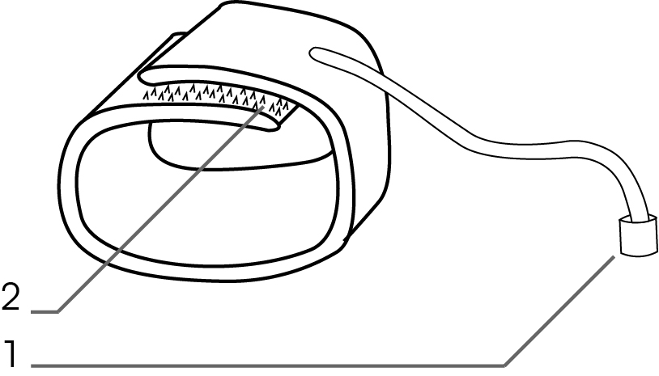
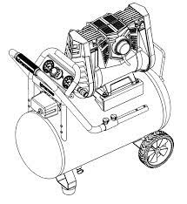
Experimental Setup
LabBench CPAR+
Cuff 2
Cuff 1
LabBench
Running the ctscpm@labbench.io protocol
Device Under Test (DUT)

Slide 2
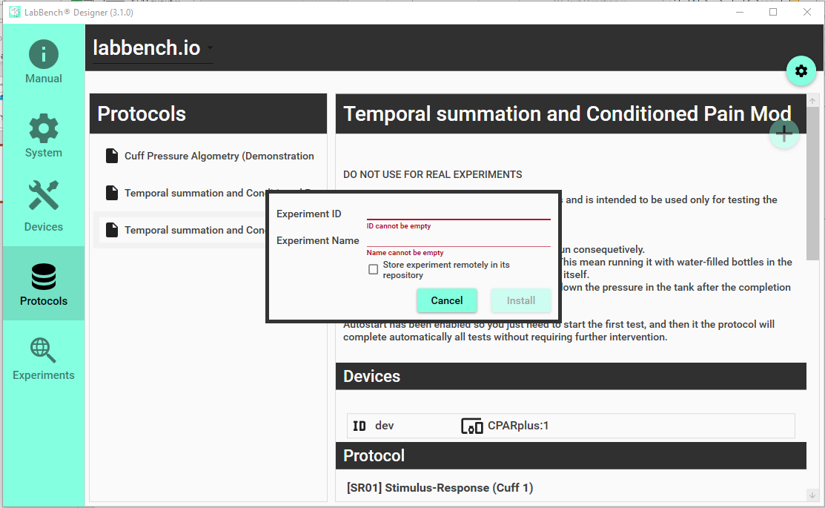
1. Select the labbench.io repository
3. Click the “+” button to install the protocol
4. Give the experiment an ID and a name.
5. Click the “Install” button.
2. Select the “Temporal Summation and Conditioned Pain Modulation Protocol (Compressor Test Version)” protocol

