Slide 1
Experiments
Illustrations for protocols in the repository

Slide 2
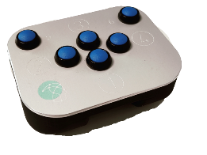
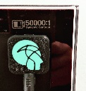
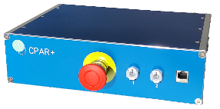
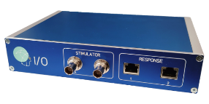
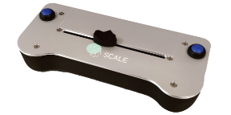
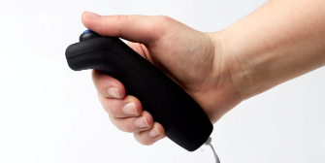


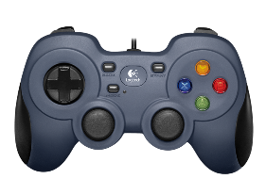
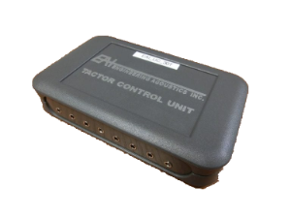
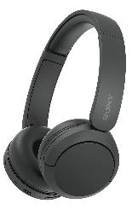
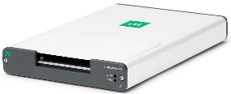
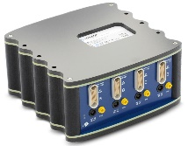
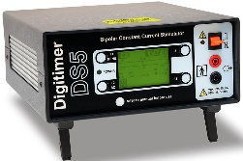
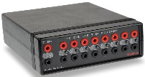

Devices
LabBench CPAR+
LabBench I/O
LabBench SCALE
LabBench BUTTON
LabBench PAD
LabBench VTG
LabBench ATG
Joystick
EA Tactors
EEG Amplifier
Electrical Stimulator
Electrode Switch
Headphones
NI DAQmx

Slide 3
Introduction to LabBench

Slide 4
Cuff pressure algometry

Slide 5
Cuff Pressure Algometry (Display Version)

Slide 6
Screen Calibration Protocol

Slide 7
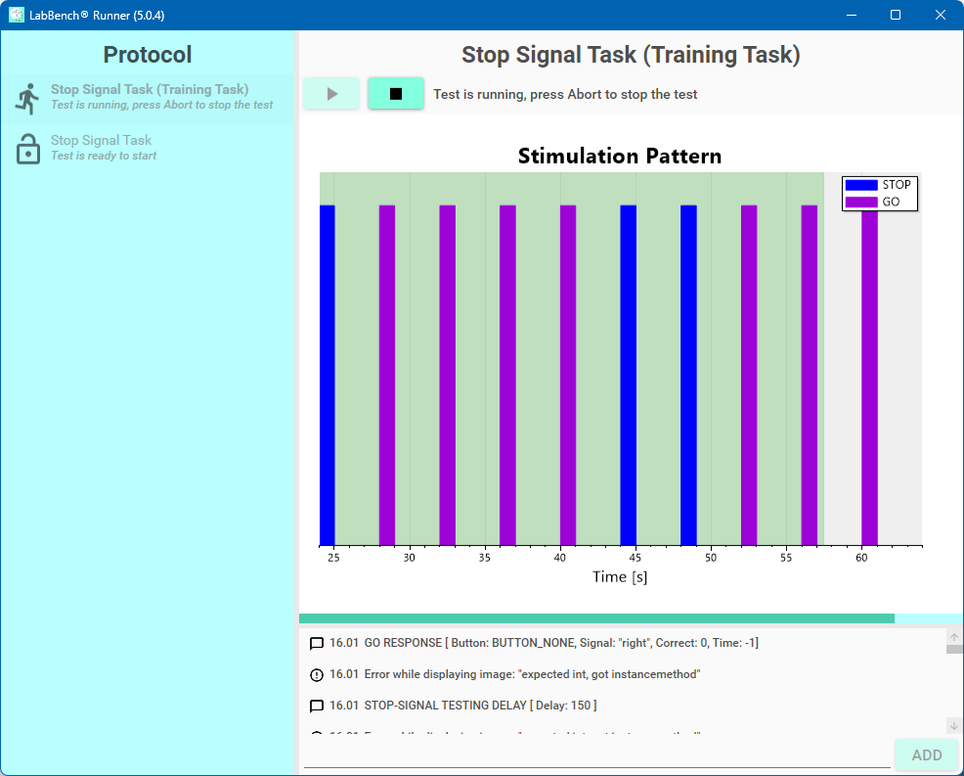


Visual Cognitive Task (LIO Version)
LabBench Software
Subject Display
LabBench I/O
LabBench PAD

Slide 8
