Slide 1
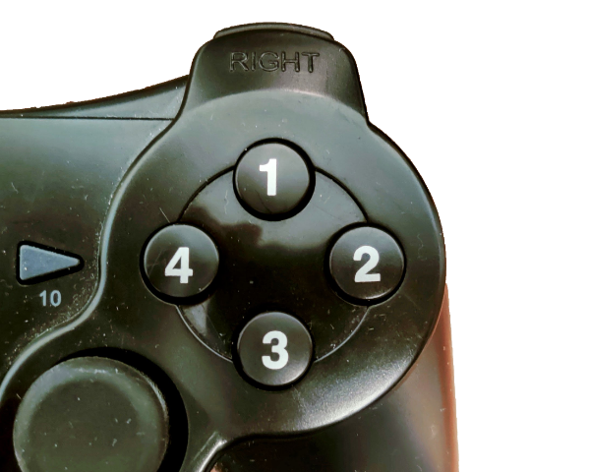
You will see a series of circles in red, green, blue or yellow. Press the button that correspond to the colour of the circle.
In this case press the RED button, because the circle is red.
Notes:
Neutral Stroop Instruction

Slide 2
You will see a series of words written in red, green, blue or yellow. Press the button that correspond to the colour the word is written in.
In this case press the RED button, because the word is written in red.
GREEN
Notes:
Neutral Stroop Instruction

Slide 3
You will see a series of squares in red, green, blue or yellow. Press the button that correspond to the colour of the square.
In this case press the BLUE button, because the square is blue.
Notes:
Neutral Stroop Instruction

Slide 4
You will see a series of words written in red, green, blue or yellow. Press the button that word say and not the colour of the ink.
BLUE
In this case press the BLUE button, because the word say blue
Notes:
Neutral Stroop Instruction

Slide 5
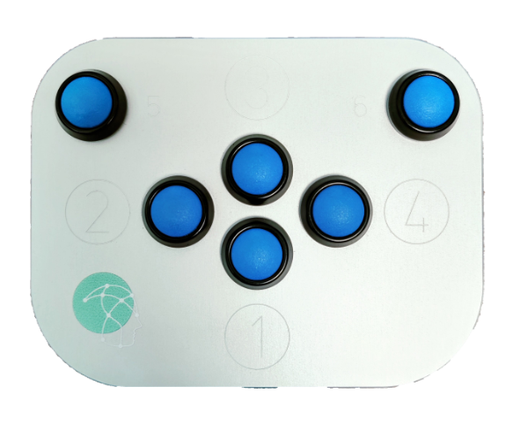
You will see a series of circles in red, green, blue or yellow. Press the button that correspond to the colour of the circle.
In this case press the RED button, because the circle is red.
Notes:
Neutral Stroop Instruction

Slide 6
You will see a series of words written in red, green, blue or yellow. Press the button that correspond to the colour the word is written in.
In this case press the RED button, because the word is written in red.
GREEN
Notes:
Neutral Stroop Instruction

Slide 7
You will see a series of squares in red, green, blue or yellow. Press the button that correspond to the colour of the square.
In this case press the BLUE button, because the square is blue.
Notes:
Neutral Stroop Instruction

Slide 8
You will see a series of words written in red, green, blue or yellow. Press the button that word say and not the colour of the ink.
BLUE
In this case press the BLUE button, because the word say blue.
Notes:
Neutral Stroop Instruction

