Slide 1
Measure the length of the screen diagonal in cm
Notes:
ScreenSizeInstruction.png

Slide 2
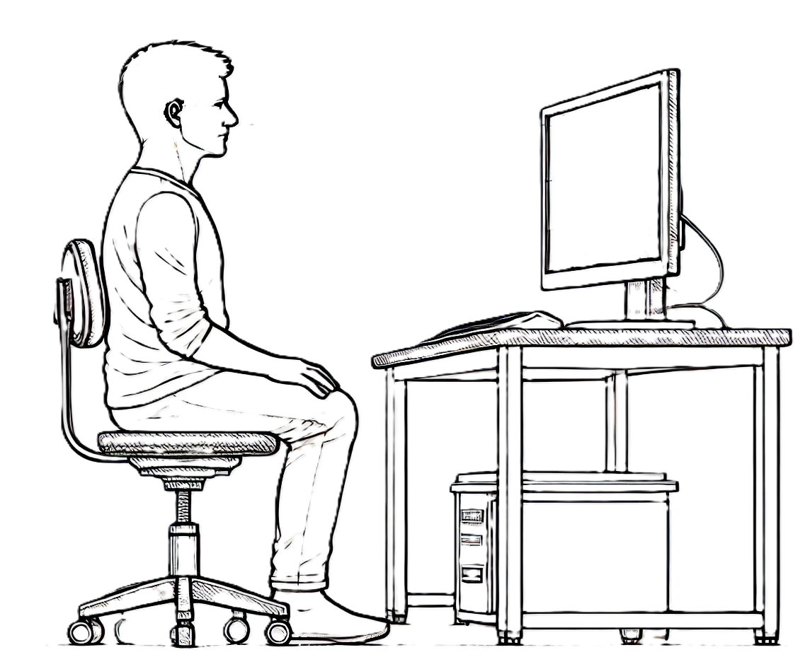
Measure the distance from the eyes of the subject to the screen
Distance in cm
Notes:
ScreenPositionInstruction.png

Slide 3
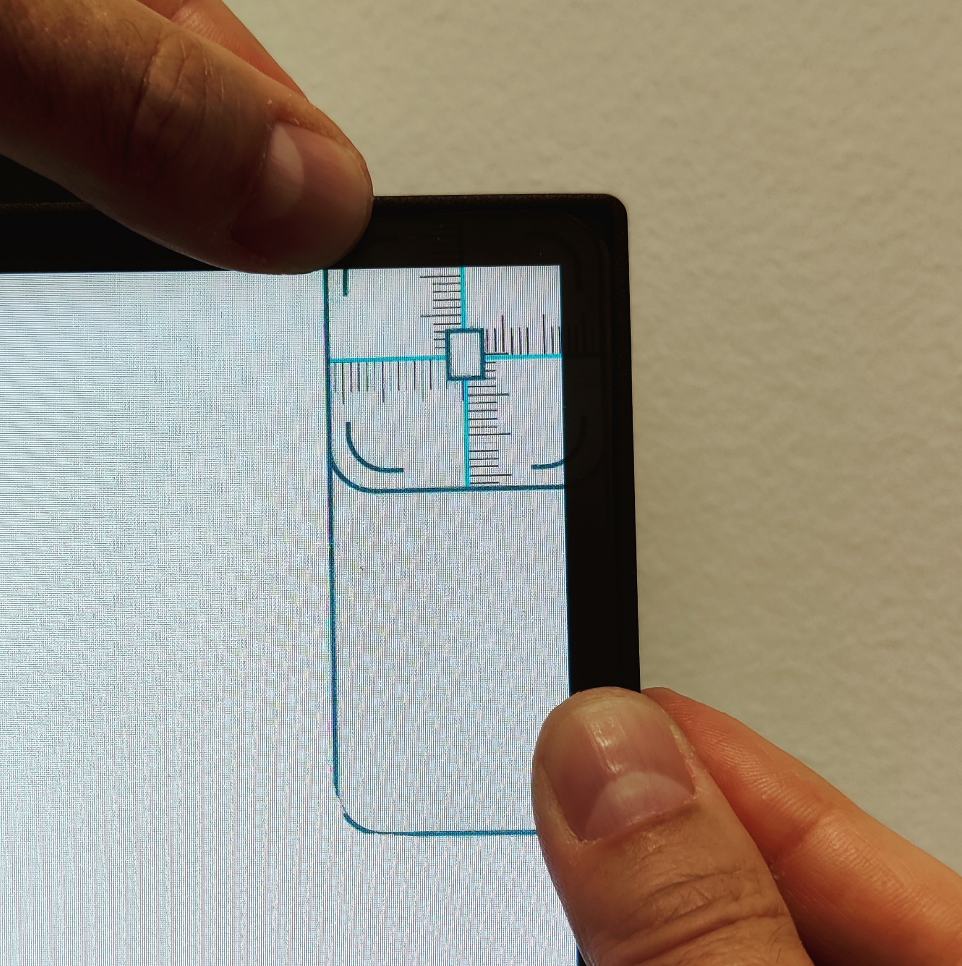
Measure the required position of the fiducial with the VTG Calibrator
Procedure:
Place the VTG Calibrator in the screen corner where the fiducials are to be generated.
Read of the vertical and horizontal distances from the centre of the fiducial edge of display area.
Please see the LabBench VTG manual if further information is required on the calibration procedure.
Notes:
PositionInstruction.png

Slide 4
Notes:
Blank.png

Slide 5
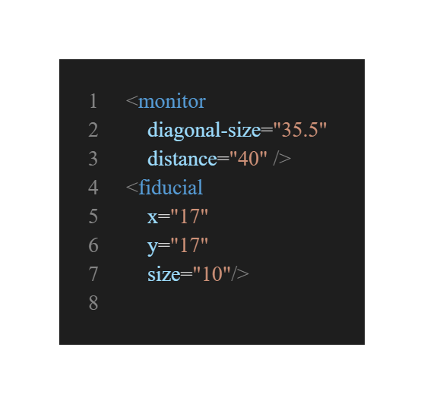
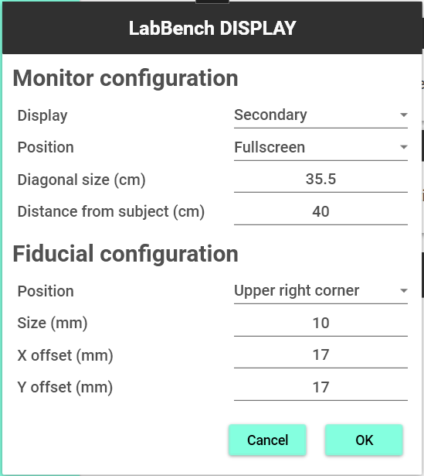
Update the LabBench DISPLAY configuration in the LabBench Designer program or the Experiment Definition File (*.expx)
LabBench Designer
Experiment Definition File
1
1
2
2
3
4
3
4
Please note this required that you close LabBench Runner to change the configuration in LabBench Designer or edit the Experiment Definition File (*.expx) file. When you close LabBench Designer the calibration values will be written to the PDF file defines by the Post Session Action named Create Calibration Record. Once you updated the LabBench DISPLAY configuration restart this protocol to validate the calibration of the screen and fiducial.
Notes:
UpdateInstruction.png

Slide 6
Start the test to generate a fiducial and use the VTG calibrator to confirm that the fiducial is in the correct position
Notes:
FiducialInstruction.png

Slide 7
Check with the VTG calibrator that the fiducial is in the correct position
Notes:
FiducialCheck.png

Slide 8
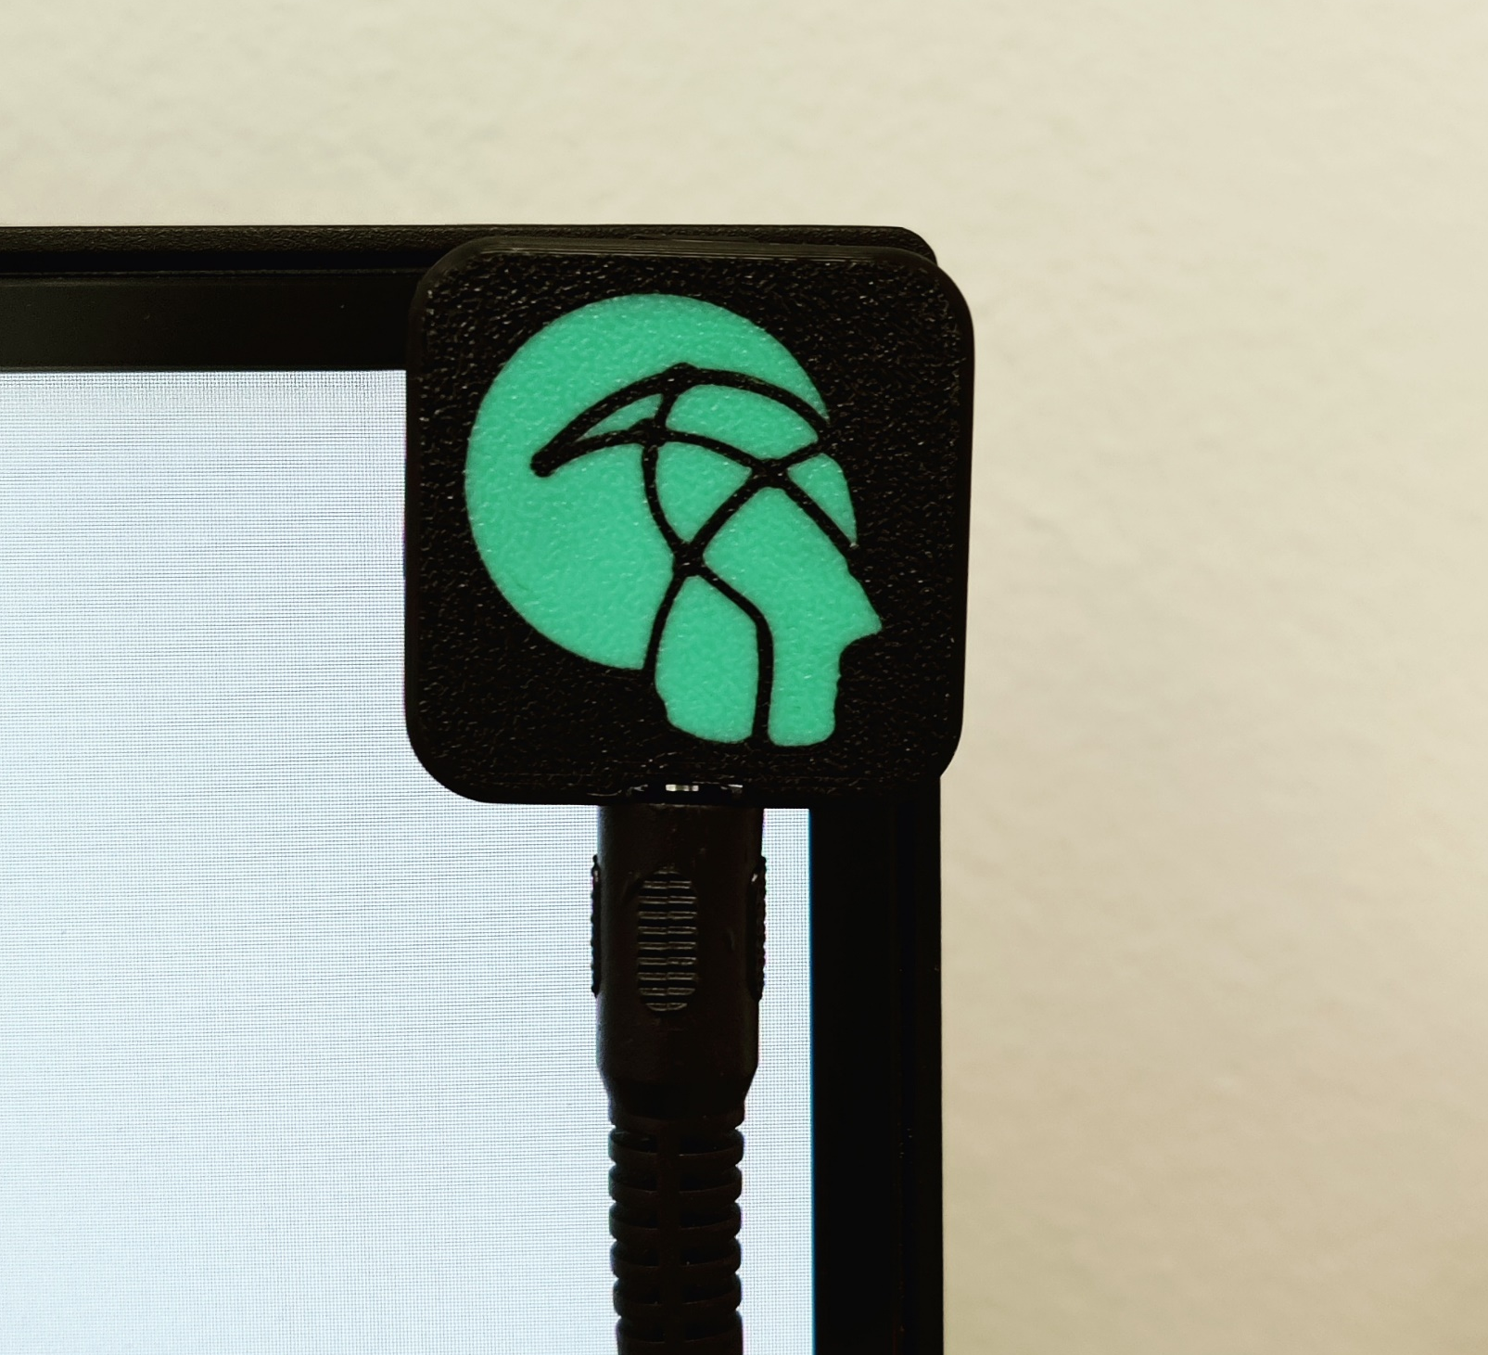
Mount the LabBench VTG device on the screen and start this test.
This test will generate a series of visual stimuli with fiducials and will verify that triggers are correctly generated by the LabBench VTG.
Each stimuli will consist of displaying a number. Each time you see a number press any button on the LabBench PAD.
Notes:
DetectorInstruction.png

Slide 9
1
Notes:
S1.png

Slide 10
2
Notes:
S2.png

Slide 11
3
Notes:
S3.png

Slide 12
4
Notes:
S4.png

