Slide 1
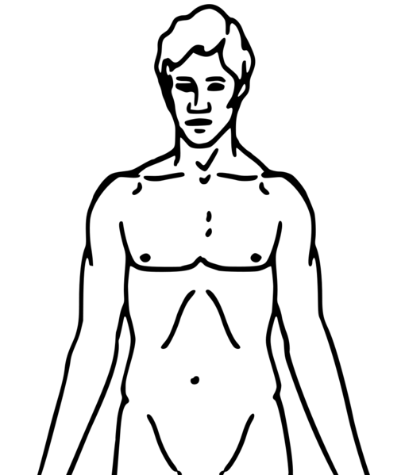
Please configuration the session
A3
A4
A1
A2

Slide 2
Area preparation
A2
A4
A1
A3
Notes:
Apply cream to A1

Slide 3
Apply cream to this area
Notes:
Apply cream to A2

Slide 4
Remove cream from this area
Notes:
Apply cream to A3
Remove cream from A2

Slide 5
APPLY COWHAGE
A2
A4
A1
A3
Wait until the area is completely dry after cleaning with ethanol wipes. Approximately 45 spicules are gently rubbed into a 1 cm diameter skin area with a circular motion for up to 15 seconds
Notes:
A1

Slide 6
APPLY HISTAMINE
A2
A4
A1
A3
To deliver histamine, standard allergy skin prick test (SPT) lancets are applied. A small drop of histamine dihydrochloride (1%, in saline) will be applied to a previously determined area on the volar forearm followed by a prick through the drop.

Slide 7
REMOVE COWHAGE
A2
A4
A1
A3
By using tape (gently applying it and stripping it off the skin a few times), the spicules are rapidly removed, and the itch will quickly disappear.

Slide 8
REMOVE HISTAMINE
A2
A4
A1
A3
Remove the remains of the Histamine drop by drying it with a tissue.

