Slide 1
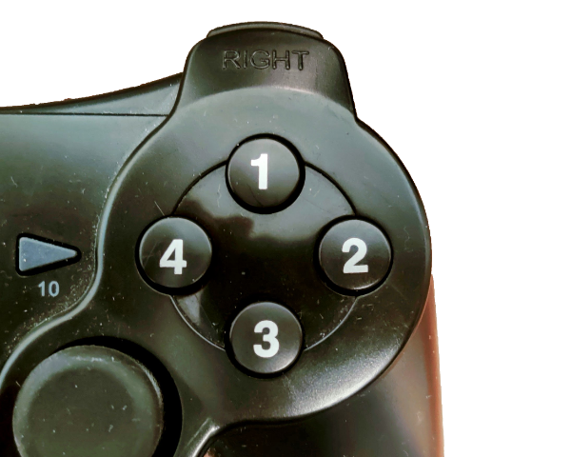
You will see a series of squares in red, green, blue or yellow. Press the button that correspond to the colour of the square.
In this case press the BLUE button, because the square is blue.
Notes:
NeutralReverseStroopJoystick.png

Slide 2
You will see a series of words written in red, green, blue or yellow. Press the button that word say and not the colour of the ink.
BLUE
In this case press the BLUE button, because the word say blue
Notes:
ReverseStroopJoystick.png

Slide 3
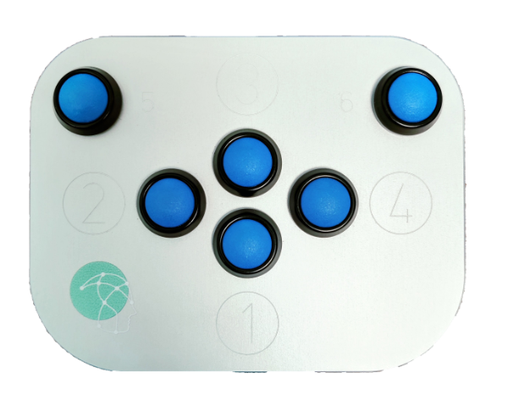
You will see a series of squares in red, green, blue or yellow. Press the button that correspond to the colour of the square.
In this case press the BLUE button, because the square is blue.
Notes:
NeutralReverseStroopPAD.png

Slide 4
You will see a series of words written in red, green, blue or yellow. Press the button that word say and not the colour of the ink.
BLUE
In this case press the BLUE button, because the word say blue.
Notes:
ReverseStroopPAD.png

