Slide 1
Shapes

Slide 2
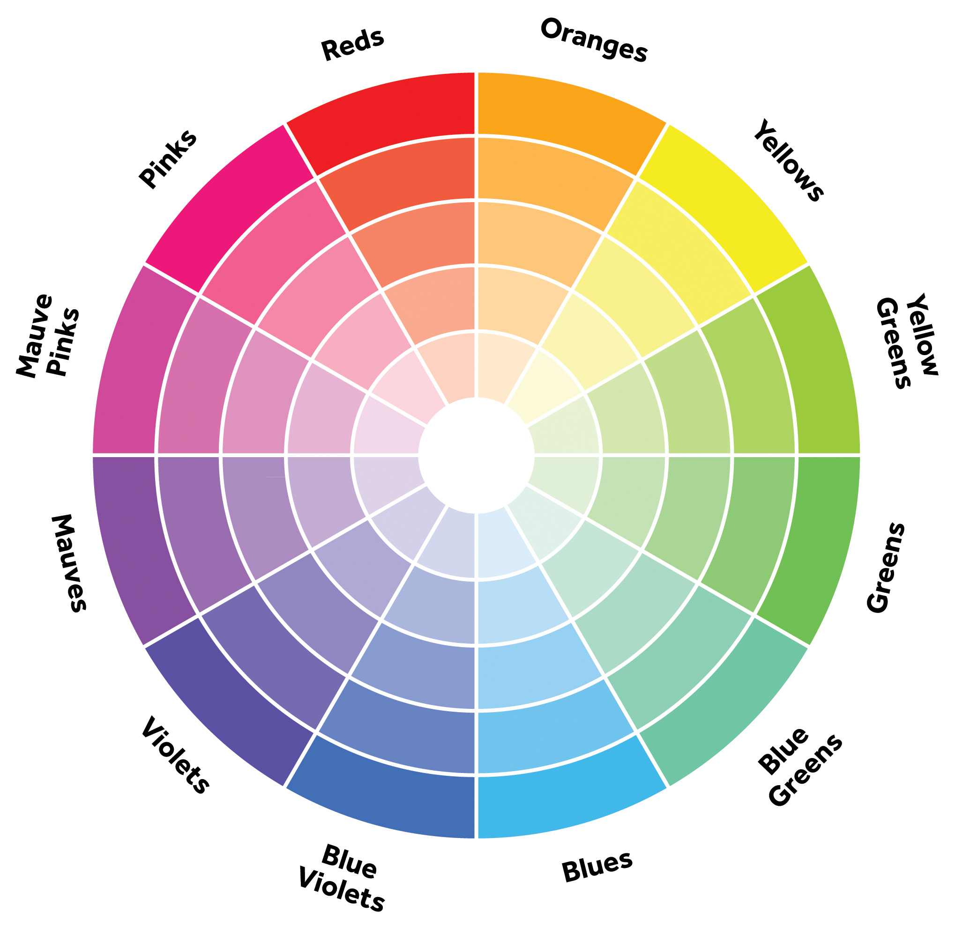
Color

Slide 3

Sprites

Slide 4

Text

Slide 5
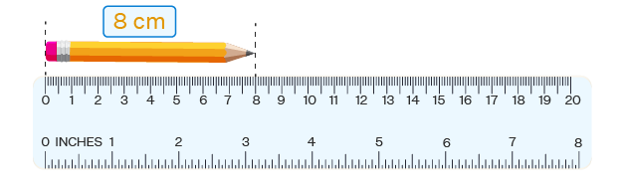
Physical Lengths

Slide 6
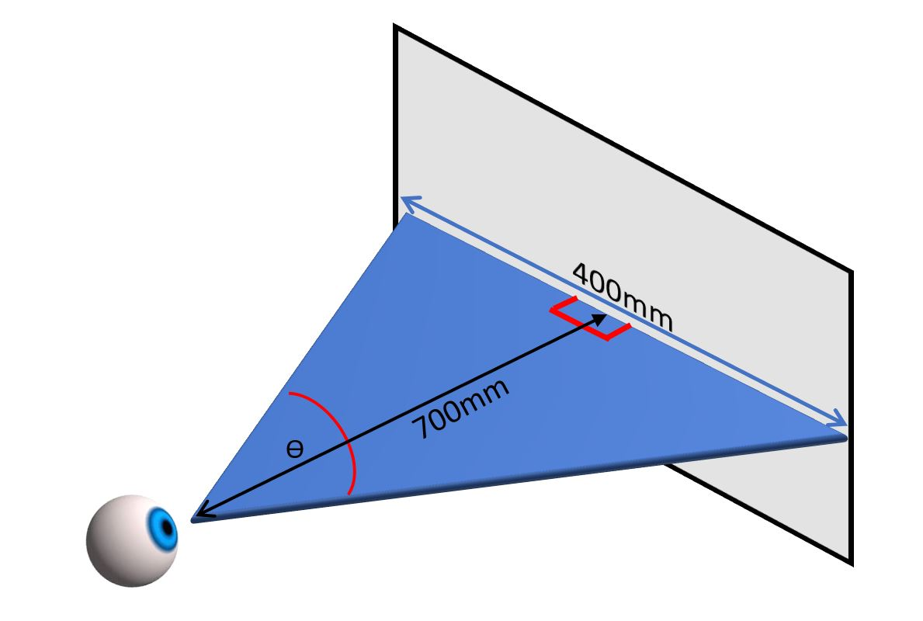
Visual Angles

Slide 7


