Slide 1
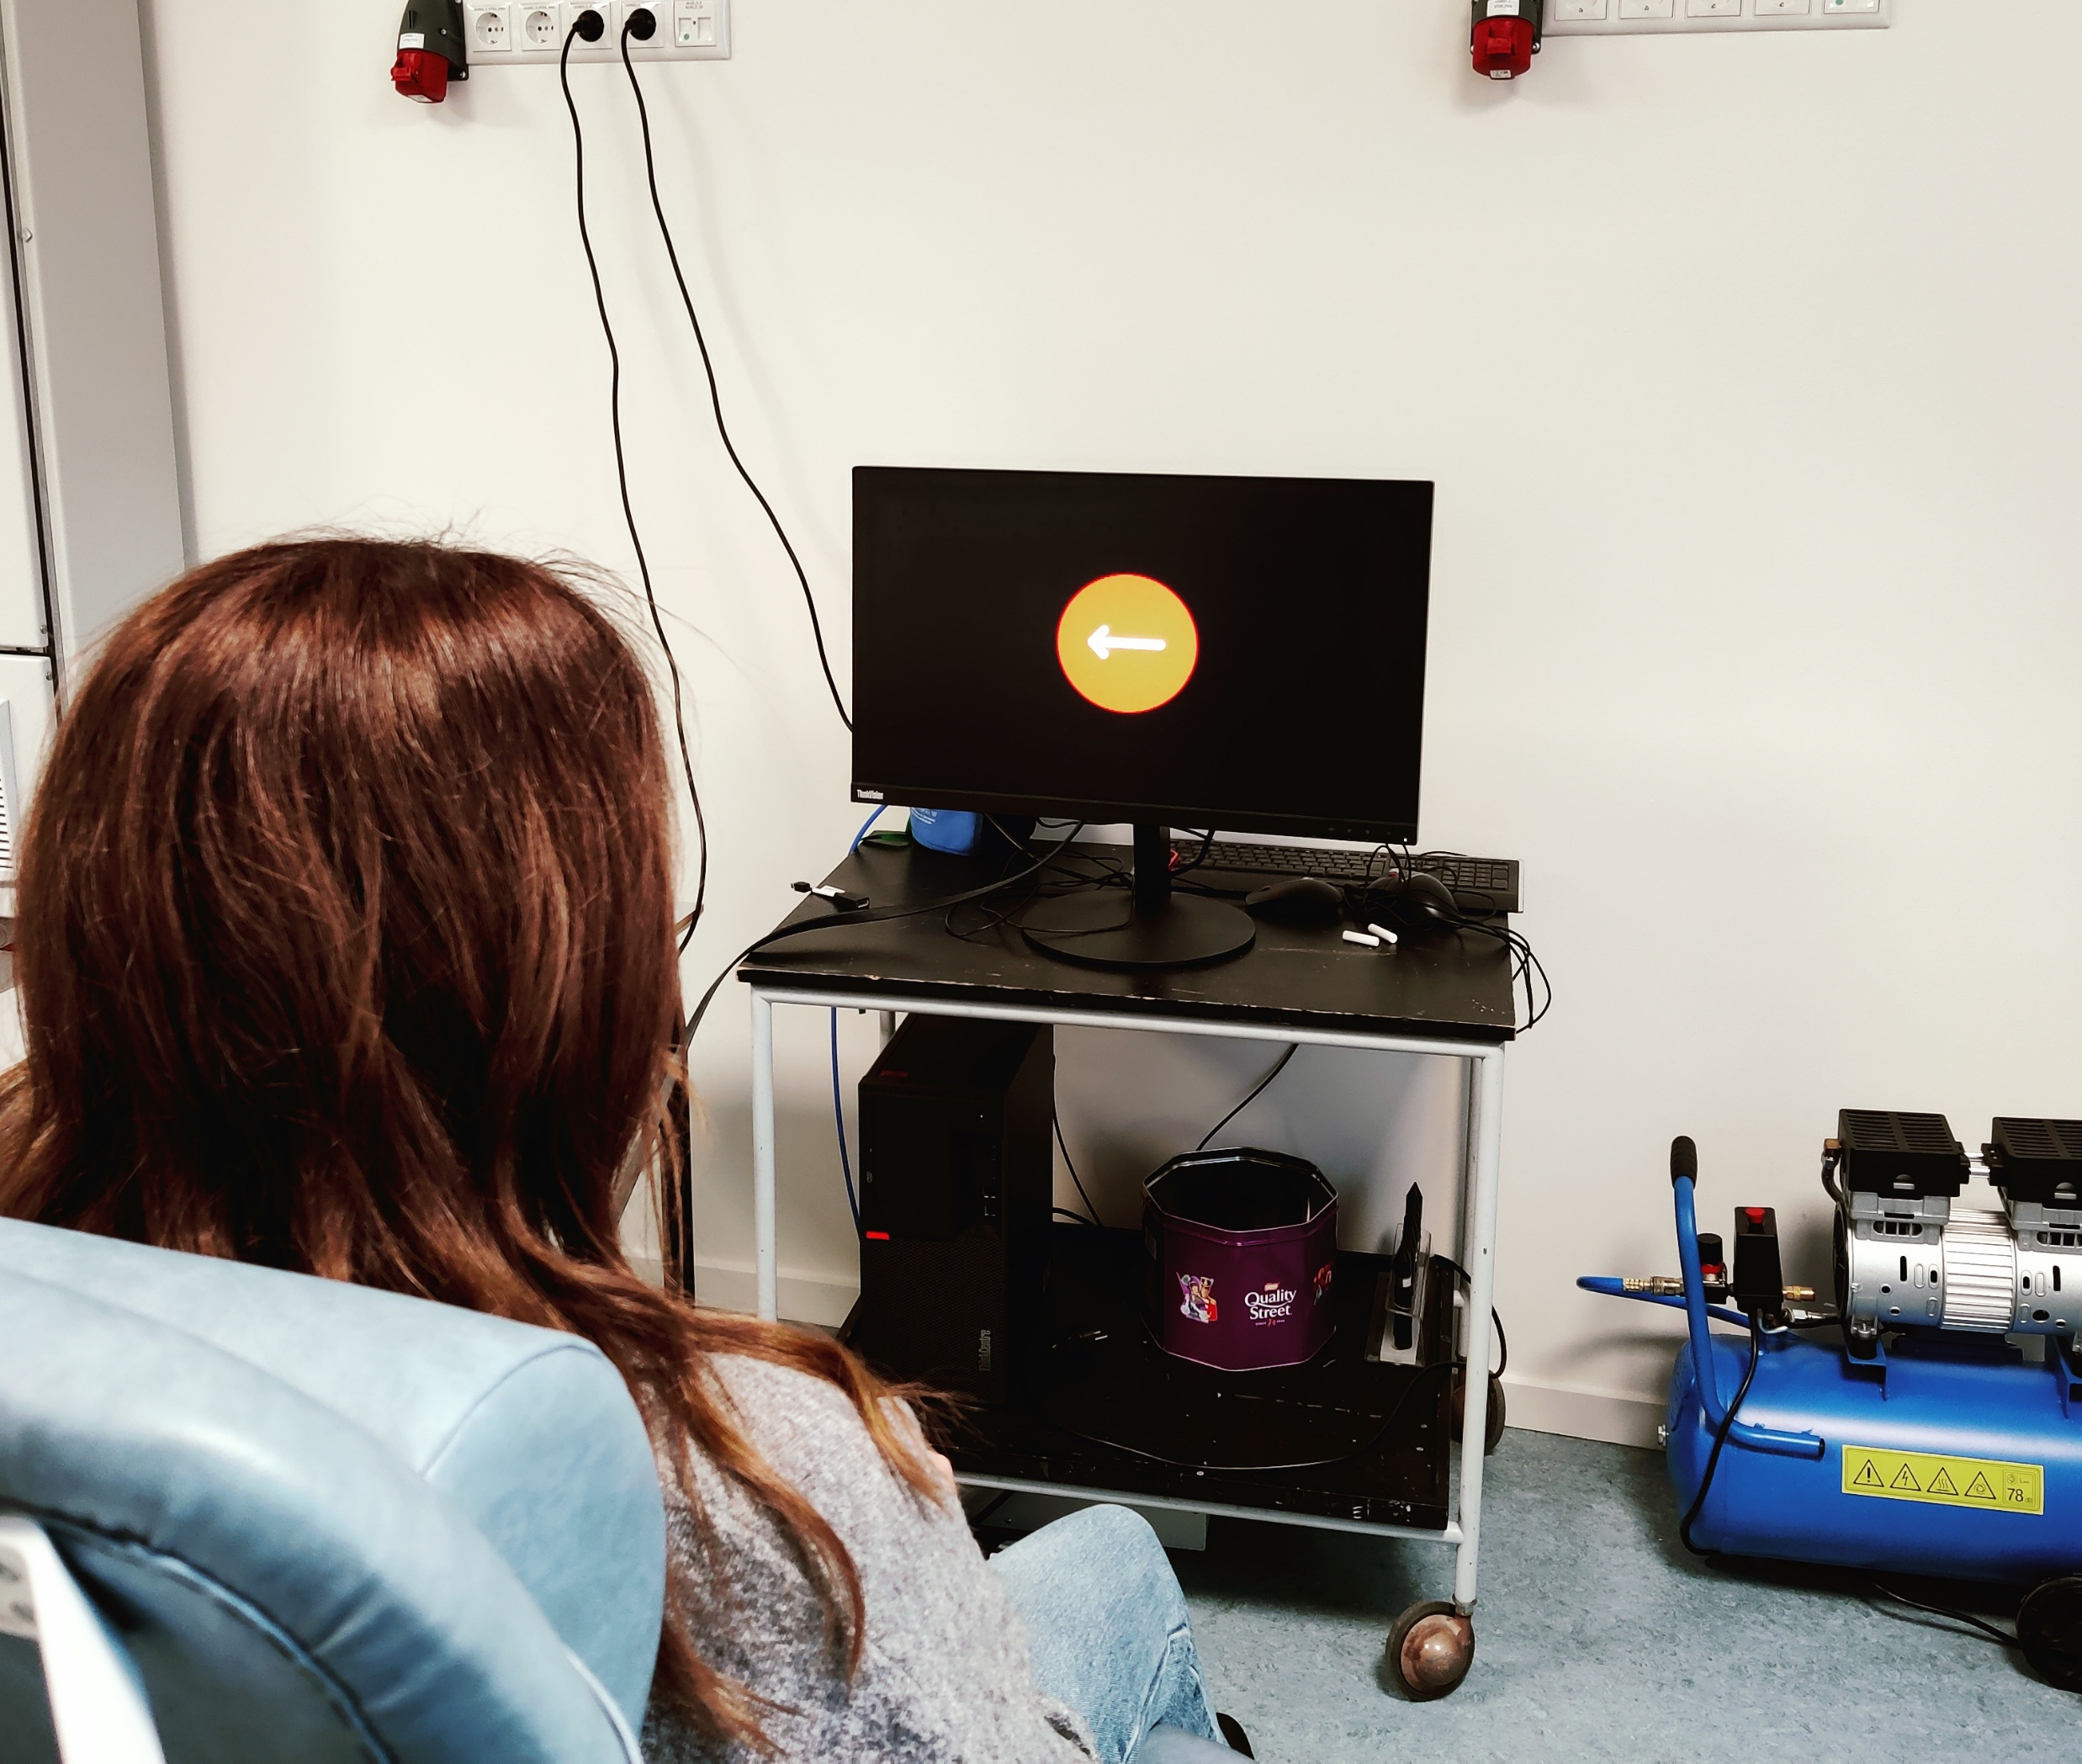

Image Generation
Kristian Hennings
This demonstration protocol shows how images can be generated programmatically in Python scripts. Programmatically generated images can implement cognitive tasks with reward/punishment.
For instance, in the Stop-Signal Task, image generation could be used to implement a reward (points) displayed after Go trials. It can also inform participants of the consequences (punishment) if they fail to inhibit their response in Stop trials.Image generation is implemented in the form of an ImageCanvas available through the TC.ImageToolkit.
This ImageCanvas provides drawing primitives to draw shapes such as points, lines, rectangles, and circles, draw Sprites (images) onto the canvas, and write text.

