Slide 1


Slide 2
1
2
3

Slide 3
1

Slide 4
2

Slide 5
3

Slide 6
4

Slide 7
1
2
3
4
When did you hear the stimulus?

Slide 8
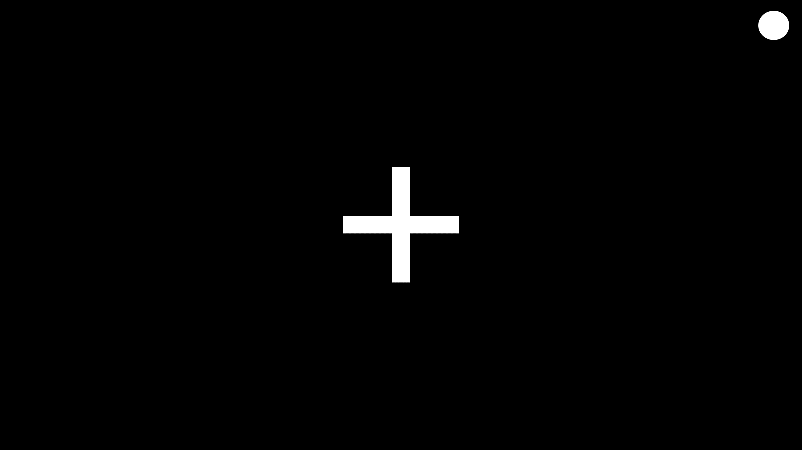

During the test you will hear a series of three tones, after which you will be asked which one in this series was different from the others.
You will hear three tones.
Press the button on the joystick that match the pattern of tones you heard.

Slide 9

During the test you will hear see a series of cues on the screen. Your task is to select the cue at which you heard a tone.
1
2
3
4

Slide 11
Was the two tones at the same intensity?
1
2

