Slide 1
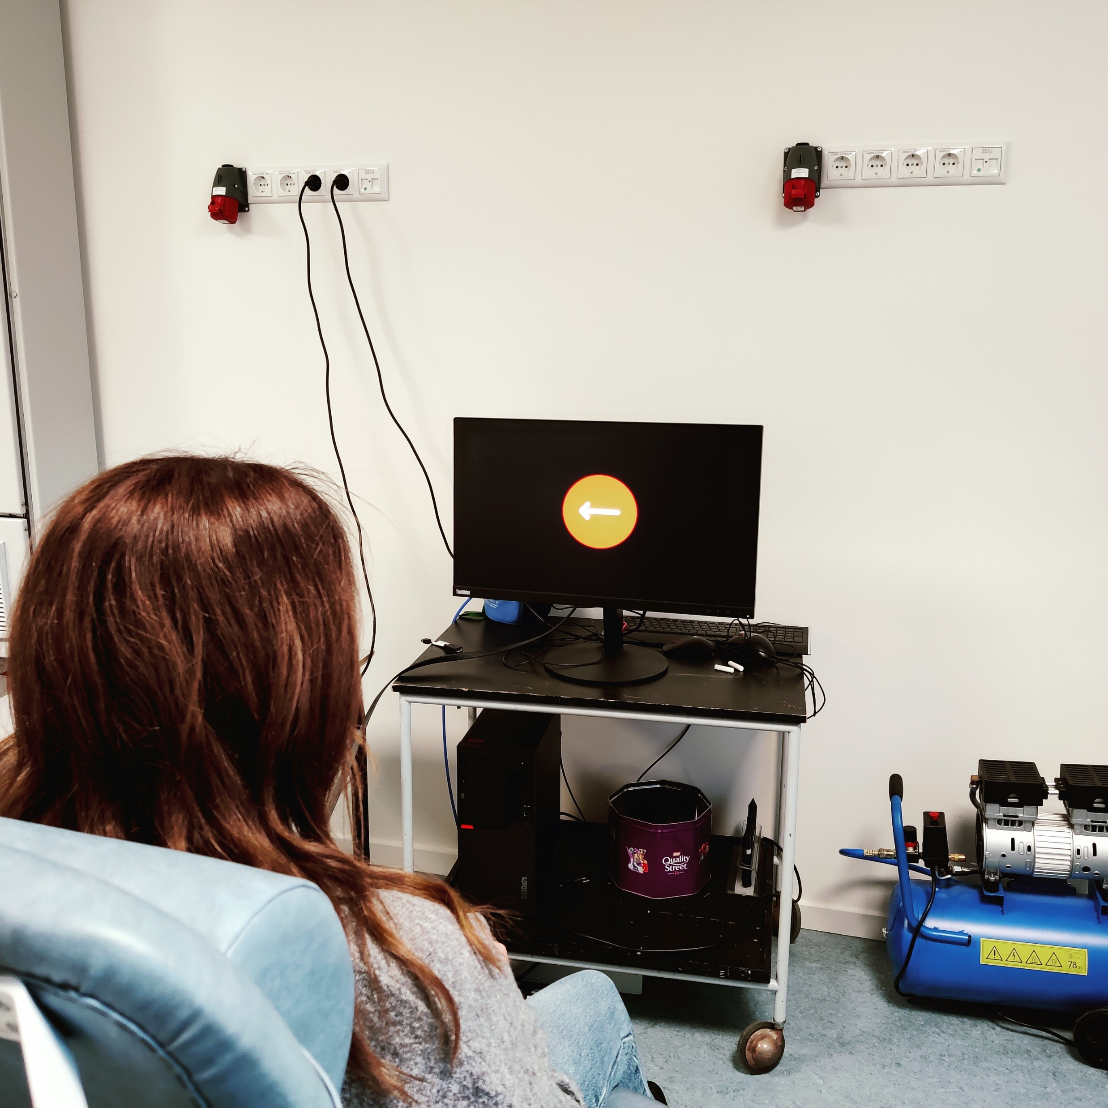

Stop-Signal Task
Laura Petrini and Kristian Hennings
The Stop-Signal Task (SST) is a psychological experiment designed to study response inhibition, a key aspect of cognitive control. In this task, participants are asked to respond quickly to a "go" signal, typically pressing a button when they see a certain stimulus (e.g., an arrow pointing left or right). However, on some trials, a "stop" signal (such as a sound or a visual cue) appears shortly after the go signal, instructing the participant to withhold their response.
The primary measure in the SST is the stop-signal reaction time (SSRT), which reflects how quickly a participant can inhibit their prepotent response. The task evaluates the ability to suppress an already initiated action, making it useful for studying impulse control. The SST is commonly used in research on attention, executive function, and disorders such as ADHD, OCD, and substance abuse, where impaired response inhibition may play a role.

