Slide 1
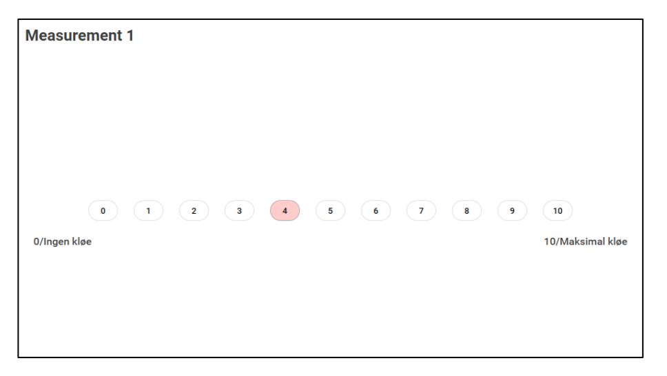
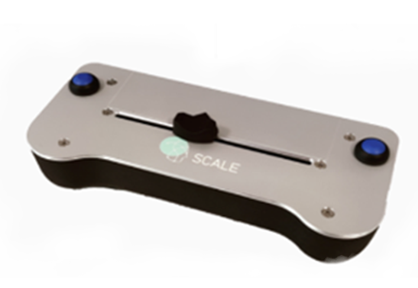
horizontal scroll bar you will use for the ratings.
LabBench Scale you will use for the ratings.
Rating scale you will see during the rating
You will use a scale with 11 numbers, ranging from 0 (no itch) to 10 (worse imaginable itch). Use the horizontal scroll bar on the scale to choose the rating number that correspond to your feeling.

Slide 2
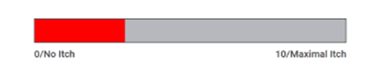
Orizontal scroll bar you will use for the ratings.
Rating scale you will see during the rating
You will move the horizontal scroll bar until you reach the point on the scale that corresponds to your feeling.

