Slide 1
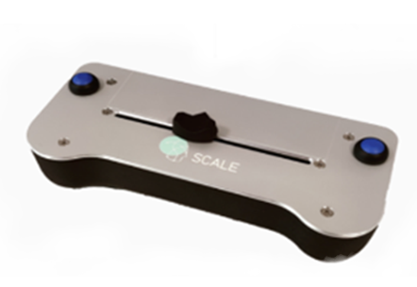
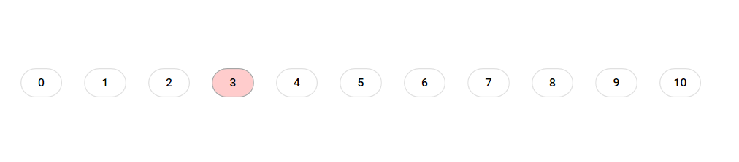
horizontal scroll bar you will use for the ratings.
0/No itch
10/Worst imaginable itch
Rating scale you will see during the rating
LabBench Scale you will use for the ratings.

Slide 2
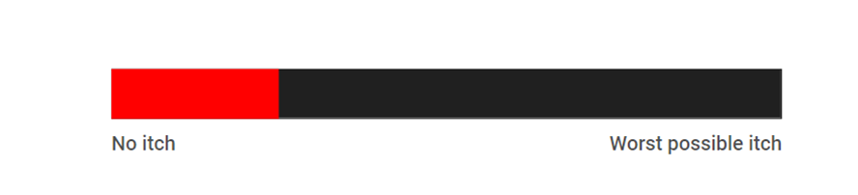
Horizontal scroll bar you will use for the ratings.
Rating scale you will see during the rating

Slide 3
