Slide 1
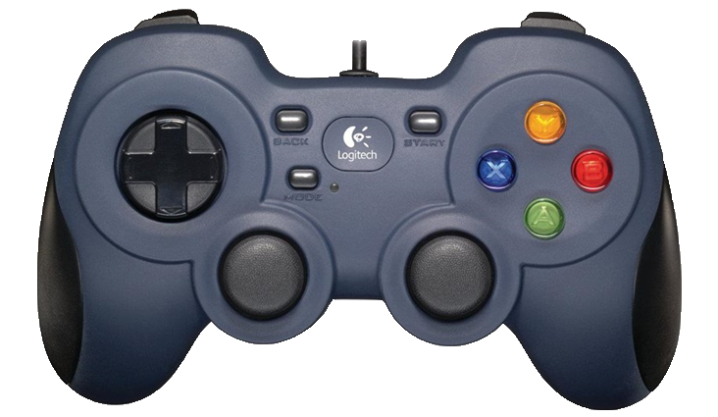
You will see a series of seven letters. Such as SSSCSSS, HHHKHHH, SSSHSSS. If the middle letter is a S or a C press button 4, and if the middle letter is a H or K press button 2.
S and C
H and K
Notes:
Joystick

Slide 2
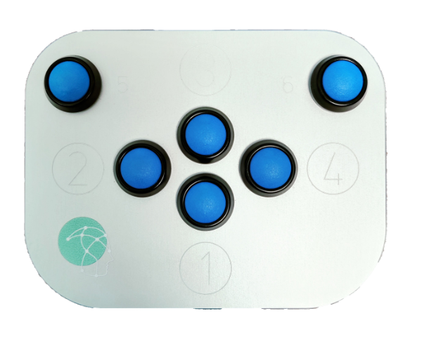
You will see a series of seven letters. Such as SSSCSSS, HHHKHHH, SSSHSSS. If the middle letter is a S or a C press button 4, and if the middle letter is a H or K press button 2.
S and C
H and K
Notes:
LIO

