Slide 1
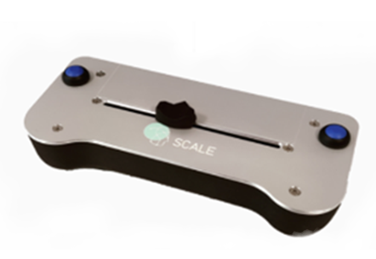
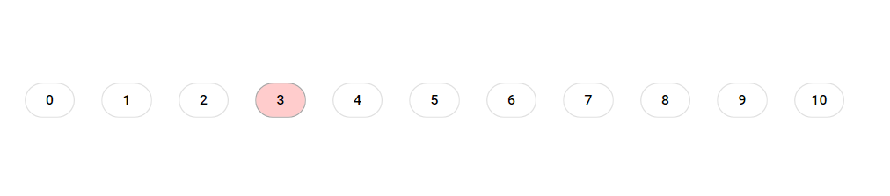
Perform the rating with the left and right buttons
0/No itch
10/Worst imaginable itch
Rating scale you will see during the rating
LabBench Scale you will use for the ratings.

Slide 2
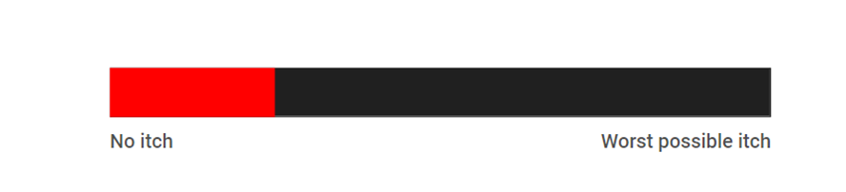
Perform the rating with the horizontal slider
Rating scale you will see during the rating

Slide 3
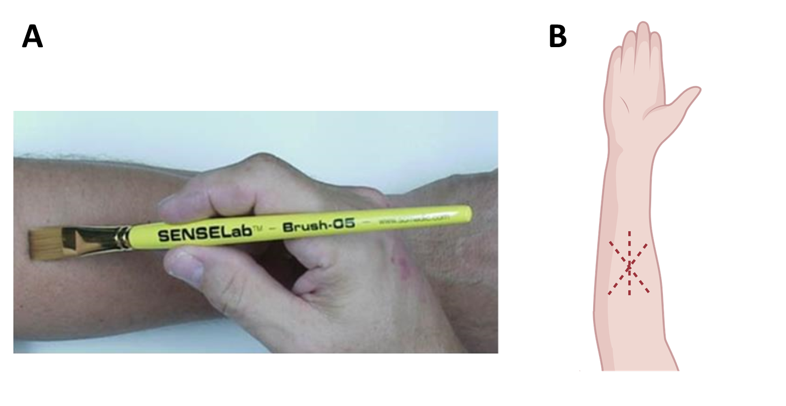

Slide 4
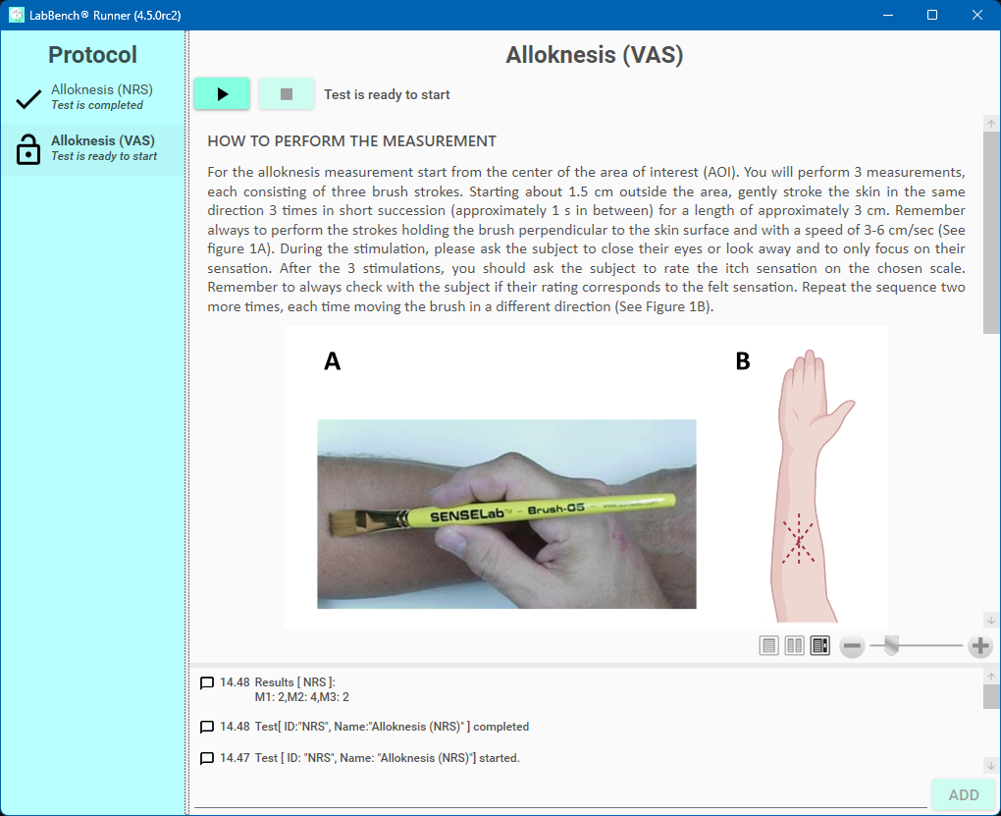
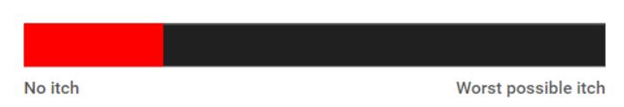
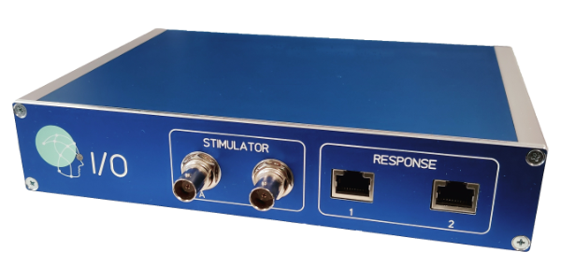
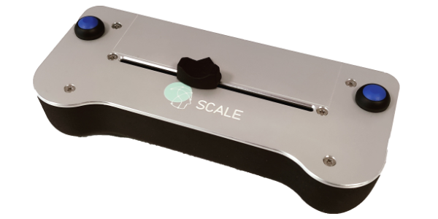
LabBench
LabBench Display
LabBench I/O
LabBench SCALE
Notes:
Experimental setup

Slide 5
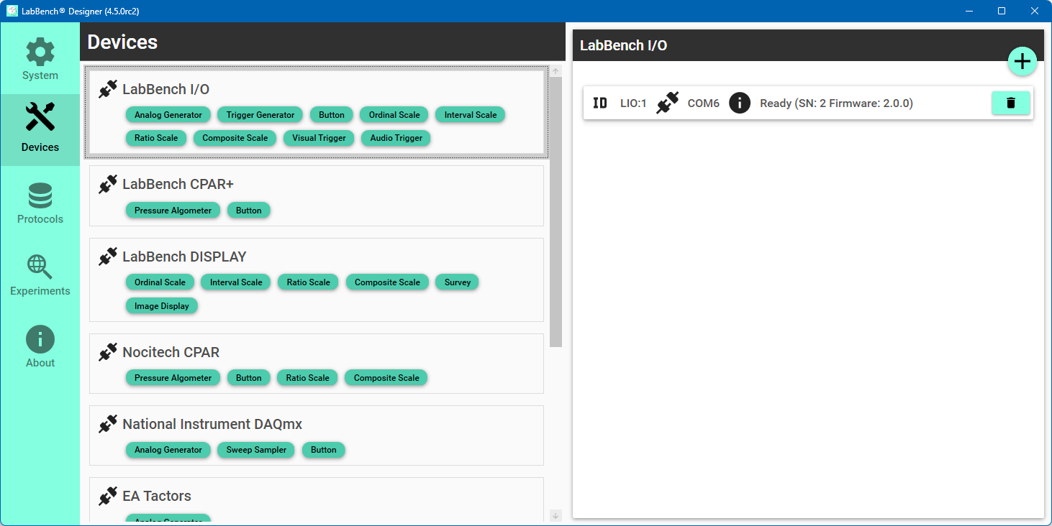
4. If not, click the (+) add device button
3. Check an LabBench I/O device is installed.
2. Select the LabBench I/O
1. Select the Devices page.

Slide 6
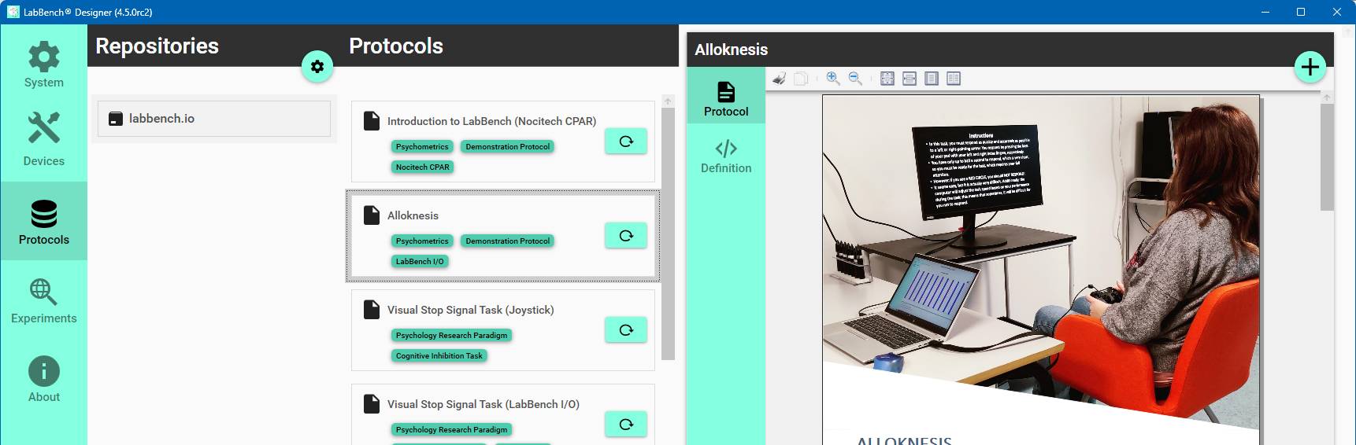
2. Select the labbench.io repository
4. Click (+) the add protocol button.
3. Select the Alloknesis protocol
1. Select the Protocols page.

Slide 7

3
2
4
1
5
8
6
7

