Slide 1
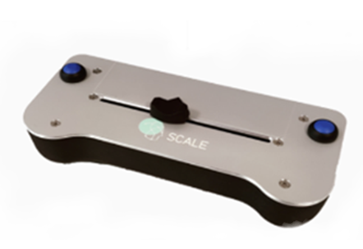
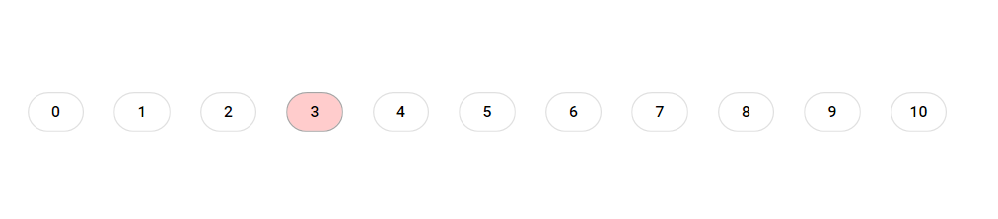
Perform the rating with the left and right buttons
0/No itch
10/Worst imaginable itch
Rating scale you will see during the rating
LabBench Scale you will use for the ratings.
You will use a scale with 11 numbers, ranging from 0 (no itch) to 10 (worse imaginable itch). Use the horizontal scroll bar on the scale to choose the rating number that correspond to your feeling.

Slide 2
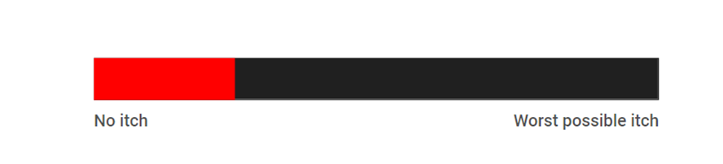
Horizontal scroll bar you will use for the ratings.
Rating scale you will see during the rating
You will use a scale ranging from 0 (no itch) to 10 (worse imaginable itch). You will move the horizontal scroll bar until you reach the point
on the scale that corresponds to your feeling.

Slide 3

3
2
4
1
5
8
6
7

