Slide 1




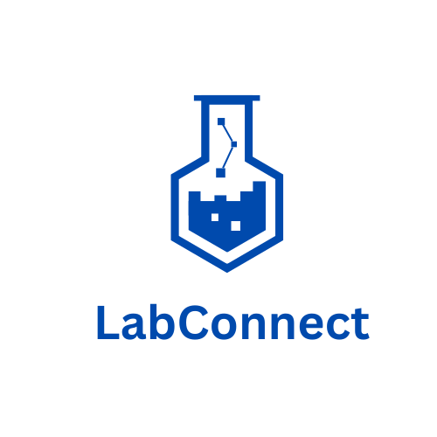



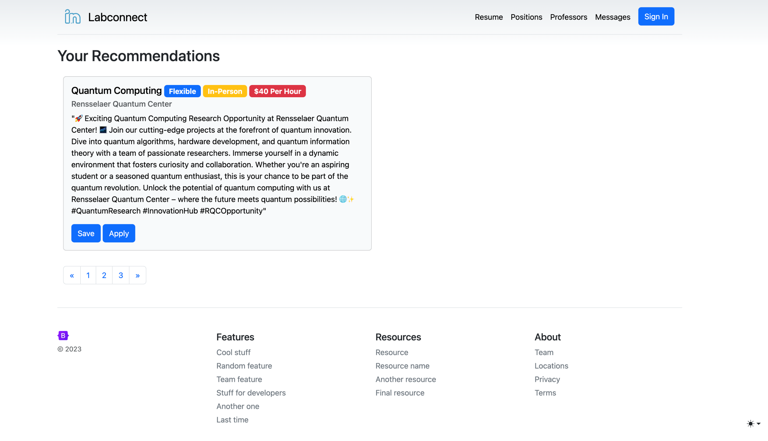
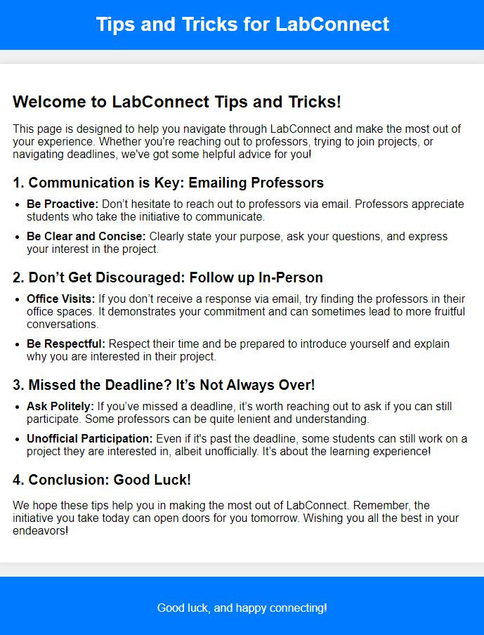
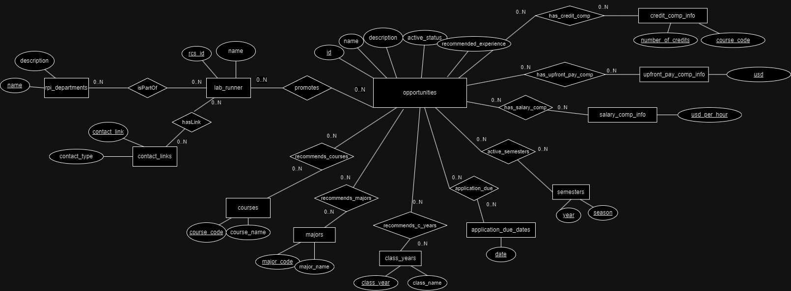
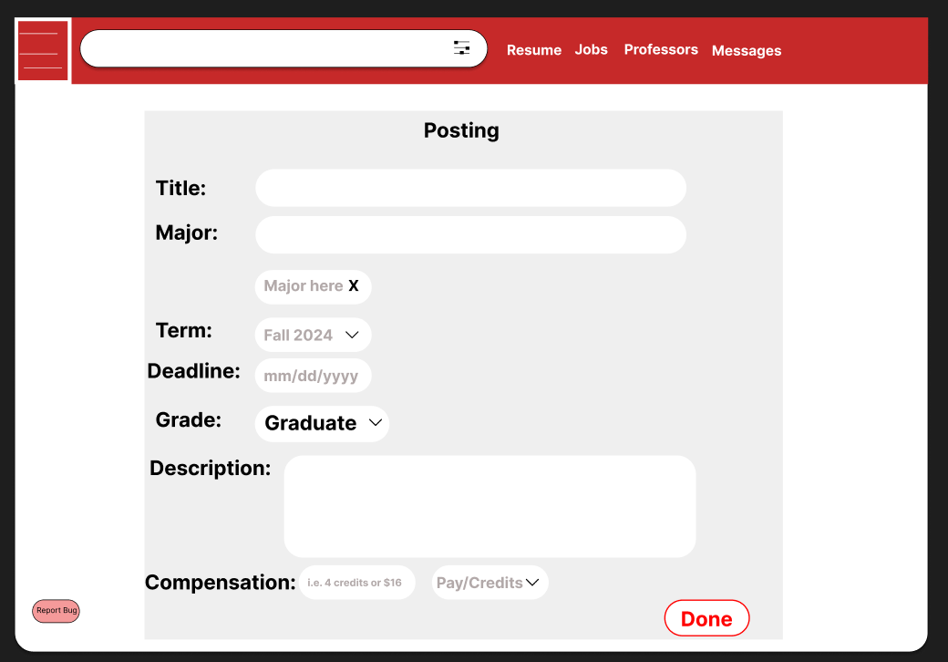
LabConnect: Connecting Students with Research Opportunities
Rafael Cenzano (Lead), Samuel Bushra, Siddhi Wadekar, Mrunal Athaley, Duy Le, Yashasvi Kishore, Abid Talukder
Rensselaer Polytechnic Institute - Department of Computer Science
Materials and Methods
Conclusions
Introduction
Throughout the project, several members of the team had to learn new programming skills alongside personal and client research skills. Throughout the project, students:
Successfully acquired proficiency in web development languages, including HTML, CSS, and Flask.
Learned Databases to create a robust and efficient database system for the LabConnect platform.
Gained expertise in Flask, a powerful web framework, to build the website's backend functionality.
Developed strong teamwork skills through close collaboration within the project team.
Demonstrated effective coordination among team members to ensure smooth project progress.
Prioritized user-centric design and functionality by aligning with the needs of prospective professors and students.
Navigated the challenges of balancing technical development with user engagement strategies.
Successfully coordinated in an effort to release a user-friendly platform that enhances research opportunities for RPI students.
Welcome to our poster presentation on LabConnect, a groundbreaking initiative in the realm of computer science and research collaboration. LabConnect is designed to bridge a critical gap that has long existed within our academic community: the divide between students eager to engage in meaningful research experiences and the professors and researchers who have exciting opportunities waiting to be explored. At RPI, a school full of innovative ideas and projects constantly in motion, can lead students to be unaware of research opportunities due to the rigorous academic workload. LabConnect emerges as the dynamic solution to this disconnect, serving as a user-friendly, database connected website that seamlessly links Rensselaer Polytechnic Institute students with a wealth of research prospects. The transformative potential of LabConnect empowers students to unlock a world of research possibilities and enhances the synergy between academia and innovation.
Results
Objectives
The goal of this project is to provide a centralized website to connect Undergraduate students with research or lab positions posted by professors, graduate students, or lab staff. This website would make the process more uniform and make it easier to find useful data like the number of credits or pay for each position. It would also include a search functionality that would make it easy to find positions that match departments or types of positions/research students are looking for. It should also help Professors and graduate students reduce their workload in searching for and posting their lab positions.
Comprehensive Database schema allowing for the optimal matching of students and opportunities
Ability for professors to post available opportunities
User friendly, frictionless website
Easily accessible supplemental information, such as tips and tricks for students and general information available on-site
References
RCOS Community
RPI CS Faculty and Staff
SQL, Flask, HTML, CSS, and Python Documentation and Resources
StackOverflow and Similar Debugging and Troubleshooting Websites
Website Homepage
Supplemental Page Example
Acknowledgments
RCOS Community
Prof. Wes Turner
Prof. Kuzmin
Database Schema
Posting Page Example

