Slide 1
Chapter 6
Time and Frequency Characterization
of Signals and Systems

Slide 2









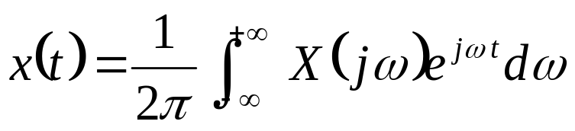
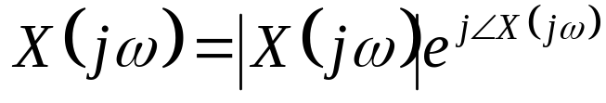
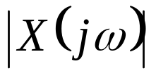
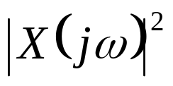
Chapter 6 Time and Frequency Characterization
Time-Domain:
Frequency-Domain:
§6.1 The Magnitude-Phase Representation
（ 幅度-相位） of the Fourier Transform
——Magnitude
——Energy-Density

Slide 3

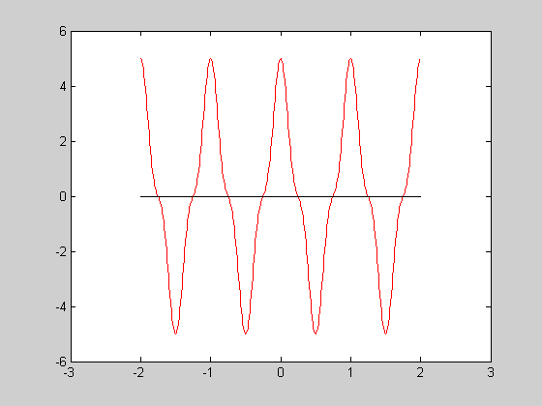

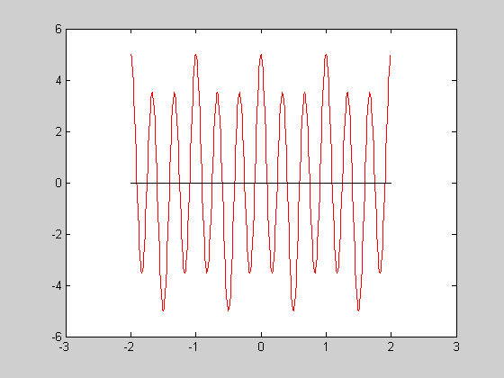
Chapter 6 Time and Frequency Characterization

Slide 4
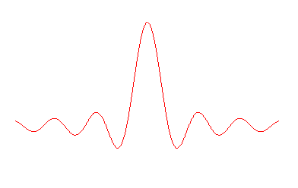


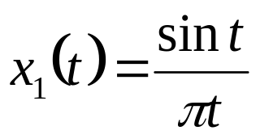

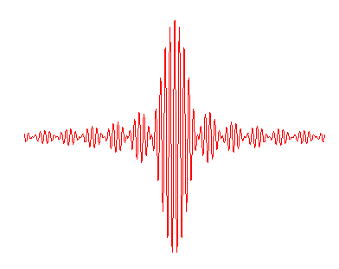
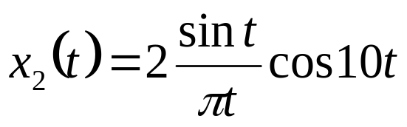
Chapter 6 Time and Frequency Characterization
-1 0 1 ω
-11 -10 –9 0 9 10 11 ω

Slide 5
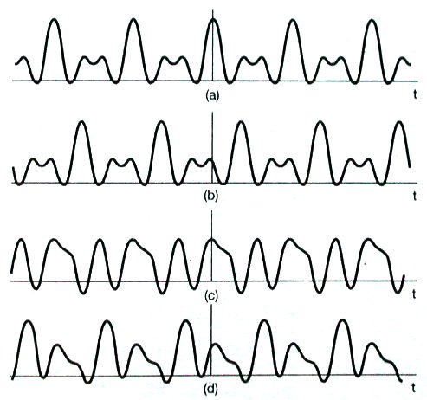




Chapter 6 Time and Frequency Characterization

Slide 6
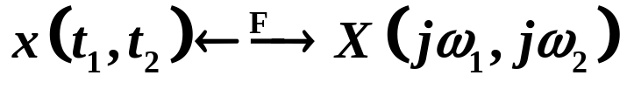
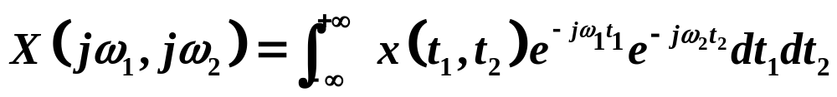
Chapter 6 Time and Frequency Characterization
2. A black-and-white picture
Figure 6.2

Slide 7
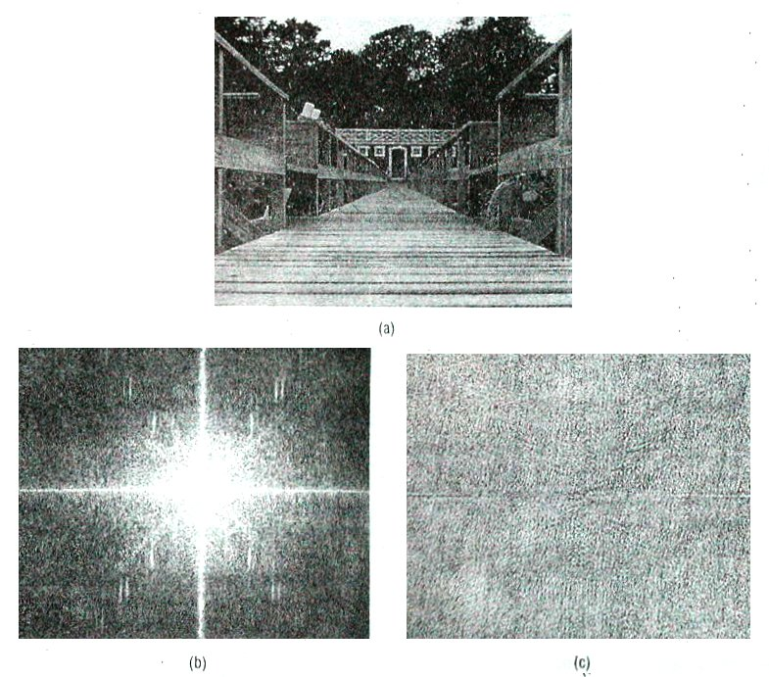


Chapter 6 Time and Frequency Characterization

Slide 8
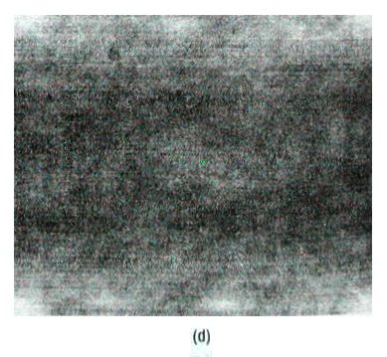
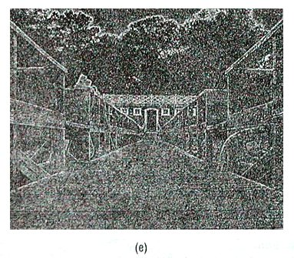
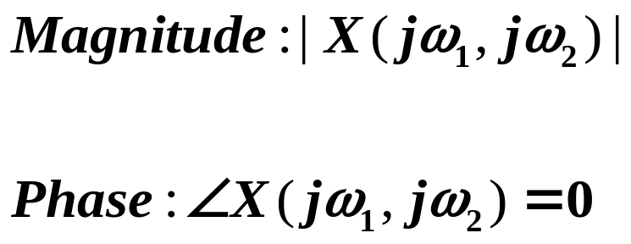
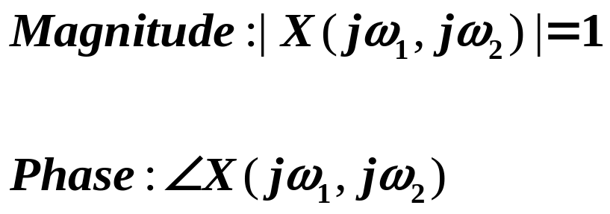
Chapter 6 Time and Frequency Characterization

Slide 9
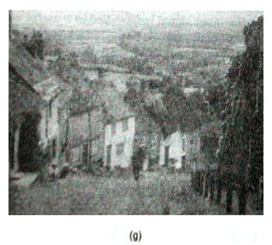
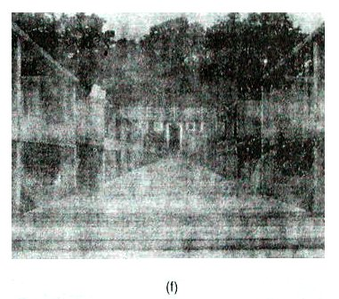

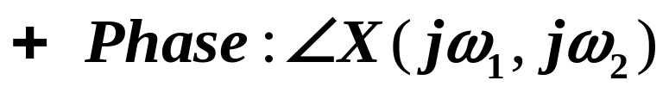
Chapter 6 Time and Frequency Characterization

Slide 10
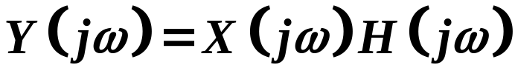
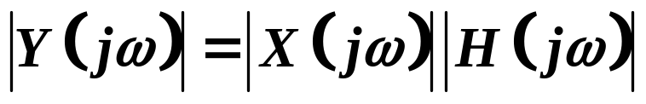
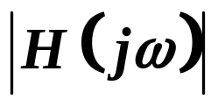
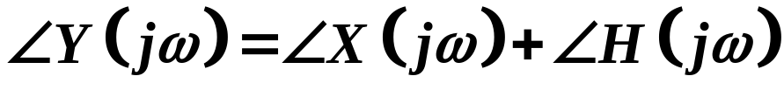
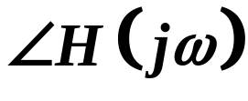
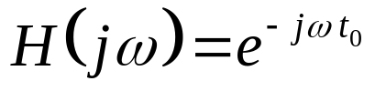
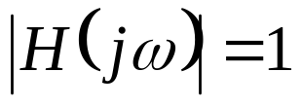
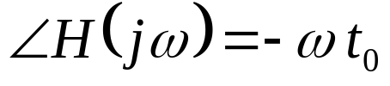
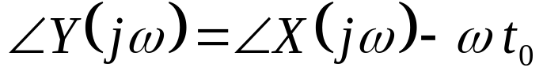
Chapter 6 Time and Frequency Characterization
§6.2 The Magnitude-Phase Representation of the
Frequency Response of LTI Systems
——Gain
——Phase Shift
§6.2.1 Linear and Nonlinear Phase
1. Linear Phase

Slide 11
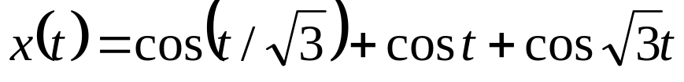
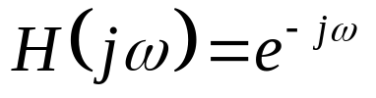

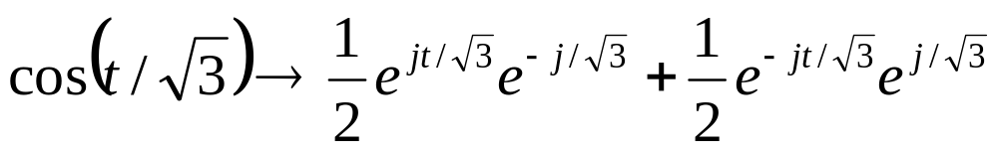
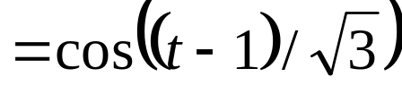
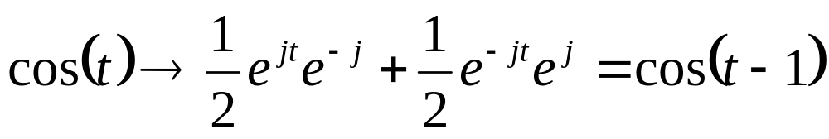
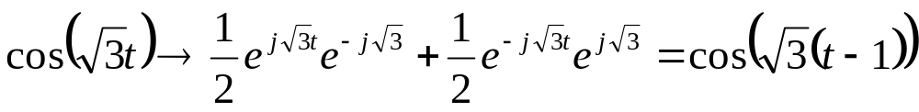
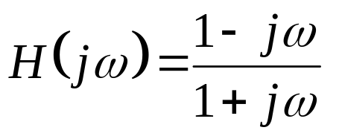
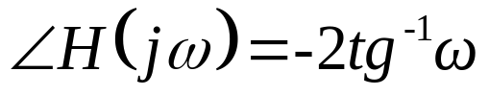
Chapter 6 Time and Frequency Characterization
2. Nonlinear Phase

Slide 12
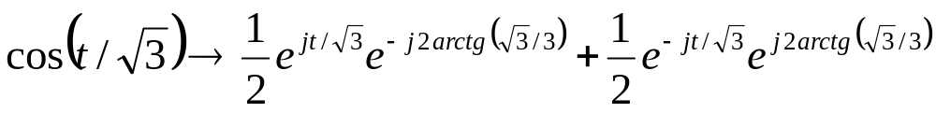


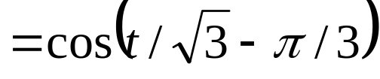
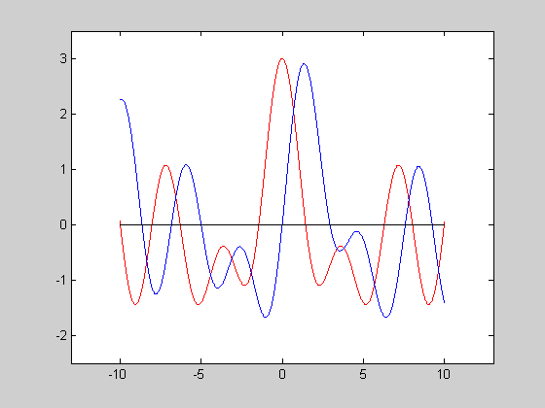




Chapter 6 Time and Frequency Characterization

Slide 13



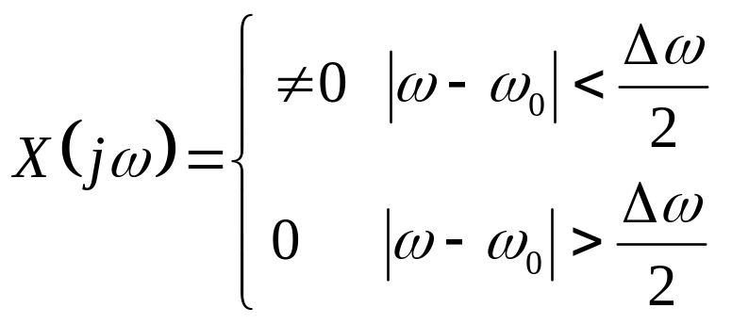

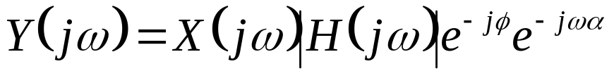
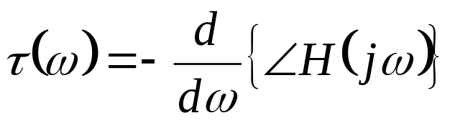
Chapter 6 Time and Frequency Characterization
§6.2.2 Group delay （群延时）
Consider a narrowband signal
窄带信号
α——Group delay
at ω=ω₀
The Group Delay at each frequency

Slide 14
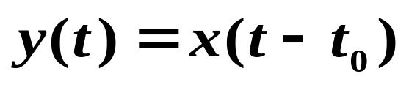
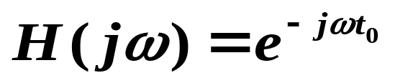
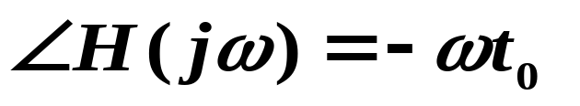
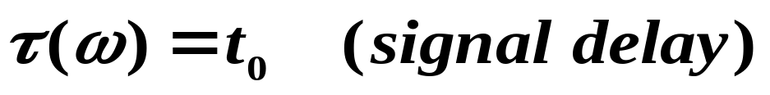
Chapter 6 Time and Frequency Characterization
Example:

Slide 15
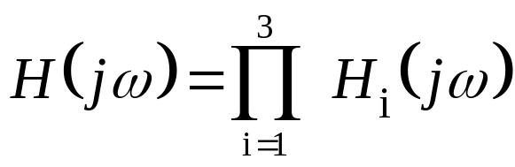
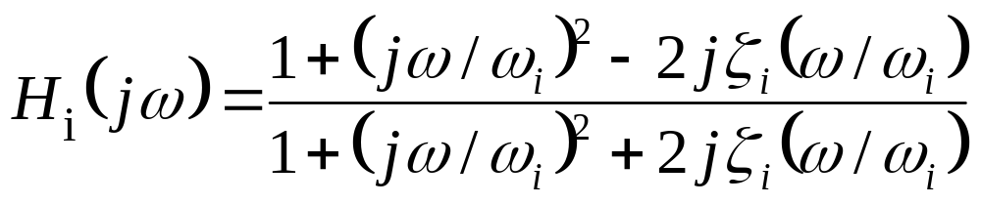





Chapter 6 Time and Frequency Characterization
Example 6.1 Consider an all-pass system.
Let
Figure 6.5

Slide 16






Chapter 6 Time and Frequency Characterization
§6.2.3 Log-Magnitude and Bode Plots
对数模和波特图
Bode Plots：Log-Frequency——Log-Magnitude

Slide 17





Chapter 6 Time and Frequency Characterization
Example
It is approximately a linear function of lg(ω)

Slide 18















Chapter 6 Time and Frequency Characterization

Slide 19












Chapter 6 Time and Frequency Characterization
§6.3 Time-Domain Properties of ideal Frequency-Selective Filters
All-pass system with linear phase

Slide 20


Chapter 6 Time and Frequency Characterization
§6.4 Time-Domain and Frequency-Domain
Aspects of Nonideal filters
overlap
1. Gradual transition from passband to stopband.
2. The step response approaches a constant value
without oscillations.
When filtering is to be carried out in real time, causality
is a necessary constraint.
4. In many contexts, we just need a simple filter.

Slide 21









Chapter 6 Time and Frequency Characterization
Nonideal Filter
Passband ripple
Magnitude
Transition
Stopband ripple
Passband
Stopband
overshoot
The unit
response
Rise time
Setting time

Slide 22
Chapter 6 Time and Frequency Characterization
Homework:
6.5 6.23 6.27

