Slide 1
ROOMMATESYNC
Find a room, split costs, manage house life — all in one place.
● PHP 8.1 ● MySQL 8.0 ● HTML5 / CSS3 ● Vanilla JS ● XAMPP ● MIT
Team RoommateSync · Dadhichi · Shawki · Plabon — ISD Course Project, KUET

Slide 2
WHAT WE'LL COVER
Presentation Agenda
• 1. Problem & Solution — why RoommateSync exists and what it delivers.
• 2. Modules — the seven integrated feature modules.
• 3. Architecture — layers, data flow, deployment.
• 4. Data Model — ERD, schema, relationships.
• 5. UML Diagrams — use case, class, sequence, state, activity & more.
• 6. Process & Results — sprints, testing, team & demo.

Slide 3
THE CONTEXT
The Problem
Students and young professionals relocating to cities like Dhaka struggle to find trustworthy roommates, verify listings, and manage shared expenses.
• Fragmented discovery — Facebook groups, word-of-mouth and spreadsheets, no single source of truth.
• Trust gap — no way to verify landlords or rate past roommates on compatibility.
• Shared-cost chaos — splitting bills is manual, unfair and easy to lose track of.
Built as a university ISD project by a team of 3 students for the Bangladeshi rental market.

Slide 4
OUR APPROACH
The Solution — One Unified Platform
A full-stack PHP web app that unifies discovery, trust and shared-living management.
# | Module | What it does
1 | Rental Marketplace | Browse, filter & search listings by price, room type & location — real-time.
2 | Bill Split Calculator | Split bills proportionally by income with optional DB logging.
3 | Viewing Booking | 30-min slots with automatic conflict prevention.
4 | Listing Upload | Landlords create listings with image upload & validation.
5 | Peer Review | Rate roommates; aggregated cleanliness & communication scores.
6 | Chat | Real-time polling messaging between accepted connections.
7 | Connect | Double opt-in matching that unlocks chat when both accept.

Slide 5
UNDER THE HOOD
Technology Stack
• FrontendHTML5, CSS3, Vanilla JS — glassmorphism dark theme, responsive grid.
• BackendPHP 8.1 (pure, no framework) — API endpoints & session management.
• DatabaseMySQL 8.0 via XAMPP — relational storage, indexing, transactions.
• Data AccessPDO singleton — prepared statements, transaction & lock support.
• Dev & VCSPHP built-in server (php -S), Git + GitHub, Jira, Zephyr.
• TestingZephyr for Jira — 49 test cases across 7 cycles, 100% pass.

Slide 6
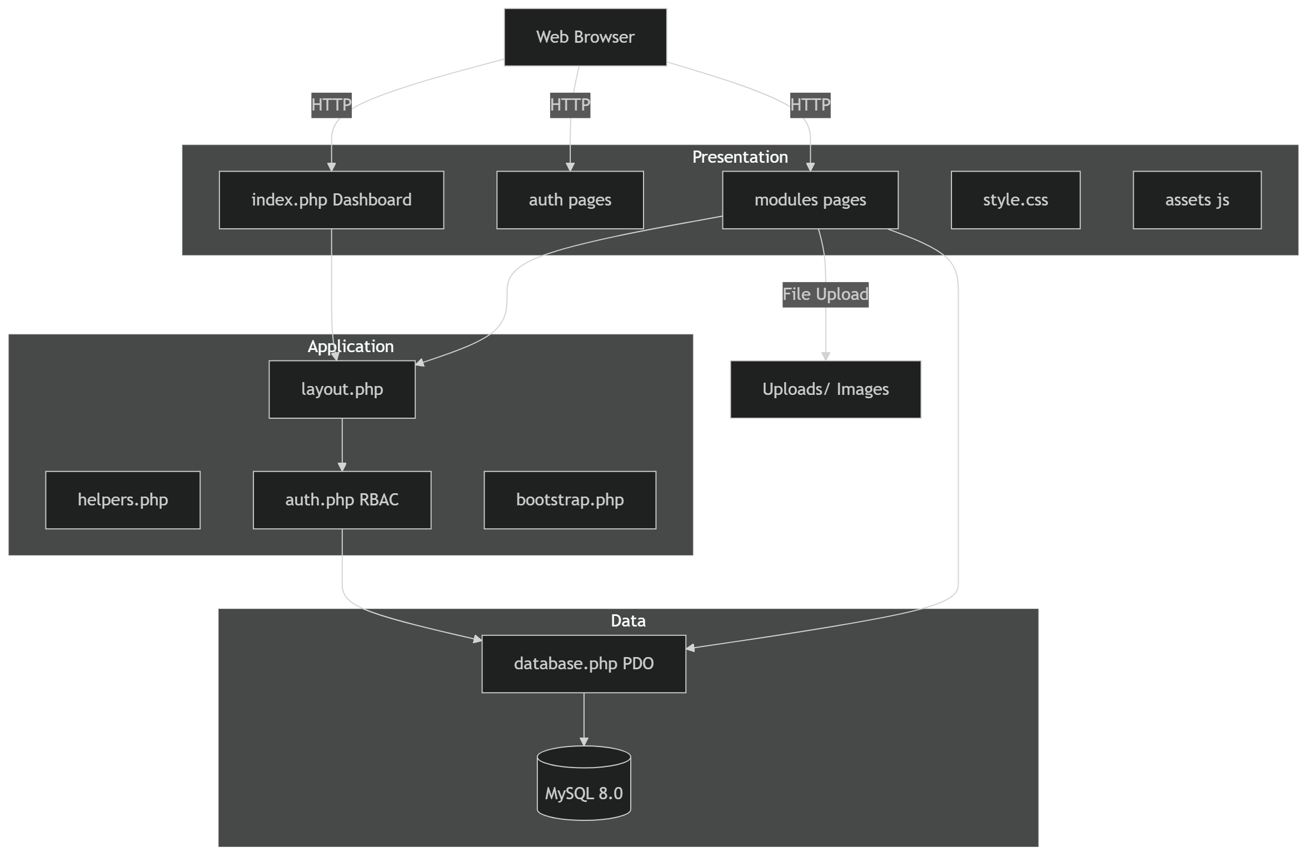
ARCHITECTURE
System Architecture

Slide 7
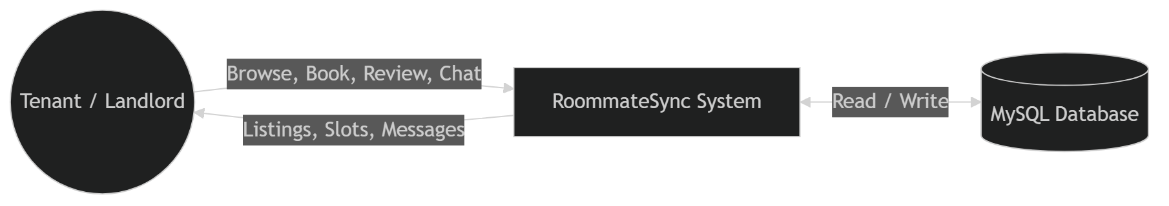
DATA FLOW DIAGRAM
DFD Level 0 — Context

Slide 8
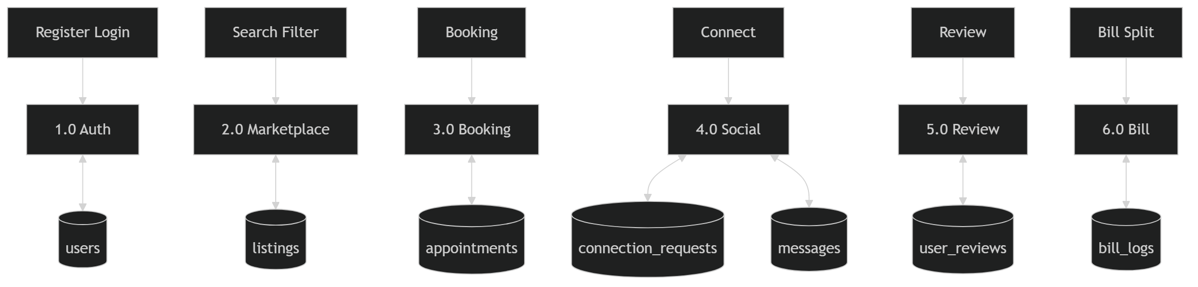
DATA FLOW DIAGRAM
DFD Level 1 — Major Processes

Slide 9
DATA FLOW DIAGRAM
DFD Level 2 — Booking Detail

Slide 10
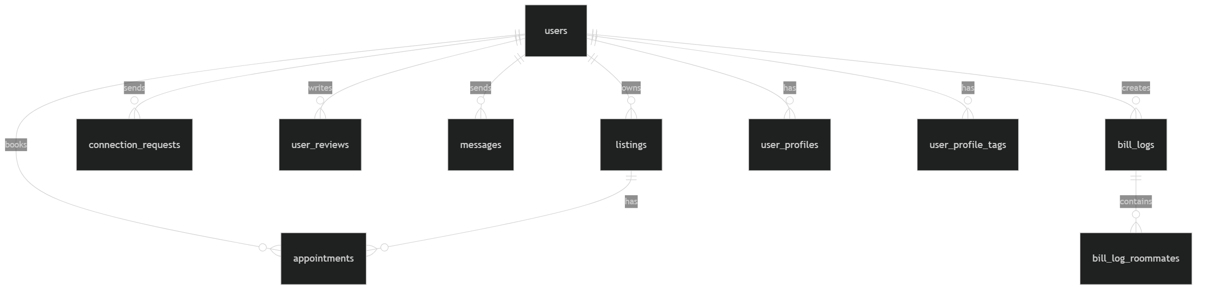
DATA MODEL
Entity Relationship Diagram

Slide 11
DATA MODEL
Database Schema
Table | Rows (seed) | Purpose
users | 5 | Accounts with roles
user_profiles | 5 | Lifestyle preferences
user_profile_tags | 19 | Interest tags
listings | 5 | Rental listings
appointments | 2 | Viewing bookings
connection_requests | 2 | Social pairs
messages | 2 | Chat
user_reviews | 1 | Peer reviews
bill_logs / bill_log_roommates | 0 | Saved splits
11 tables · 8 indexes · 12 foreign keys.

Slide 12
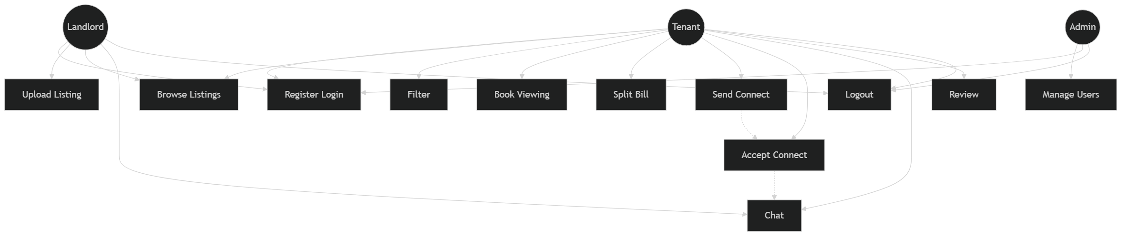
UML
Use Case Diagram

Slide 13
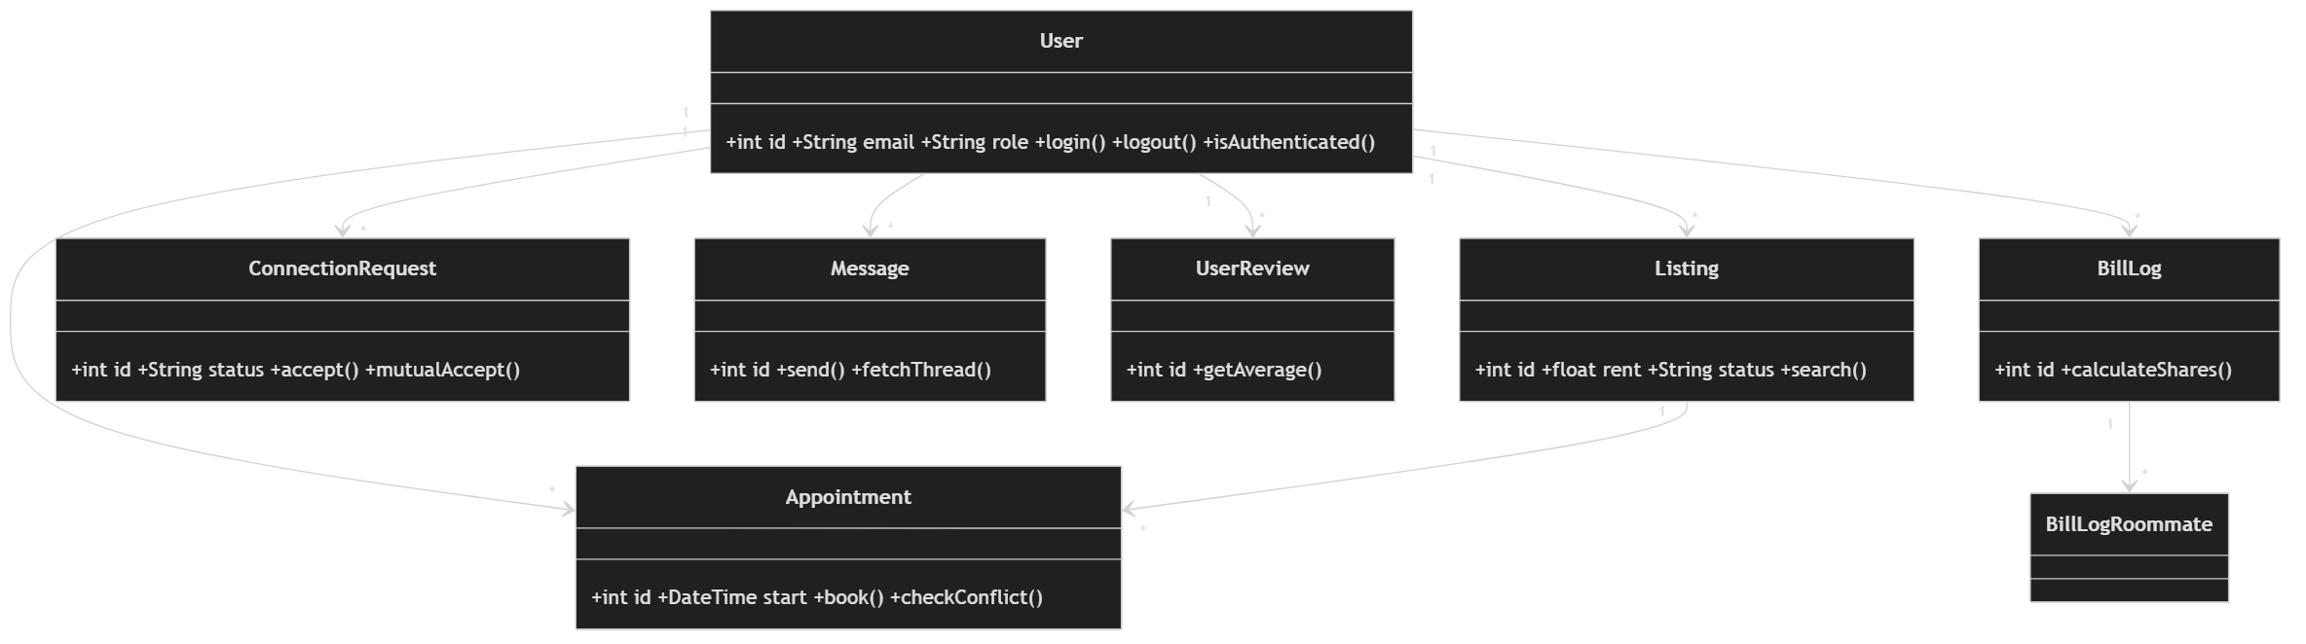
UML
Class Diagram (core entities)

Slide 14
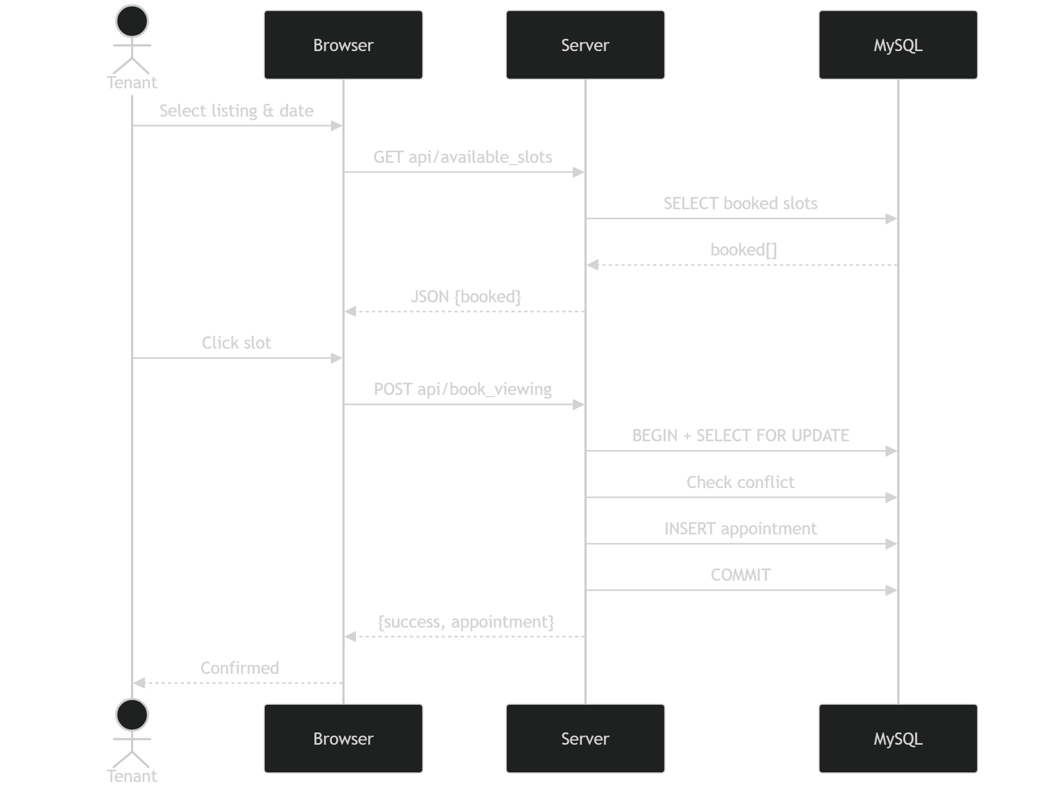
UML
Sequence — Booking a Viewing

Slide 15
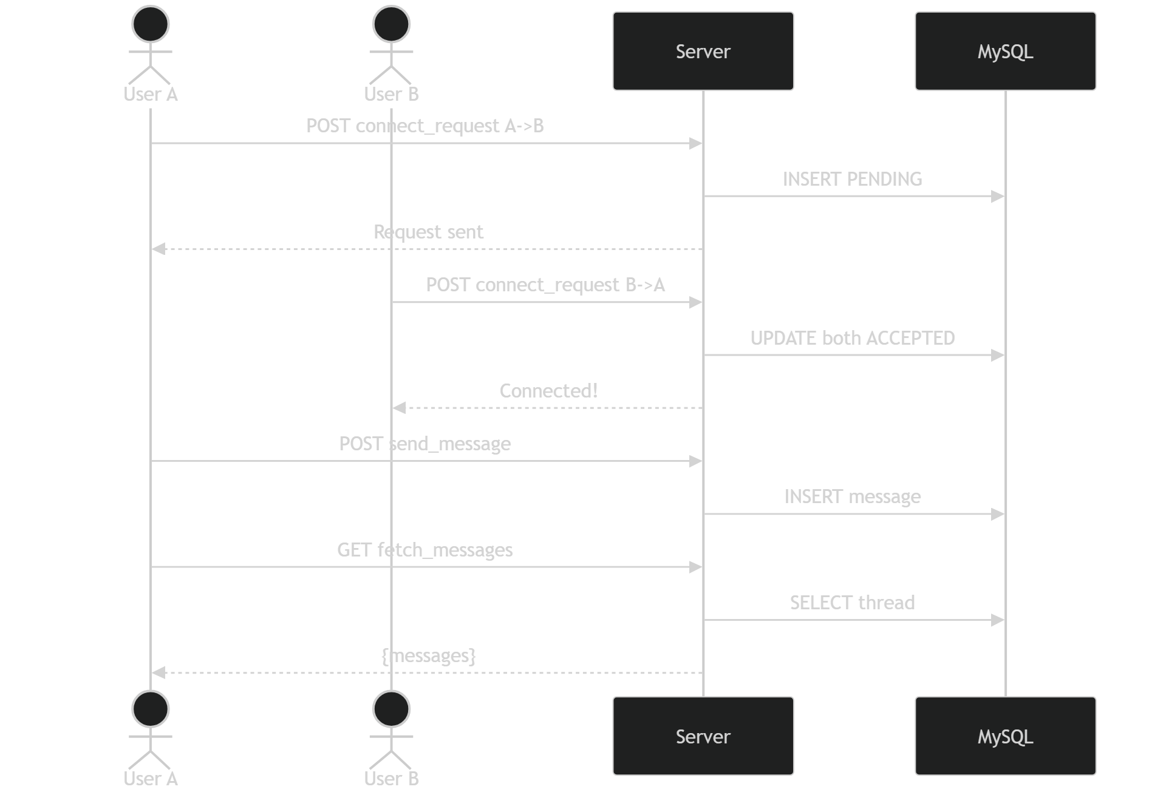
UML
Sequence — Connect & Chat

Slide 16
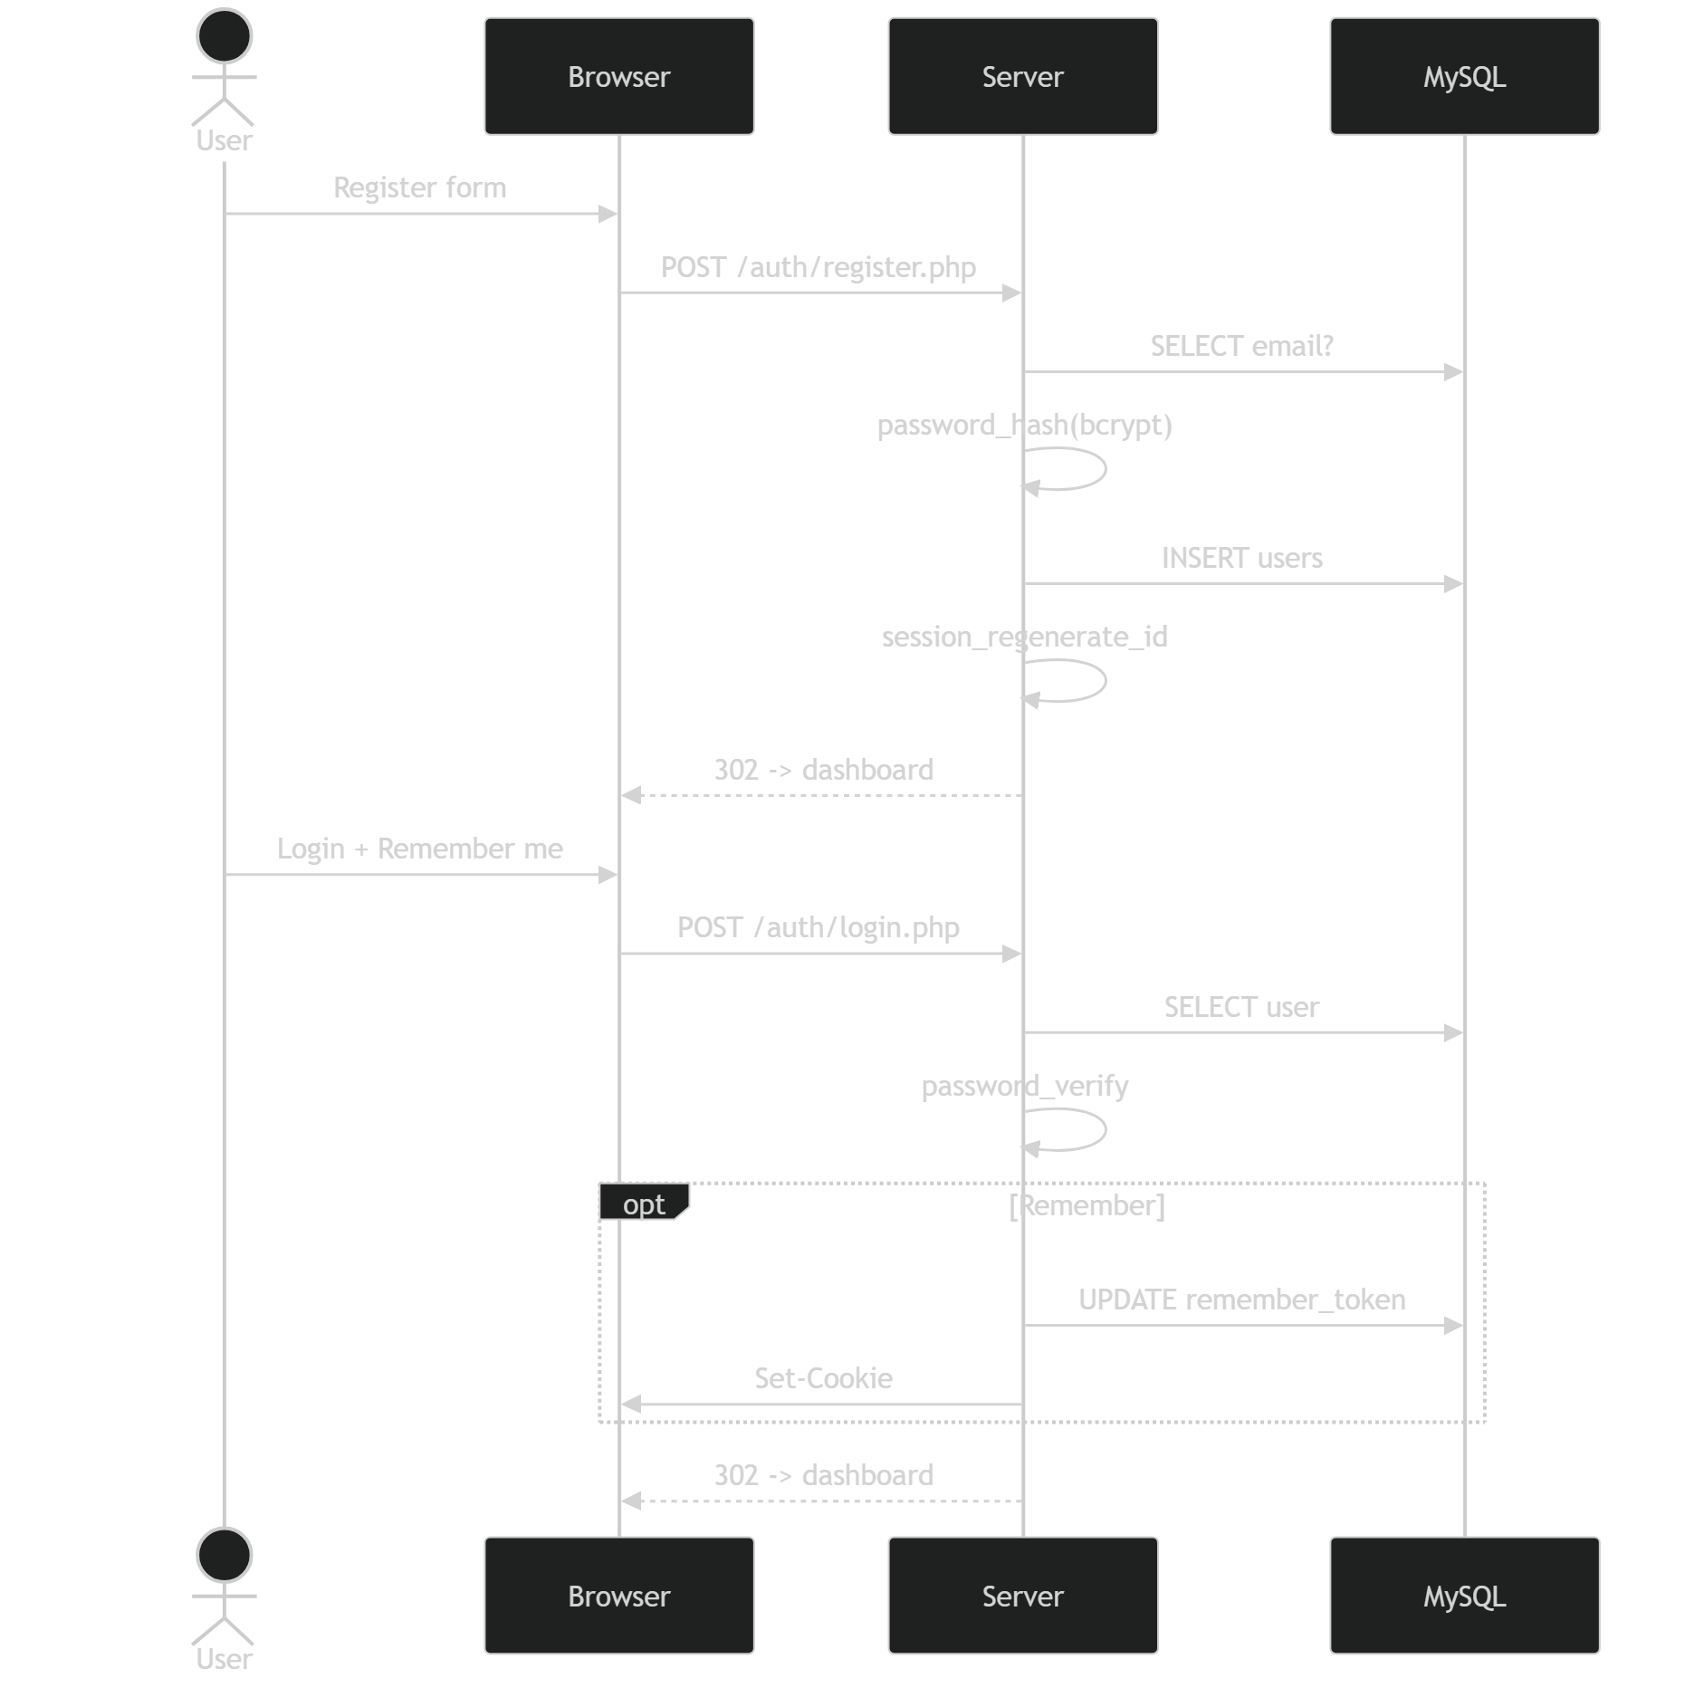
UML
Sequence — Register & Login

Slide 17
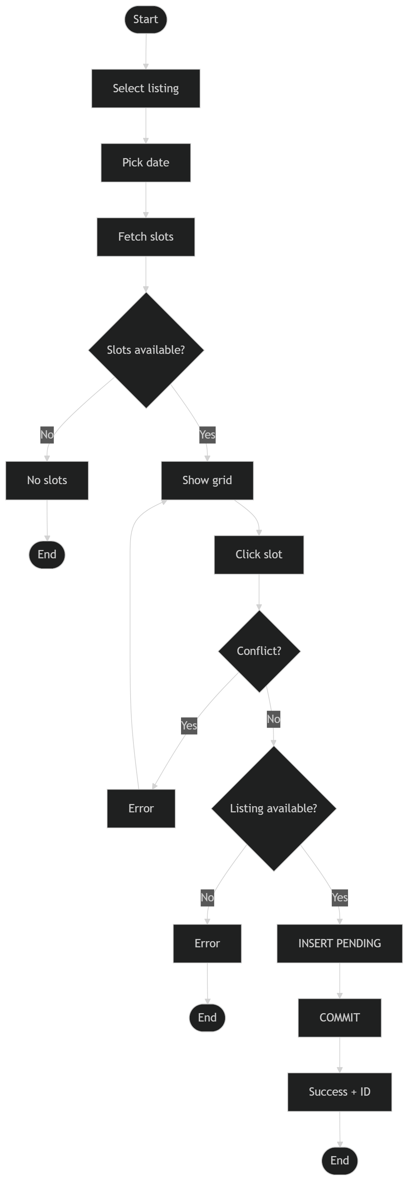
UML
Activity — Booking Flow

Slide 18
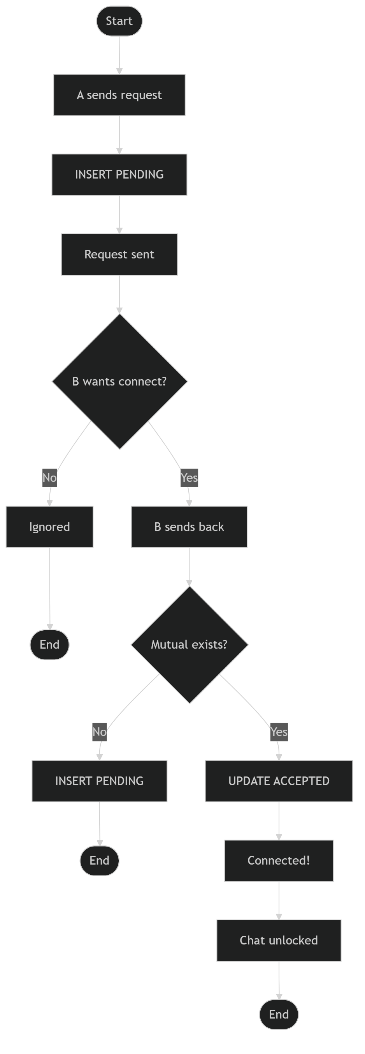
UML
Activity — Connection Flow

Slide 19
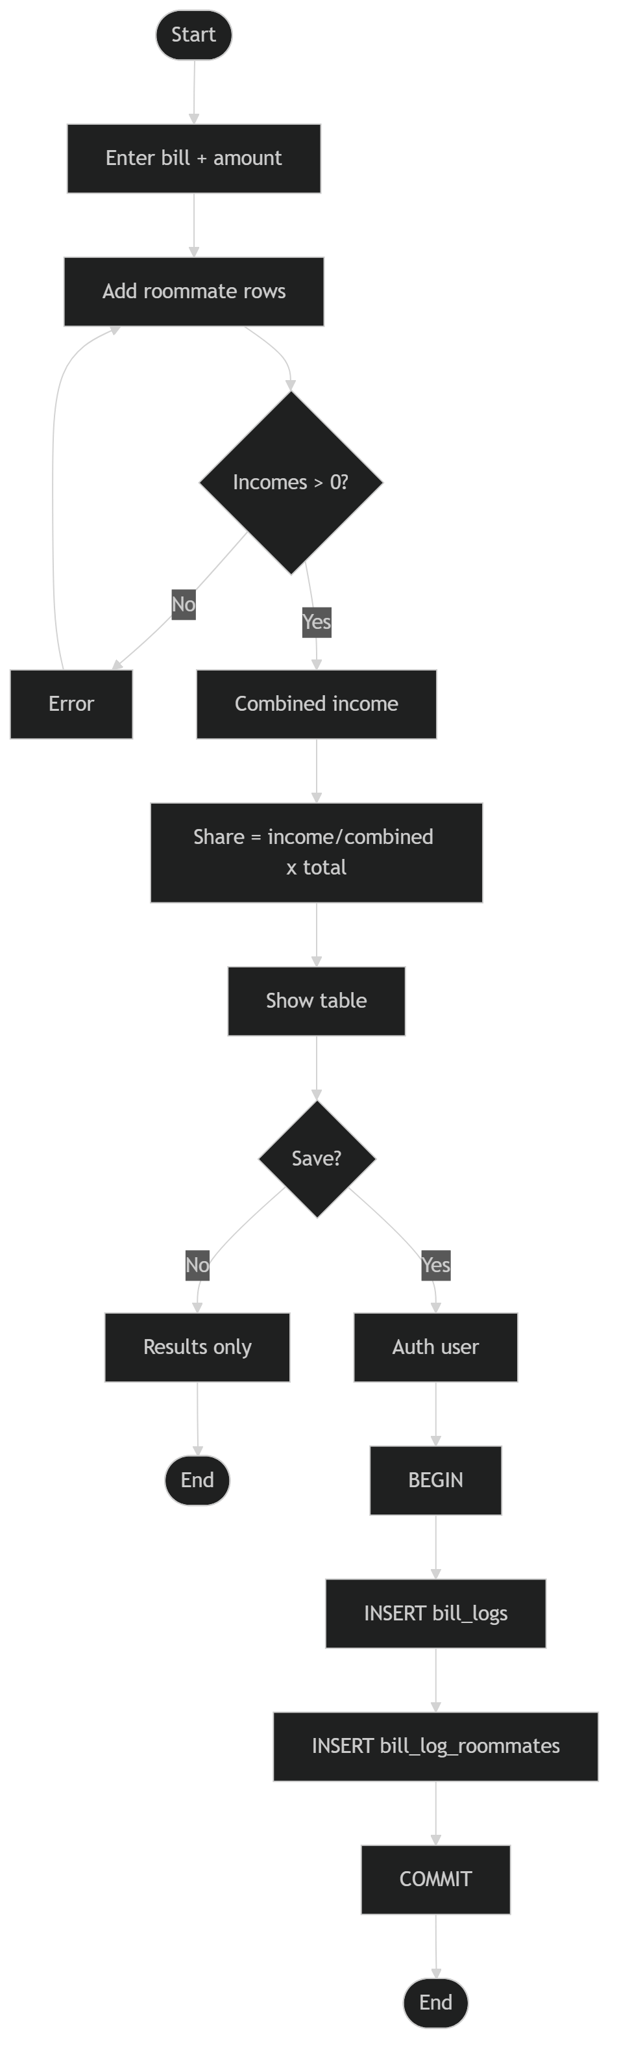
UML
Activity — Bill Split Flow

Slide 20
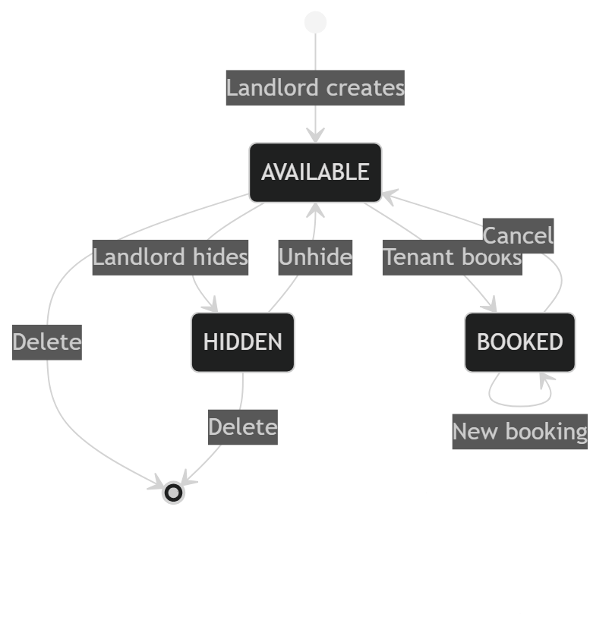
UML
State Machine — Listing Status

Slide 21
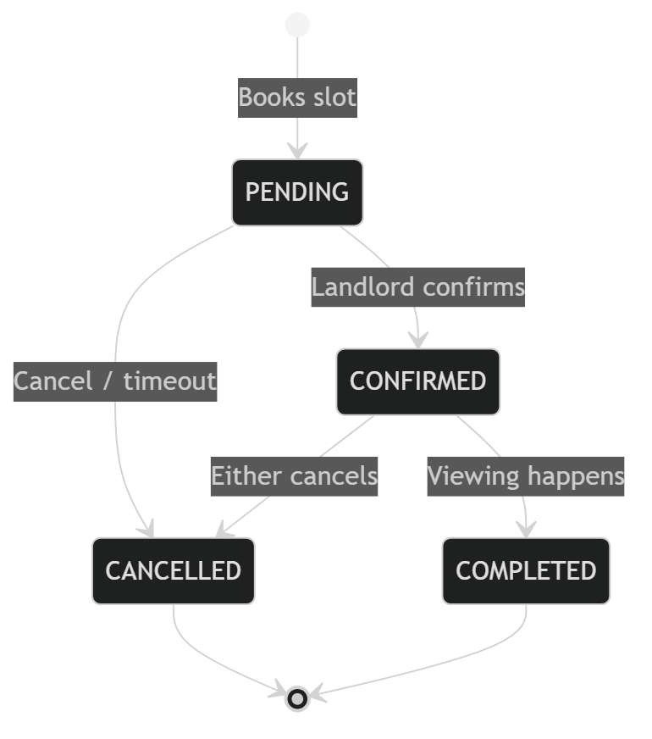
UML
State Machine — Appointment

Slide 22
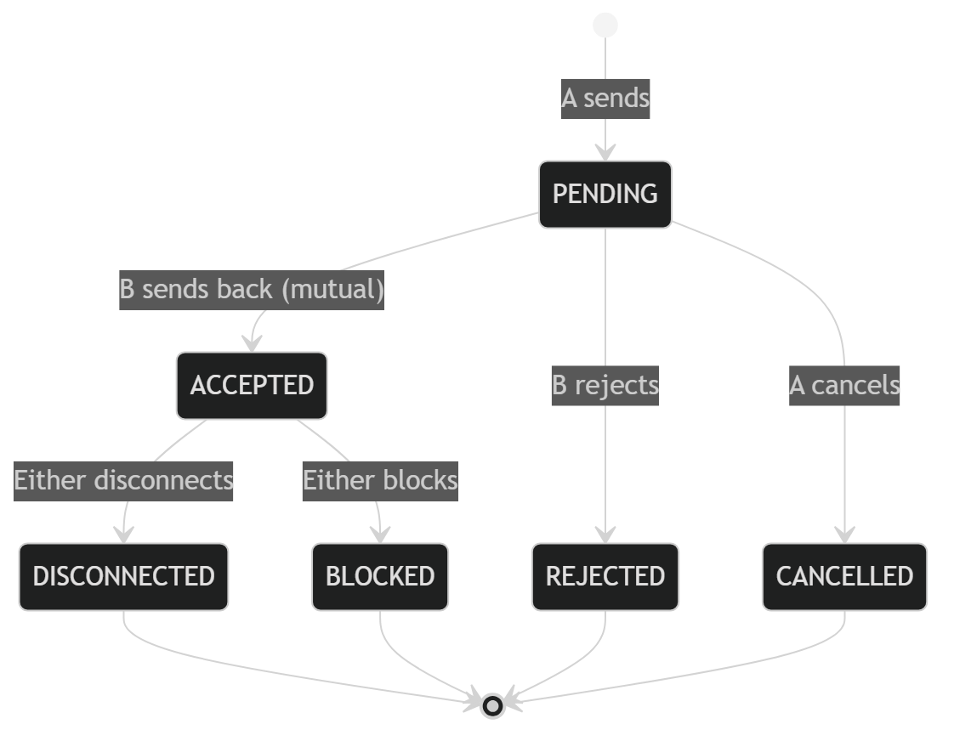
UML
State Machine — Connection

Slide 23
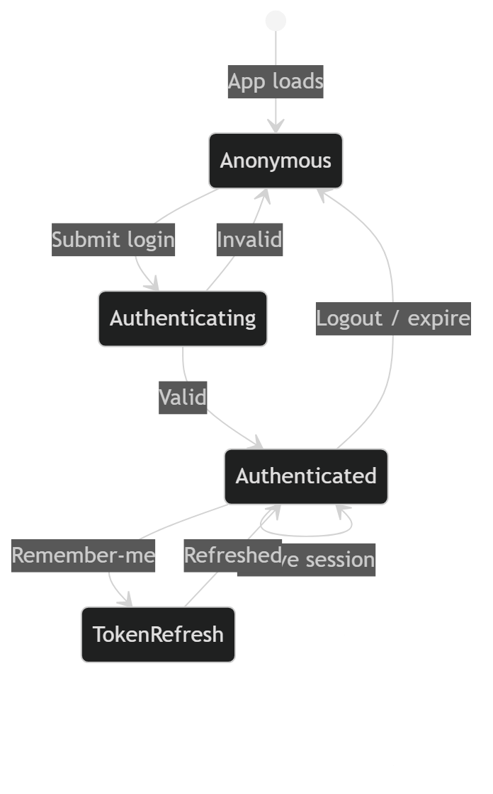
UML
State Machine — User Session

Slide 24
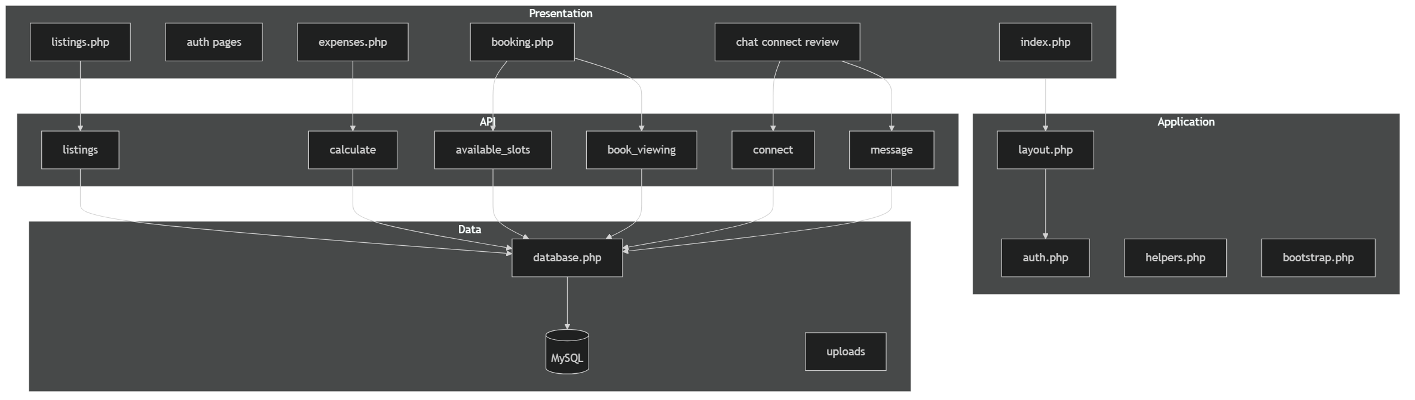
UML
Component Diagram

Slide 25
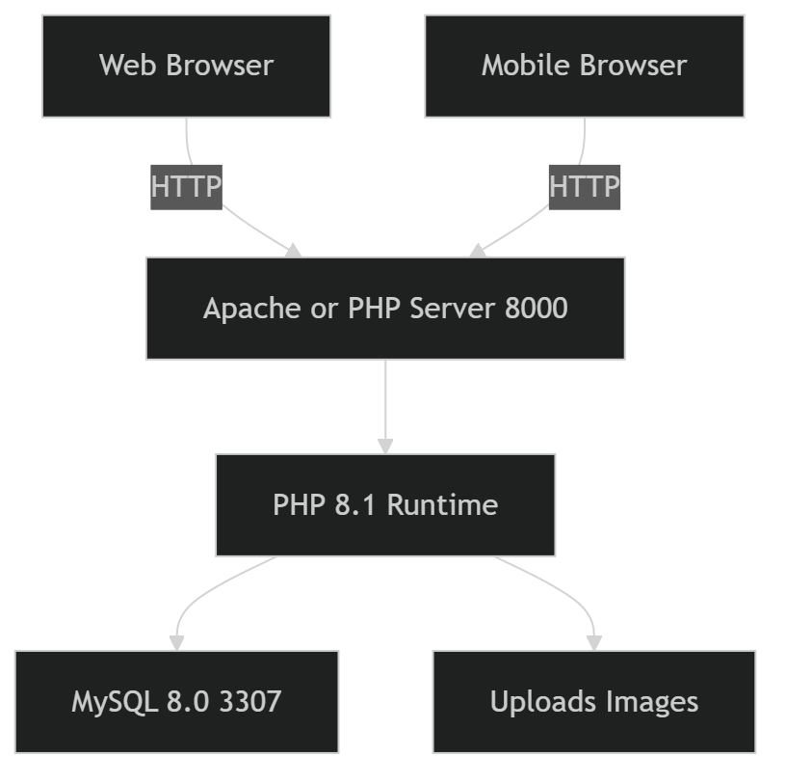
UML
Deployment Diagram

Slide 26
FEATURE DEEP DIVE
Module Highlights
• MarketplaceReal-time fetch() filtering by price, room type & location; debounced 250ms.
• Bill SplitShare = income / combined × total; dynamic roommate rows; optional DB save.
• Booking30-min slots 9:00–17:00; SELECT FOR UPDATE lock; 409 on conflict; transactional.
• Listing UploadJPG/PNG only, 5MB max; house-rule checkboxes; landlord-only via RBAC.
• SocialDouble opt-in Connect; 4s polling Chat with escapeHtml XSS guard; 1–5 reviews.
• AuthSession + remember-me cookie; bcrypt password_hash; roles tenant/landlord/admin.

Slide 27
INTEGRATION
API Endpoints
Method | Endpoint | Purpose
GET | listings.php?api=listings | Filtered listings
POST | expenses.php?api=calculate | Bill split breakdown
GET | booking.php?api=available_slots | Booked slots
POST | booking.php?api=book_viewing | Create appointment
POST | connect_request.php | Send connection
POST | send_message.php | Store message
GET | fetch_messages.php | Poll thread
POST | submit_review.php | Save review
GET | get_user_reviews.php | Aggregated scores

Slide 28
PROCESS
Jira Sprint Management
Scrum board · 4 sprints · 18 stories · 53 points planned, 83 delivered.
Sprint | Goal | Points
1 | Foundation — DB, auth, layout, dashboard | 23
2 | Core — marketplace & bill split | 19
3 | Booking & listing upload | 20
4 | Social, polish, testing, docs | 21
Burndown: all sprints completed on time — 100% delivery across 8 weeks.

Slide 29
QUALITY
Zephyr Test Management
Cycle | Module | Tests | Pass
1 | Authentication | 8 | 8
2 | Marketplace | 6 | 6
3 | Bill Split | 5 | 5
4 | Booking | 7 | 7
5 | Listing Upload | 5 | 5
6 | Social | 8 | 8
7 | Regression | 10 | 10
Total |  | 49 | 49 (100%)

Slide 30
PEOPLE
Team & Work Distribution
• Dadhichi Sarker ShayonTeam Lead / Full-Stack — architecture, auth, social, UI, docs.
• ShawkiBackend — marketplace, bill split, booking, listing upload.
• Plabon BaruaDatabase / Backend — schema, seed, project setup.
Commits: Dadhichi 8 (47%) · Shawki 5 (29%) · Plabon 3 (18%) · Merge 1 (6%).
Branch strategy: main (protected) -> feature branches dadhichi / shawki / plabon.

Slide 31
TRY IT
Demo Accounts & Getting Started
Role | Email | Password
Tenant | ayesha@example.com | Roommate123!
Landlord | rakib@example.com | Roommate123!
Tenant | nusrat@example.com | Roommate123!
Landlord | sajid@example.com | Roommate123!
Tenant | tania@example.com | Roommate123!
• Setup — import schema.sql & seed.sql, then php -S localhost:8000.
• Windows — double-click start_server.bat, open localhost:8000.

Slide 32
ROOMMATESYNC
Find a room, split costs, manage house life — all in one place.
Built with by Team RoommateSync · ISD Course Project, KUET
● PHP 8.1 ● MySQL 8.0 ● 100% Tests Passing ● 7 Modules

