Slide 1
IP Traffic Flow Security Improving IPsec Traffic Flow Confidentiality
Christian Hopps
LabN Consulting, LLC

Slide 2
Why?
Traffic Analysis is the act of extracting information about data being sent through a network (RFC4301, [AppCrypt]).
Need to protect against this.
One may directly obscure data using encryption (IPsec/ESP).
However, the traffic pattern itself exposes information due to variations in its shape and timing ([AppCrypt], [I-D.iab-wire-image], [USENIX]).
Hiding the size and frequency of traffic is referred to as Traffic Flow Confidentiality (TFC) in RFC4303.

Slide 3
Current Available Option: ESP + Padding
RFC4303.
Send fixed-sized ESP packets with padding.
Each ESP packet can only carry 0 or 1 IP packets padded to fixed size.
Sub-optimal performance.
Increased latency.
Low bandwidth.
For many inner packet sizes, the reduction is drastic.

Slide 4
Proposed IPsec Improvement - IP-TFS
Continue to use IPsec/ESP
Fragment and aggregate IP packets into new IPsec/ESP payload.
Minimal latency increase.
Constant High Bandwidth.
Higher than raw Ethernet for small to medium inner packet sizes.

Slide 5
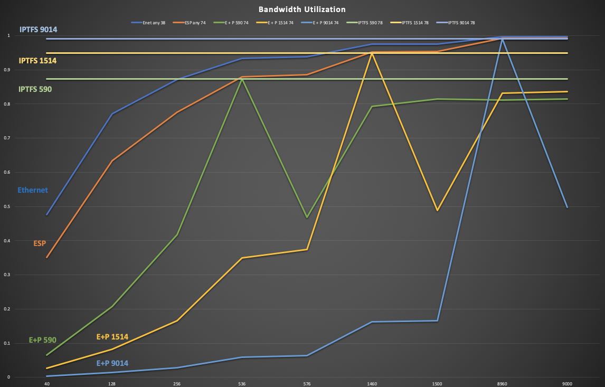

Slide 6
Key Design Points
Improve on existing IPsec (ESP + Padding) option.
Fragment and Aggregate inner packets.
Fixed-size encapsulating packets.
Constant send rate.
Unidirectional.
Congestion Controlled and Non-CC operating modes.
Uses IPsec/ESP.
[Optional] IKEv2 Additions.
Minimize configuration required.

Slide 7
IPsec Transport
Use IPsec/ESP (encrypted encapsulation) as transport.
Input packets are fragmented and aggregated into IPsec/ESP.
New IP Protocol Number for new ESP payload (framing).

Slide 8
Fixed-Size Packets / Constant Send Rate
Packet size never varies.
Packet size manual or automatic configuration.
Can use Path MTU Discovery for automatic optimal configuration.
Constant send rate.
Provides for transport flow confidentiality.

Slide 9
Unidirectional/Bidirectional
Data path is unidirectional.
Sender to Receiver.
Congestion-Control (CC) info is sent in reverse direction.
Receiver to Sender.
Configure 2 paths for bidirectional operation.

Slide 10
Variation Fully Allowed
Egress must accept packets at any rate.
Egress must accept packets of any size.
IPSec tunnels can start in normal "IP Mode", transition to IP-TFS.
SA reset required to leave IP-TFS mode.

Slide 11
Congestion Controlled (CC) Mode
Packet send rate adjusted, as packet size fixed.
Congestion causes packet drops not byte drops.
CC Info sent from Receiver to Sender using IKEv2.
Sender uses CC algorithms to modify packet send rate.
CC algorithm a local choice.
No need to standardize.
Circuit breaking supported.
ECN supported, but off by default.

Slide 12
Non-Congestion-Controlled Mode
For use when IP path bandwidth can be guaranteed.
Packet loss reported by receiver to admin/operations.
Optional CC info can be used to report packet loss from sender.
Optional CC info can be used for circuit breaker.

Slide 13
IKEv2 (CC Info)
Use IKEv2 for CC info advertisement.
Use INFORMATION "exchange" Notification Data.
Periodic send interval (e.g., 1 per second).
CFG_REQUEST/CFG_REPSPONSE used to configure interval.
0 interval allowed for no send.
* Non-reliable transport (*may need to change).

Slide 14
IP-TFS Packet Format
. . . . . . . . . . . . . . . . . . . . . . . . . . . . . . . . . .
. Outer Encapsulating Header ... .
. . . . . . . . . . . . . . . . . . . . . . . . . . . . . . . . . .
. ESP Header... .
+-----------------------------------------------------------------+
|V| Reserved | BlockOffset |
+-----------------------------------------------------------------+
| Data Blocks Payload ... ~
~ |
+-----------------------------------------------------------------|
. ESP Trailer... .
. . . . . . . . . . . . . . . . . . . . . . . . . . . . . . . . . .

Slide 15
ESP Payload Format
1 2 3
0 1 2 3 4 5 6 7 8 9 0 1 2 3 4 5 6 7 8 9 0 1 2 3 4 5 6 7 8 9 0 1 2
+-+-+-+-+-+-+-+-+-+-+-+-+-+-+-+-+-+-+-+-+-+-+-+-+-+-+-+-+-+-+-+-+-+
|V| Reserved | BlockOffset |
+-+-+-+-+-+-+-+-+-+-+-+-+-+-+-+-+-+-+-+-+-+-+-+-+-+-+-+-+-+-+-+-+-+
| DataBlocks ...
+-+-+-+-+-+-+-+-+-+-+-
V :: Version, must be set to zero and dropped if set to 1.
Reserved :: set to 0 ignored on receipt.
Block Offset :: This is the number of bytes before the next IP/IPv6 data block. It can point past the end of the containing packet in which case this packet is the continuation of a preivous one and possibly padding. NOTE: This can point into the next packet and yet the current packet can end with padding. This will happen if there's not enough bytes to start a new inner packet in the current outer packet.
Data Blocks :: variable number of bytes that constitute the start or continuation of a previous data block.

Slide 16
Data Blocks
1 2 3
0 1 2 3 4 5 6 7 8 9 0 1 2 3 4 5 6 7 8 9 0 1 2 3 4 5 6 7 8 9 0 1 2
+-+-+-+-+-+-+-+-+-+-+-+-+-+-+-+-+-+-+-+-+-+-+-+-+-+-+-+-+-+-+-+-+-+
| Type | IPv4, IPv6 or pad...
+-+-+-+-+-+-+-+-+-+-+-+-+-+-+-
Version
0x0 for pad.
0x4 for IPv4.
0x6 for IPv6.

Slide 17
IPv4 Data Blocks
1 2 3
0 1 2 3 4 5 6 7 8 9 0 1 2 3 4 5 6 7 8 9 0 1 2 3 4 5 6 7 8 9 0 1 2
+-+-+-+-+-+-+-+-+-+-+-+-+-+-+-+-+-+-+-+-+-+-+-+-+-+-+-+-+-+-+-+-+-+
| 0x4 | IHL | TypeOfService | TotalLength |
+-+-+-+-+-+-+-+-+-+-+-+-+-+-+-+-+-+-+-+-+-+-+-+-+-+-+-+-+-+-+-+-+-+
| Rest of the inner packet ...
+-+-+-+-+-+-+-+-+-+-+-+-+-+-+-
Version :: 0x4 for IPv4.
Total Length :: Length of the IPv4 inner packet.

Slide 18
IPv6 Data Blocks
1 2 3
0 1 2 3 4 5 6 7 8 9 0 1 2 3 4 5 6 7 8 9 0 1 2 3 4 5 6 7 8 9 0 1 2
+-+-+-+-+-+-+-+-+-+-+-+-+-+-+-+-+-+-+-+-+-+-+-+-+-+-+-+-+-+-+-+-+-+
| 0x6 | TrafficClass | FlowLabel |
+-+-+-+-+-+-+-+-+-+-+-+-+-+-+-+-+-+-+-+-+-+-+-+-+-+-+-+-+-+-+-+-+-+
| TotalLength | Rest of the inner packet ...
+-+-+-+-+-+-+-+-+-+-+-+-+-+-+-+-+-+-+-+-+-+-+-+-+-+-+-+-+-+-
Version :: 0x6 for IPv6.
Total Length :: Length of the IPv4 inner packet.

Slide 19
Pad Data Blocks
1 2 3
0 1 2 3 4 5 6 7 8 9 0 1 2 3 4 5 6 7 8 9 0 1 2 3 4 5 6 7 8 9 0 1 2
+-+-+-+-+-+-+-+-+-+-+-+-+-+-+-+-+-+-+-+-+-+-+-+-+-+-+-+-+-+-+-+-+-+
| 0x0 | Padding ...
+-+-+-+-+-+-+-+-+-+-+-
Version :: 0x0 for Padding.
Padding :: extends to end of the encapsulating packet.

Slide 20
IKEv2 Config CC Info Sending Interval Attribute
1 2 3
0 1 2 3 4 5 6 7 8 9 0 1 2 3 4 5 6 7 8 9 0 1 2 3 4 5 6 7 8 9 0 1 2
+-+-+-+-+-+-+-+-+-+-+-+-+-+-+-+-+-+-+-+-+-+-+-+-+-+-+-+-+-+-+-+-+-+
|R| Attribute Type | Length |
+-+-+-+-+-+-+-+-+-+-+-+-+-+-+-+-+-+-+-+-+-+-+-+-+-+-+-+-+-+-+-+-+-+
| Interval |
+-+-+-+-+-+-+-+-+-+-+-+-+-+-+-+-+
R:: 1 bit set to 0.
Attribute Type:: 15 bit value set to TFS_INFO_INTERVAL (TBD).
Length:: 2 octet length set to 2.
Interval :: 2 octet unsigned integer. The sending interval in milliseconds.

Slide 21
CC Info Notification Data
1 2 3
0 1 2 3 4 5 6 7 8 9 0 1 2 3 4 5 6 7 8 9 0 1 2 3 4 5 6 7 8 9 0 1 2
+-+-+-+-+-+-+-+-+-+-+-+-+-+-+-+-+-+-+-+-+-+-+-+-+-+-+-+-+-+-+-+-+-+
|E| Reserved | DropCount |
+-+-+-+-+-+-+-+-+-+-+-+-+-+-+-+-+-+-+-+-+-+-+-+-+-+-+-+-+-+-+-+-+-+
| Timestamp |
+-+-+-+-+-+-+-+-+-+-+-+-+-+-+-+-+-+-+-+-+-+-+-+-+-+-+-+-+-+-+-+-+-+
| AckSeqStart |
+-+-+-+-+-+-+-+-+-+-+-+-+-+-+-+-+-+-+-+-+-+-+-+-+-+-+-+-+-+-+-+-+-+
| AckSeqEnd |
+-+-+-+-+-+-+-+-+-+-+-+-+-+-+-+-+-+-+-+-+-+-+-+-+-+-+-+-+-+-+-+-+-+
E :: A 1 bit value that if set indicates that packet[s] with Congestion Experienced (CE) ECN bits set were received and used in calculating the DropCount value.
Reserved :: set to 0 ignored on receipt.
DropCount:: For ack data block this is the drop count between AckSeqStart and AckSeqEnd, If the drops exceed the resolution of the counter then set to the max value.
Timestamp :: The time when this notification was created and sent.
AckESPSeqStart :: The first ESP Seq. Num. of the range that this information relates to.
AckESPSeqEnd :: The last ESP Seq. Num. of the range that this information relates to.

Slide 22
Comparison Data

Slide 23
Overhead Comparison in Octets
| Type | ESP+Pad | ESP+Pad | ESP+Pad | IP-TFS | IP-TFS | IP-TFS |
| L3 MTU | 576 | 1500 | 9000 | 576 | 1500 | 9000 |
| PSize | 540 | 1464 | 8964 | 536 | 1460 | 8960 |
|--------+---------+---------+---------+--------+--------+--------|
| 40 | 500 | 1424 | 8924 | 3.0 | 1.1 | 0.2 |
| 128 | 412 | 1336 | 8836 | 9.6 | 3.5 | 0.6 |
| 256 | 284 | 1208 | 8708 | 19.1 | 7.0 | 1.1 |
| 536 | 4 | 928 | 8428 | 40.0 | 14.7 | 2.4 |
| 576 | 576 | 888 | 8388 | 43.0 | 15.8 | 2.6 |
| 1460 | 268 | 4 | 7504 | 109.0 | 40.0 | 6.5 |
| 1500 | 228 | 1500 | 7464 | 111.9 | 41.1 | 6.7 |
| 8960 | 1408 | 1540 | 4 | 668.7 | 245.5 | 40.0 |
| 9000 | 1368 | 1500 | 9000 | 671.6 | 246.6 | 40.2 |

Slide 24
Overhead as Percentage of Inner Packet
| Type | ESP+Pad | ESP+Pad | ESP+Pad | IP-TFS | IP-TFS | IP-TFS |
| MTU | 576 | 1500 | 9000 | 576 | 1500 | 9000 |
| PSize | 540 | 1464 | 8964 | 536 | 1460 | 8960 |
|-------+---------+---------+----------+--------+--------+--------|
| 40 | 1250.0% | 3560.0% | 22310.0% | 7.46% | 2.74% | 0.45% |
| 128 | 321.9% | 1043.8% | 6903.1% | 7.46% | 2.74% | 0.45% |
| 256 | 110.9% | 471.9% | 3401.6% | 7.46% | 2.74% | 0.45% |
| 536 | 0.7% | 173.1% | 1572.4% | 7.46% | 2.74% | 0.45% |
| 576 | 100.0% | 154.2% | 1456.2% | 7.46% | 2.74% | 0.45% |
| 1460 | 18.4% | 0.3% | 514.0% | 7.46% | 2.74% | 0.45% |
| 1500 | 15.2% | 100.0% | 497.6% | 7.46% | 2.74% | 0.45% |
| 8960 | 15.7% | 17.2% | 0.0% | 7.46% | 2.74% | 0.45% |
| 9000 | 15.2% | 16.7% | 100.0% | 7.46% | 2.74% | 0.45% |

Slide 25
Bandwidth Utilization over Ethernet
| | Enet | ESP | E + P | E + P | E + P | IPTFS | IPTFS | IPTFS |
| | any | any | 590 | 1514 | 9014 | 590 | 1514 | 9014 |
| Size | 38 | 74 | 74 | 74 | 74 | 78 | 78 | 78 |
|------+-------+-------+-------+-------+-------+-------+-------+-------|
| 40 | 47.6% | 35.1% | 6.5% | 2.6% | 0.4% | 87.3% | 94.9% | 99.1% |
| 128 | 77.1% | 63.4% | 20.8% | 8.3% | 1.4% | 87.3% | 94.9% | 99.1% |
| 256 | 87.1% | 77.6% | 41.7% | 16.6% | 2.8% | 87.3% | 94.9% | 99.1% |
| 536 | 93.4% | 87.9% | 87.3% | 34.9% | 5.9% | 87.3% | 94.9% | 99.1% |
| 576 | 93.8% | 88.6% | 46.9% | 37.5% | 6.4% | 87.3% | 94.9% | 99.1% |
| 1460 | 97.5% | 95.2% | 79.3% | 94.9% | 16.2% | 87.3% | 94.9% | 99.1% |
| 1500 | 97.5% | 95.3% | 81.4% | 48.8% | 16.6% | 87.3% | 94.9% | 99.1% |
| 8960 | 99.6% | 99.2% | 81.1% | 83.2% | 99.1% | 87.3% | 94.9% | 99.1% |
| 9000 | 99.6% | 99.2% | 81.4% | 83.6% | 49.8% | 87.3% | 94.9% | 99.1% |

Slide 26
Latency
Latency values seem very similar
IP-TFS values represent max latency
IP-TFS provides for constant high bandwidth
ESP + padding value represents min latency
ESP + padding often greatly reduces available bandwidth.
| | ESP+Pad | ESP+Pad | IP-TFS | IP-TFS |
| | 1500 | 9000 | 1500 | 9000 |
| | | | | |
|------+---------+---------+---------+---------|
| 40 | 1.14 us | 7.14 us | 1.17 us | 7.17 us |
| 128 | 1.07 us | 7.07 us | 1.10 us | 7.10 us |
| 256 | 0.97 us | 6.97 us | 1.00 us | 7.00 us |
| 536 | 0.74 us | 6.74 us | 0.77 us | 6.77 us |
| 576 | 0.71 us | 6.71 us | 0.74 us | 6.74 us |
| 1460 | 0.00 us | 6.00 us | 0.04 us | 6.04 us |
| 1500 | 1.20 us | 5.97 us | 0.00 us | 6.00 us |

Slide 27
Related Work – IEEE
An Ethernet TFS problem statement along with high level requirements were presented to the 802.1 Security Task Force at March 2019 meeting.
http://www.ieee802.org/1/files/public/docs2019/new-fedyk-traffic-flow-security-0219.pdf
The group discussed complementary amendments to 802.1AE Media Access Control (MAC) Security (MACsec) to address the requirements and fit with existing MACsec.
Progress on the above is anticipated in upcoming interim meetings.

Slide 28
Running Code
https://github.com/LabNConsulting/iptfs [will be present by meeting]
Proof-of-concept code.
IP in UDP tunnel encapsulation.
UDP stands in for ESP
Implements new IP-TFS payload.
Inner packet fragmentation and aggregation using Datablocks
Implements Congestion Control Info Reports.
Sent in UDP rather than IKEv2.
Auto-adjusts send rate correctly based on congestion.
2 implementations (Python and C).

Slide 29
Open Issues
CC Information Report transmission.
Message IDs use.
Full INFO exchange (reliable not really needed)
The CC data is basically telemetry that doesn't need to be reliably delivered for TFS to function correctly.
If reverse direction is lossy could cause TFS tunnel teardown when there is no actual issue with the tunnel traffic.
Would it be useful to generalize/legitimize this "in-SA" unreliable notification in IKEv2?
Could do this separately, and use normal exchange method for now.

Slide 30
Questions and Comments

Slide 31
References
[AppCrypt] - B. Schneier, "Applied Cryptography: Protocols, Algorithms, and Source Code in C", Nov, 2017.
[I-D.iab-wire-image] - B. Trammell, M. Kuehlewind, "The Wire Image of a Network Protocol", Nov 05, 2018
https://datatracker.ietf.org/doc/draft-iab-wire-image
[USENIX] - R. Schuster, V. Shmatikov, and E. Tromer, “Beauty and the Burst: Remote Identification of Encrypted Video Streams” 26th USENIX Security Symposium, August 16–18, 2017, Vancouver, BC, Canada
https://www.usenix.org/conference/usenixsecurity17/technical-sessions/presentation/schuster

