Slide 1
IP Traffic Flow Security Improving IPsec Traffic Flow Confidentiality IETF 105 – draft-hopps-ipsecme-iptfs-01 Update
Christian Hopps
LabN Consulting, LLC

Slide 2
Why is this Needed?
Current Solution: ESP + Padding 1:1
Not Deployable.
Solution Cost (I-Mix)
 | ESP + Pad | IPTFS | Enet
Bandwidth Used | 1Gb | 1Gb | 1Gb
I-Mix Throughput | 219Mb | 943Mb | 672Mb

Slide 3
Update From version-00
Updates based on comments received on mailing list and during IETF104 from ipsecme and TSV folks.
IKEv2 TFS Type transform type introduced.
Notification Status Message for indicating dont-fragment.
Congestion Control information is now in-band, instead of using IKE.
Congestion Control information and text changed to align with published TCP friendly congestion control algorithms.
Appendix illustrating how to implement TCP friendly CC algorithm.

Slide 4
New IKEv2 Transform Type – TFS
New Transform Type “TFS Type” (TBD - 6?).
0 – None.
1 – TFS_IPTFS_CC (congestion controlled).
2 – TFS_IPTFS_NOCC (non-congestion controlled).
Used during Child SA establishment (SA_INIT and CREATE_CHILD_SA)

Slide 5
New IPTFS_REQUIREMENTS Notify Message
Sent during SA_INIT (or CHILD_CREATE) when accepting TFS transform to indicate the sender should only aggregate and not fragment packets.
1 octet of flag data.
+-+-+-+-+-+-+-+-+
|0|0|0|0|0|0|0|D|
+-+-+-+-+-+-+-+-+
1 bit defined – “D bit” for don’t Fragment.

Slide 6
IP-TFS (updated) Packet Format
. . . . . . . . . . . . . . . . . . . . . . . . . . . . . . . . . .
. Outer Encapsulating Header ... .
. . . . . . . . . . . . . . . . . . . . . . . . . . . . . . . . . .
. ESP Header... .
+-----------------------------------------------------------------+
|V|C| Reserved | BlockOffset |
+-----------------------------------------------------------------+
: [Optional Congestion Info] :
+-----------------------------------------------------------------+
| Data Blocks Payload ... ~
~ |
+-----------------------------------------------------------------|
. ESP Trailer... .
. . . . . . . . . . . . . . . . . . . . . . . . . . . . . . . . . .

Slide 7
ESP Congestion Control Payload Format
1 2 3
0 1 2 3 4 5 6 7 8 9 0 1 2 3 4 5 6 7 8 9 0 1 2 3 4 5 6 7 8 9 0 1
+-+-+-+-+-+-+-+-+-+-+-+-+-+-+-+-+-+-+-+-+-+-+-+-+-+-+-+-+-+-+-+-+
|V|C|E| Reserved | BlockOffset |
+-+-+-+-+-+-+-+-+-+-+-+-+-+-+-+-+-+-+-+-+-+-+-+-+-+-+-+-+-+-+-+-+
| RTT | Delay |
+-+-+-+-+-+-+-+-+-+-+-+-+-+-+-+-+-+-+-+-+-+-+-+-+-+-+-+-+-+-+-+-+
| LossEventRate |
+-+-+-+-+-+-+-+-+-+-+-+-+-+-+-+-+-+-+-+-+-+-+-+-+-+-+-+-+-+-+-+-+
| LastSeqNum |
+-+-+-+-+-+-+-+-+-+-+-+-+-+-+-+-+-+-+-+-+-+-+-+-+-+-+-+-+-+-+-+-+
| DataBlocks ...
+-+-+-+-+-+-+-+-+-+-+-
C :: Congestion Control set to 1 for this format, 0 for Non-CC.
E :: ECN bit were used in calculating the LossEventRate.
RTT :: Sender’s round trip time estimate in milliseconds.
Delay :: Millisecond estimate between receiver receiving LastSeqNum, and sending this info.
LossEventRate :: 1/LossEventRate is the receivers calculation of the current loss event rate
LastSeqNum :: The latest sequence number received by the receiver.

Slide 8
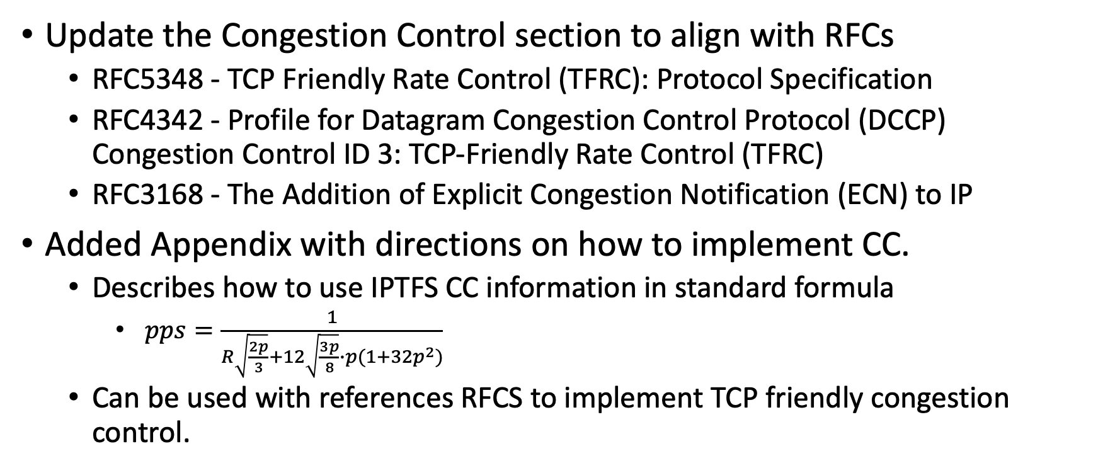
TCP Friendly Congestion Control
Update the Congestion Control section to align with RFCs
RFC5348 - TCP Friendly Rate Control (TFRC): Protocol Specification
RFC4342 - Profile for Datagram Congestion Control Protocol (DCCP) Congestion Control ID 3: TCP-Friendly Rate Control (TFRC)
RFC3168 - The Addition of Explicit Congestion Notification (ECN) to IP
Added Appendix with directions on how to implement CC.
Describes how to use IPTFS CC information in standard formula
$pps=\frac{1}{R\sqrt{\frac{2p}{3}}+12\sqrt{\frac{3p}{8}}∙p(1+32p^{2})}$
Can be used with references RFCS to implement TCP friendly congestion control.

Slide 9
Summary
Updated based on WG comments.
Congestion control
Don’t Fragment
Update based on implementation experience.
IKEv2 Transform Type
CC Algorithm implementation guidance.
Ready for WG Adoption?

Slide 10
Questions and Comments

Slide 11
Backup Slides

Slide 12
Key Design Points
Improve on existing IPsec (ESP + Padding) option.
Fragment and Aggregate inner packets.
Fixed-size encapsulating packets.
Constant send rate.
Unidirectional.
Congestion Controlled and Non-CC operating modes.
Uses IPsec/ESP.
[Optional] IKEv2 Additions.
Minimize configuration required.

Slide 13
Comparison Data

Slide 14
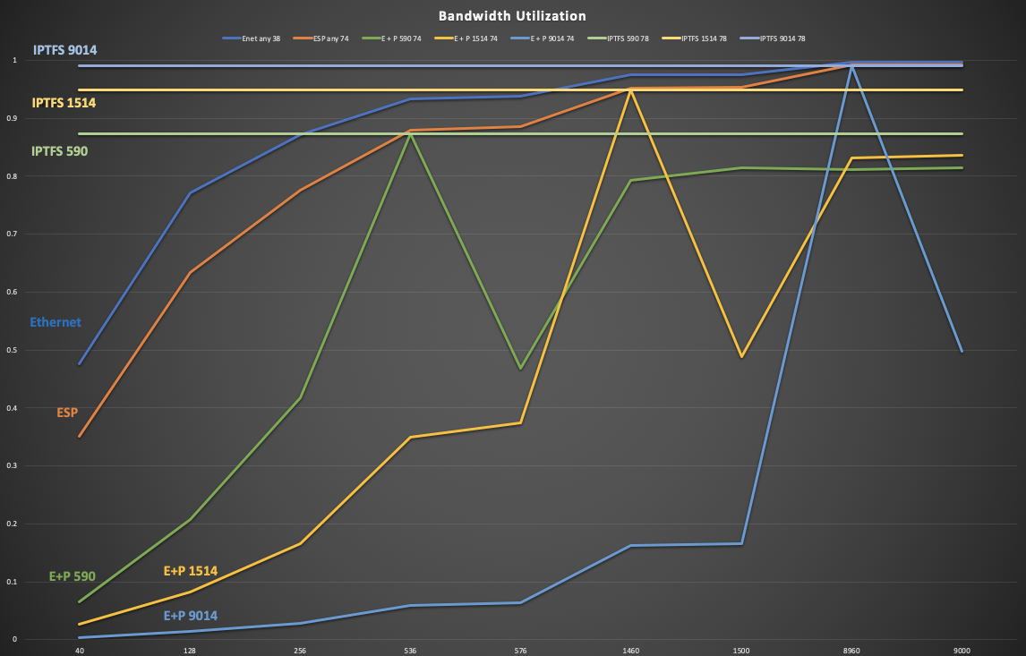

Slide 15
Overhead Comparison in Octets
| Type | ESP+Pad | ESP+Pad | ESP+Pad | IP-TFS | IP-TFS | IP-TFS |
| L3 MTU | 576 | 1500 | 9000 | 576 | 1500 | 9000 |
| PSize | 540 | 1464 | 8964 | 536 | 1460 | 8960 |
|--------+---------+---------+---------+--------+--------+--------|
| 40 | 500 | 1424 | 8924 | 3.0 | 1.1 | 0.2 |
| 128 | 412 | 1336 | 8836 | 9.6 | 3.5 | 0.6 |
| 256 | 284 | 1208 | 8708 | 19.1 | 7.0 | 1.1 |
| 536 | 4 | 928 | 8428 | 40.0 | 14.7 | 2.4 |
| 576 | 576 | 888 | 8388 | 43.0 | 15.8 | 2.6 |
| 1460 | 268 | 4 | 7504 | 109.0 | 40.0 | 6.5 |
| 1500 | 228 | 1500 | 7464 | 111.9 | 41.1 | 6.7 |
| 8960 | 1408 | 1540 | 4 | 668.7 | 245.5 | 40.0 |
| 9000 | 1368 | 1500 | 9000 | 671.6 | 246.6 | 40.2 |

Slide 16
Overhead as Percentage of Inner Packet
| Type | ESP+Pad | ESP+Pad | ESP+Pad | IP-TFS | IP-TFS | IP-TFS |
| MTU | 576 | 1500 | 9000 | 576 | 1500 | 9000 |
| PSize | 540 | 1464 | 8964 | 536 | 1460 | 8960 |
|-------+---------+---------+----------+--------+--------+--------|
| 40 | 1250.0% | 3560.0% | 22310.0% | 7.46% | 2.74% | 0.45% |
| 128 | 321.9% | 1043.8% | 6903.1% | 7.46% | 2.74% | 0.45% |
| 256 | 110.9% | 471.9% | 3401.6% | 7.46% | 2.74% | 0.45% |
| 536 | 0.7% | 173.1% | 1572.4% | 7.46% | 2.74% | 0.45% |
| 576 | 100.0% | 154.2% | 1456.2% | 7.46% | 2.74% | 0.45% |
| 1460 | 18.4% | 0.3% | 514.0% | 7.46% | 2.74% | 0.45% |
| 1500 | 15.2% | 100.0% | 497.6% | 7.46% | 2.74% | 0.45% |
| 8960 | 15.7% | 17.2% | 0.0% | 7.46% | 2.74% | 0.45% |
| 9000 | 15.2% | 16.7% | 100.0% | 7.46% | 2.74% | 0.45% |

Slide 17
Bandwidth Utilization over Ethernet
| | Enet | ESP | E + P | E + P | E + P | IPTFS | IPTFS | IPTFS |
| | any | any | 590 | 1514 | 9014 | 590 | 1514 | 9014 |
| Size | 38 | 74 | 74 | 74 | 74 | 78 | 78 | 78 |
|------+-------+-------+-------+-------+-------+-------+-------+-------|
| 40 | 47.6% | 35.1% | 6.5% | 2.6% | 0.4% | 87.3% | 94.9% | 99.1% |
| 128 | 77.1% | 63.4% | 20.8% | 8.3% | 1.4% | 87.3% | 94.9% | 99.1% |
| 256 | 87.1% | 77.6% | 41.7% | 16.6% | 2.8% | 87.3% | 94.9% | 99.1% |
| 536 | 93.4% | 87.9% | 87.3% | 34.9% | 5.9% | 87.3% | 94.9% | 99.1% |
| 576 | 93.8% | 88.6% | 46.9% | 37.5% | 6.4% | 87.3% | 94.9% | 99.1% |
| 1460 | 97.5% | 95.2% | 79.3% | 94.9% | 16.2% | 87.3% | 94.9% | 99.1% |
| 1500 | 97.5% | 95.3% | 81.4% | 48.8% | 16.6% | 87.3% | 94.9% | 99.1% |
| 8960 | 99.6% | 99.2% | 81.1% | 83.2% | 99.1% | 87.3% | 94.9% | 99.1% |
| 9000 | 99.6% | 99.2% | 81.4% | 83.6% | 49.8% | 87.3% | 94.9% | 99.1% |

Slide 18
Latency
Latency values seem very similar
IP-TFS values represent max latency
IP-TFS provides for constant high bandwidth
ESP + padding value represents min latency
ESP + padding often greatly reduces available bandwidth.
| | ESP+Pad | ESP+Pad | IP-TFS | IP-TFS |
| | 1500 | 9000 | 1500 | 9000 |
| | | | | |
|------+---------+---------+---------+---------|
| 40 | 1.14 us | 7.14 us | 1.17 us | 7.17 us |
| 128 | 1.07 us | 7.07 us | 1.10 us | 7.10 us |
| 256 | 0.97 us | 6.97 us | 1.00 us | 7.00 us |
| 536 | 0.74 us | 6.74 us | 0.77 us | 6.77 us |
| 576 | 0.71 us | 6.71 us | 0.74 us | 6.74 us |
| 1460 | 0.00 us | 6.00 us | 0.04 us | 6.04 us |
| 1500 | 1.20 us | 5.97 us | 0.00 us | 6.00 us |

Slide 19
Data Blocks
1 2 3
0 1 2 3 4 5 6 7 8 9 0 1 2 3 4 5 6 7 8 9 0 1 2 3 4 5 6 7 8 9 0 1 2
+-+-+-+-+-+-+-+-+-+-+-+-+-+-+-+-+-+-+-+-+-+-+-+-+-+-+-+-+-+-+-+-+-+
| Type | IPv4, IPv6 or pad...
+-+-+-+-+-+-+-+-+-+-+-+-+-+-+-
Version
0x0 for pad.
0x4 for IPv4.
0x6 for IPv6.

Slide 20
IPv4 Data Blocks
1 2 3
0 1 2 3 4 5 6 7 8 9 0 1 2 3 4 5 6 7 8 9 0 1 2 3 4 5 6 7 8 9 0 1 2
+-+-+-+-+-+-+-+-+-+-+-+-+-+-+-+-+-+-+-+-+-+-+-+-+-+-+-+-+-+-+-+-+-+
| 0x4 | IHL | TypeOfService | TotalLength |
+-+-+-+-+-+-+-+-+-+-+-+-+-+-+-+-+-+-+-+-+-+-+-+-+-+-+-+-+-+-+-+-+-+
| Rest of the inner packet ...
+-+-+-+-+-+-+-+-+-+-+-+-+-+-+-
Version :: 0x4 for IPv4.
Total Length :: Length of the IPv4 inner packet.

Slide 21
IPv6 Data Blocks
1 2 3
0 1 2 3 4 5 6 7 8 9 0 1 2 3 4 5 6 7 8 9 0 1 2 3 4 5 6 7 8 9 0 1 2
+-+-+-+-+-+-+-+-+-+-+-+-+-+-+-+-+-+-+-+-+-+-+-+-+-+-+-+-+-+-+-+-+-+
| 0x6 | TrafficClass | FlowLabel |
+-+-+-+-+-+-+-+-+-+-+-+-+-+-+-+-+-+-+-+-+-+-+-+-+-+-+-+-+-+-+-+-+-+
| TotalLength | Rest of the inner packet ...
+-+-+-+-+-+-+-+-+-+-+-+-+-+-+-+-+-+-+-+-+-+-+-+-+-+-+-+-+-+-
Version :: 0x6 for IPv6.
Total Length :: Length of the IPv4 inner packet.

Slide 22
Pad Data Blocks
1 2 3
0 1 2 3 4 5 6 7 8 9 0 1 2 3 4 5 6 7 8 9 0 1 2 3 4 5 6 7 8 9 0 1 2
+-+-+-+-+-+-+-+-+-+-+-+-+-+-+-+-+-+-+-+-+-+-+-+-+-+-+-+-+-+-+-+-+-+
| 0x0 | Padding ...
+-+-+-+-+-+-+-+-+-+-+-
Version :: 0x0 for Padding.
Padding :: extends to end of the encapsulating packet.

Slide 23
Related Work – IEEE
An Ethernet TFS problem statement along with high level requirements were presented to the 802.1 Security Task Force at March 2019 meeting.
http://www.ieee802.org/1/files/public/docs2019/new-fedyk-traffic-flow-security-0219.pdf
The group discussed complementary amendments to 802.1AE Media Access Control (MAC) Security (MACsec) to address the requirements and fit with existing MACsec.
Progress on the above is anticipated in upcoming interim meetings.

Slide 24
Running Code
https://github.com/LabNConsulting/iptfs [will be present by meeting]
Proof-of-concept code.
IP in UDP tunnel encapsulation.
UDP stands in for ESP
Implements new IP-TFS payload.
Inner packet fragmentation and aggregation using Datablocks
Implements Congestion Control Info Reports.
Sent in UDP rather than IKEv2.
Auto-adjusts send rate correctly based on congestion.
2 implementations (Python and C).

Slide 25
References
[AppCrypt] - B. Schneier, "Applied Cryptography: Protocols, Algorithms, and Source Code in C", Nov, 2017.
[I-D.iab-wire-image] - B. Trammell, M. Kuehlewind, "The Wire Image of a Network Protocol", Nov 05, 2018
https://datatracker.ietf.org/doc/draft-iab-wire-image
[USENIX] - R. Schuster, V. Shmatikov, and E. Tromer, “Beauty and the Burst: Remote Identification of Encrypted Video Streams” 26th USENIX Security Symposium, August 16–18, 2017, Vancouver, BC, Canada
https://www.usenix.org/conference/usenixsecurity17/technical-sessions/presentation/schuster

