Slide 1
ATTENTION

Slide 2
Cue trigger
Attention
trigger
Probe trigger
c
c
c
c
c
c
+
Cue
Attention
Response
Note response probe is on for 500 ms only
500 ms
500 ms
500 ms
2000 ms
Self-terminating
Three blocks (pop-out), repeated color (habitual), change color (flexible).
150 trials of each type is plenty
At max 3.5 sec per trial, that’s 17 trials/minute. A 75 trial block would last ~ 5 minutes, less if they respond quickly.
6 blocks of 75 stimuli would be ~30 minutes.
We still need to decide if we run separate blocks or interleave. For habitual, we would need to decide on how many a row if so.

Slide 3
Cue
Attention
Probe
c
c
c
c
c
No up/down
c

Slide 4
Cue
Attention
Probe
c
c
c
c
Pop Out
c
c
c
c
c
c
c
c
c
c
c
c
c
c
c
c
Habitual
c
c
c
c
c
c
c
c
c
c
c
c
Flex
c
c
c
c

Slide 5
0. INSTRUCTIONS?
Cue
Attention
Probe
c
c
c
c
Pop Out
c
c
c
c
c
c
c
c
1. Distractor can be different colors within a block?
c
c
c
c
c
c
c
c
Habitual
c
c
c
c
2. Hab/pop cue differs every blocks?
c
c
c
c
c
c
c
c
Flex
c
c
c
c
3. Only one type (hab, pop,flex) per block?

Slide 6
fMRI Timing Optimization
c
c
c
c
c
c
c
c
c
c
c
c
2 types of catch trials?
FIX
CUE
ATT
PROB
BLANK
c
c
+
c
c
c
c
Jitter
Fixed .5s
Fixed
.5s
RT
(fixed .5s)
RT - .5s || 1.5 s
testing efficency of PROB with jittered fixation
4 stims
c
c
c
c
c
c
c
c
c
c
c
c
c
c
c
c
c
c
c
c
c
c
c
c
Right-Left
Right-Right
Left-Right
Left-Left

Slide 7
Working Memory

Slide 8
Basic layout for the lateralized vSTM task
Background is medium gray
3° x 7° grid 1.5° to the left and right of central fixation
Filled circles subtend 0.65°
Circles appear randomly in grids
Circles selected without replacement independently for each side from 8 colors: black, purple, green, light blue, pink, red, yellow, white. Since all are used randomly on each side luminance and contrast are OK.
Load on each trial varies between 1, 3, and 5, matched bilaterally
Only one color changes if there is a change, location does not
Crucial references: Ikkai, McCollough, Vogel, 2010, J Neurophysiol; Robitaille, Grimault, Jolicoeur, 2009, Psychophysiology

Slide 9
Left trigger
Right trigger
Set trigger
Delay trigger
Probe trigger
Same array
+
Cue left/right, prepare
Memory Set
Delay
Same Lt, dif Rt array
Same Rt, dif Lt array
Note preparatory period is part of this epoch
Both dif array
500 ms
500 ms
300 ms
1000 ms
2000 ms max
Response-terminated
Eight combinations per load: attend left or right, no change, attend change, ignore change, both change.
If we collapse across attended hemifield, we can get 50 trials of each doing 200 trials per load (600 total).
At max 5 sec per trial, that’s 12 trials/minute. A 100 trial block would last ~ 8 minutes, less if they respond quickly.
Two blocks of 100 stimuli would be ~16 minutes, by 3 loads would be ~ 48. We need a minimum of 50 trials to get signal in the EEG/MEG I would think.
Ultimately, we would collapse across only what happened in the attended field, and 100 trials is our target.

Slide 10
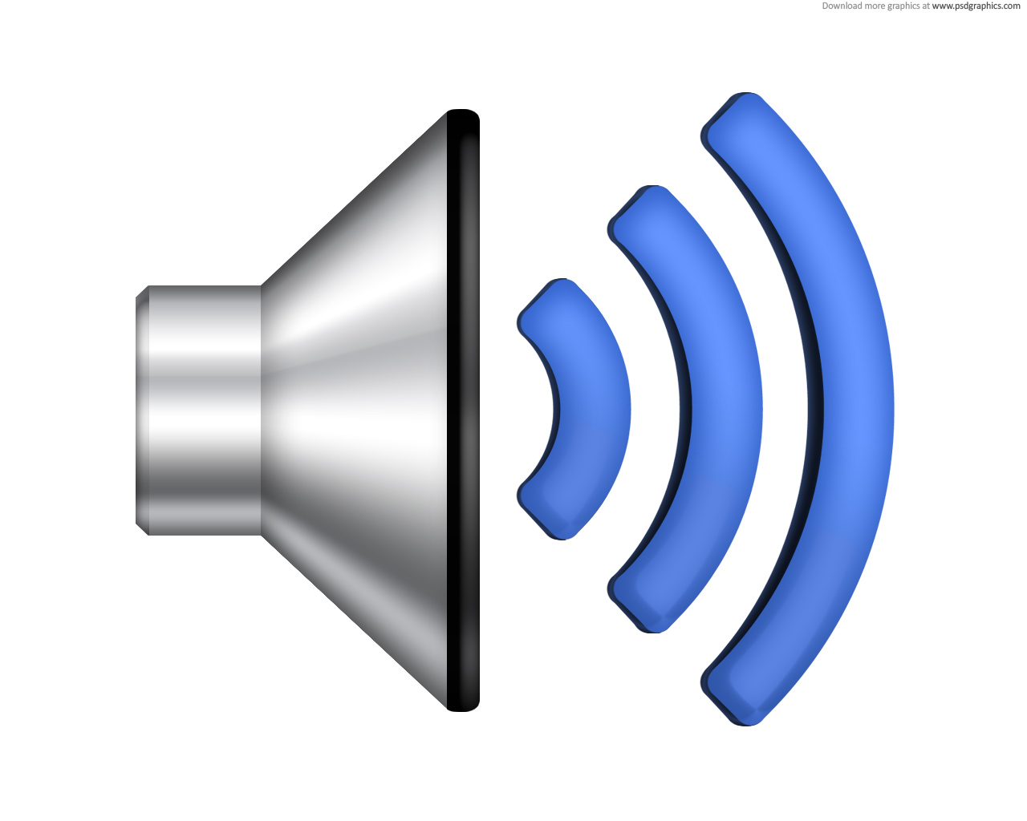
||
+
+
+
+
+
Same array
Same Lt, dif Rt array
+
+
+
Cue left/right, prepare
Memory Set
Delay
Same Rt, dif Lt array
Both dif array
.5 s
.5 s
.3 s
1 s
RT || 2 s
+

Slide 11
||
1. Word “left” or isolated channel (left/right)
+
+
+
+
+
Same array
Same Lt, dif Rt array
+
+
+
Cue left/right, prepare
Memory Set
Delay
Same Rt, dif Lt array
Both dif array
Jitter
.5 s
.3 s
1 s
RT || 2 s
+
2. Load interleaved or blocked?
3. Instructions? index for same, middle for different
Left: index same, middle diff
Right: middle same, index diff
two button gloves?
Notes:
Ikkai et al 2010 used arrows over fixation instead of sound?

Slide 12
||
+
+
+
+
+
Same array
Same Lt, dif Rt array
+
+
Fix
Cue
Mem
Delay
Same Rt, dif Lt array
Both dif array
Jitter
.5 s
.3 s
1 s
RT || 2 s
+
fMRI Timing Optimization
Side (2) X Change (4) => 8 stims
3 catch trial types?
Cue
cue+mem
cue+mem+delay
Optimize Response?
All equal?
Max catch trials?

