Slide 1
Tasks

Slide 2
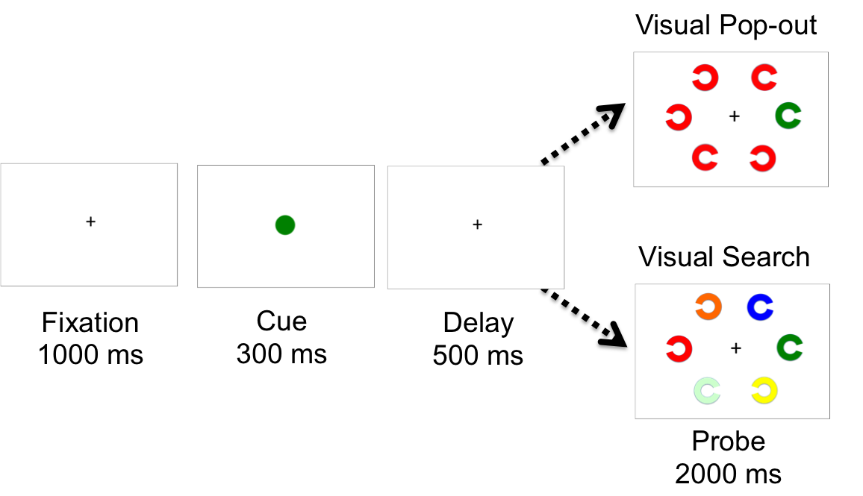
Attention
Relative contributions of bottom-up and top-down processes

Slide 3
Increasing ATT demands
C
C
Visual Pop-out task (Habitual)
Same color of cue and stimuli across trials
Perceptual oddball (distractors same color)
Bottom-up aids Top Down response
Visual Search task (Habitual)
Same color of cue and stimuli across trials
Distractors different color
Top down but enhanced by “habit”
Visual Search task in “flexible” mode.
Different color of cue and stimuli across trials
Top down predominant
C
C
C
C
C
C
Notes:
Cue= will need to direct attention to same color later
Stimuli: respond indicating location (L or R) of gap in color cued stimuli

Slide 4
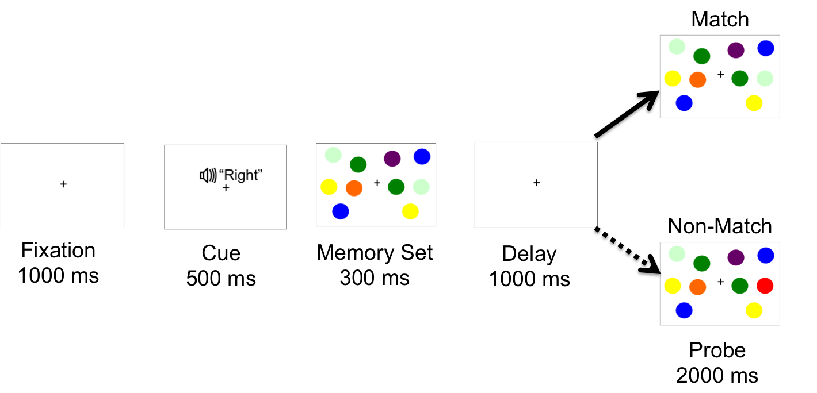
Working Memory
Dissociating location from mnemonic processes which may be supported in a distinct fashion in V1, PPC, and DLPFC

Slide 5
Increasing WM demands
1 Load item
+
3 Load item
+
5 Load item
+
Notes:
Cue= will need to direct attention to same color later
Stimuli: respond indicating location (L or R) of gap in color cued stimuli

Slide 6
Analyses
Regional Activation of V1, PPC, DLPFC
fMRI BOLD activation during encoding, maintenance, retrieval
M/EEG: local oscillatory activity
Functional Connectivity V1-PPC/PPC-DLPFC
fMRI: Strength and organization of resting state and task based functional connectivity
M/EEG frequency specific coupling

