Slide 1
Practical Data Science
Introduction to Data Science

Slide 2
What is Data Science (DS)
Data Science is an interdisciplinary field of scientific methods, processes and systems to extract knowledge from data in various forms.

Slide 3
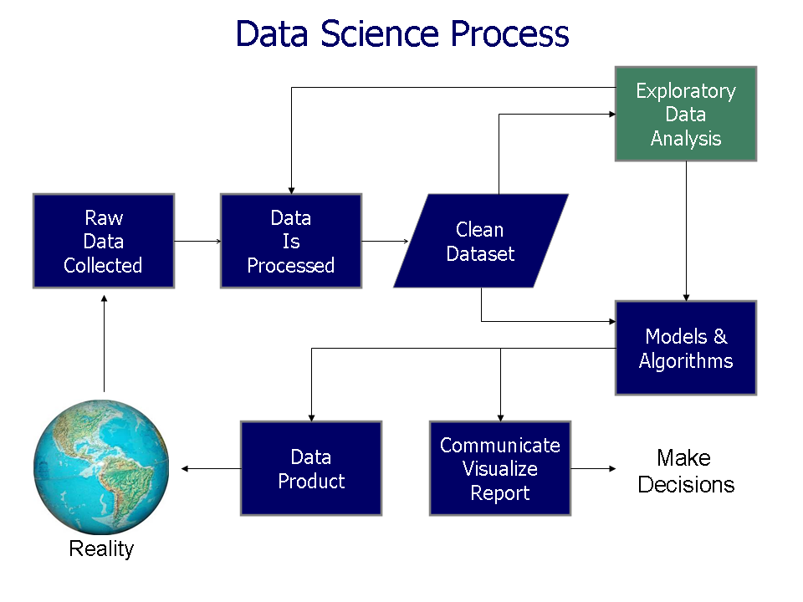
Methods Data Science

Slide 4
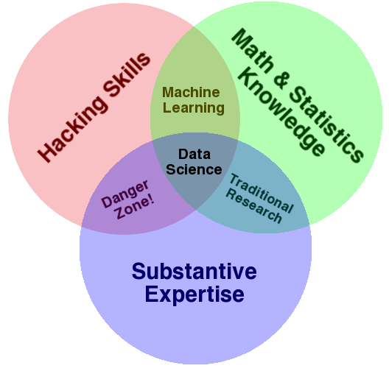
Structure of Data Science
Computer Science

Slide 5
Why Data Science
Large demand for data scientists
Software Engineer salary (mean $95,195/year) vs Data Scientist salary (mean $113,436/year) (Glassdoor)
Harvard Business review: Data Scientist: The Sexiest Job of the 21st Century.

Slide 6
Why Data Science
Large demand for data scientists
Prof. Andrew Ng: Artificial Intelligence is the New Form of Electricity
Data Science rise up in all domains: from web to heavy industry, from healthcare to robotics

Slide 7
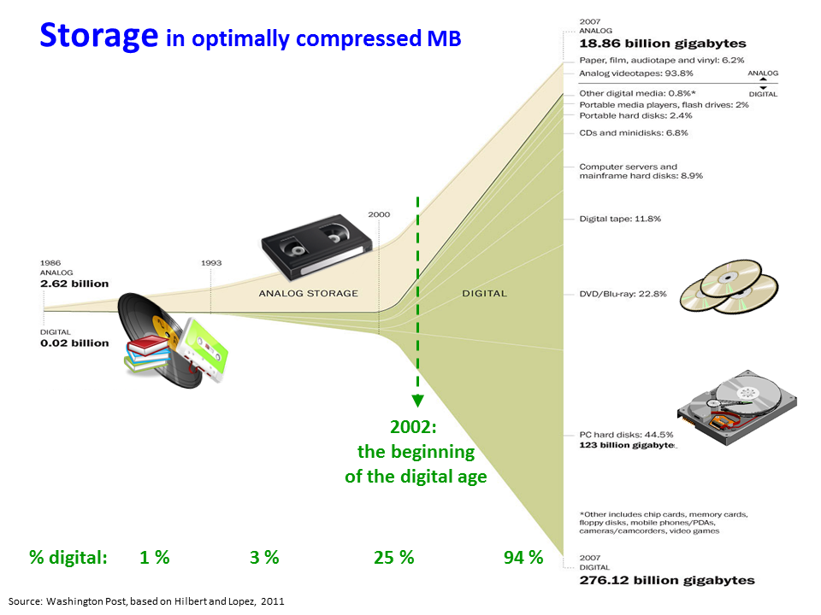
Big Data

Slide 8
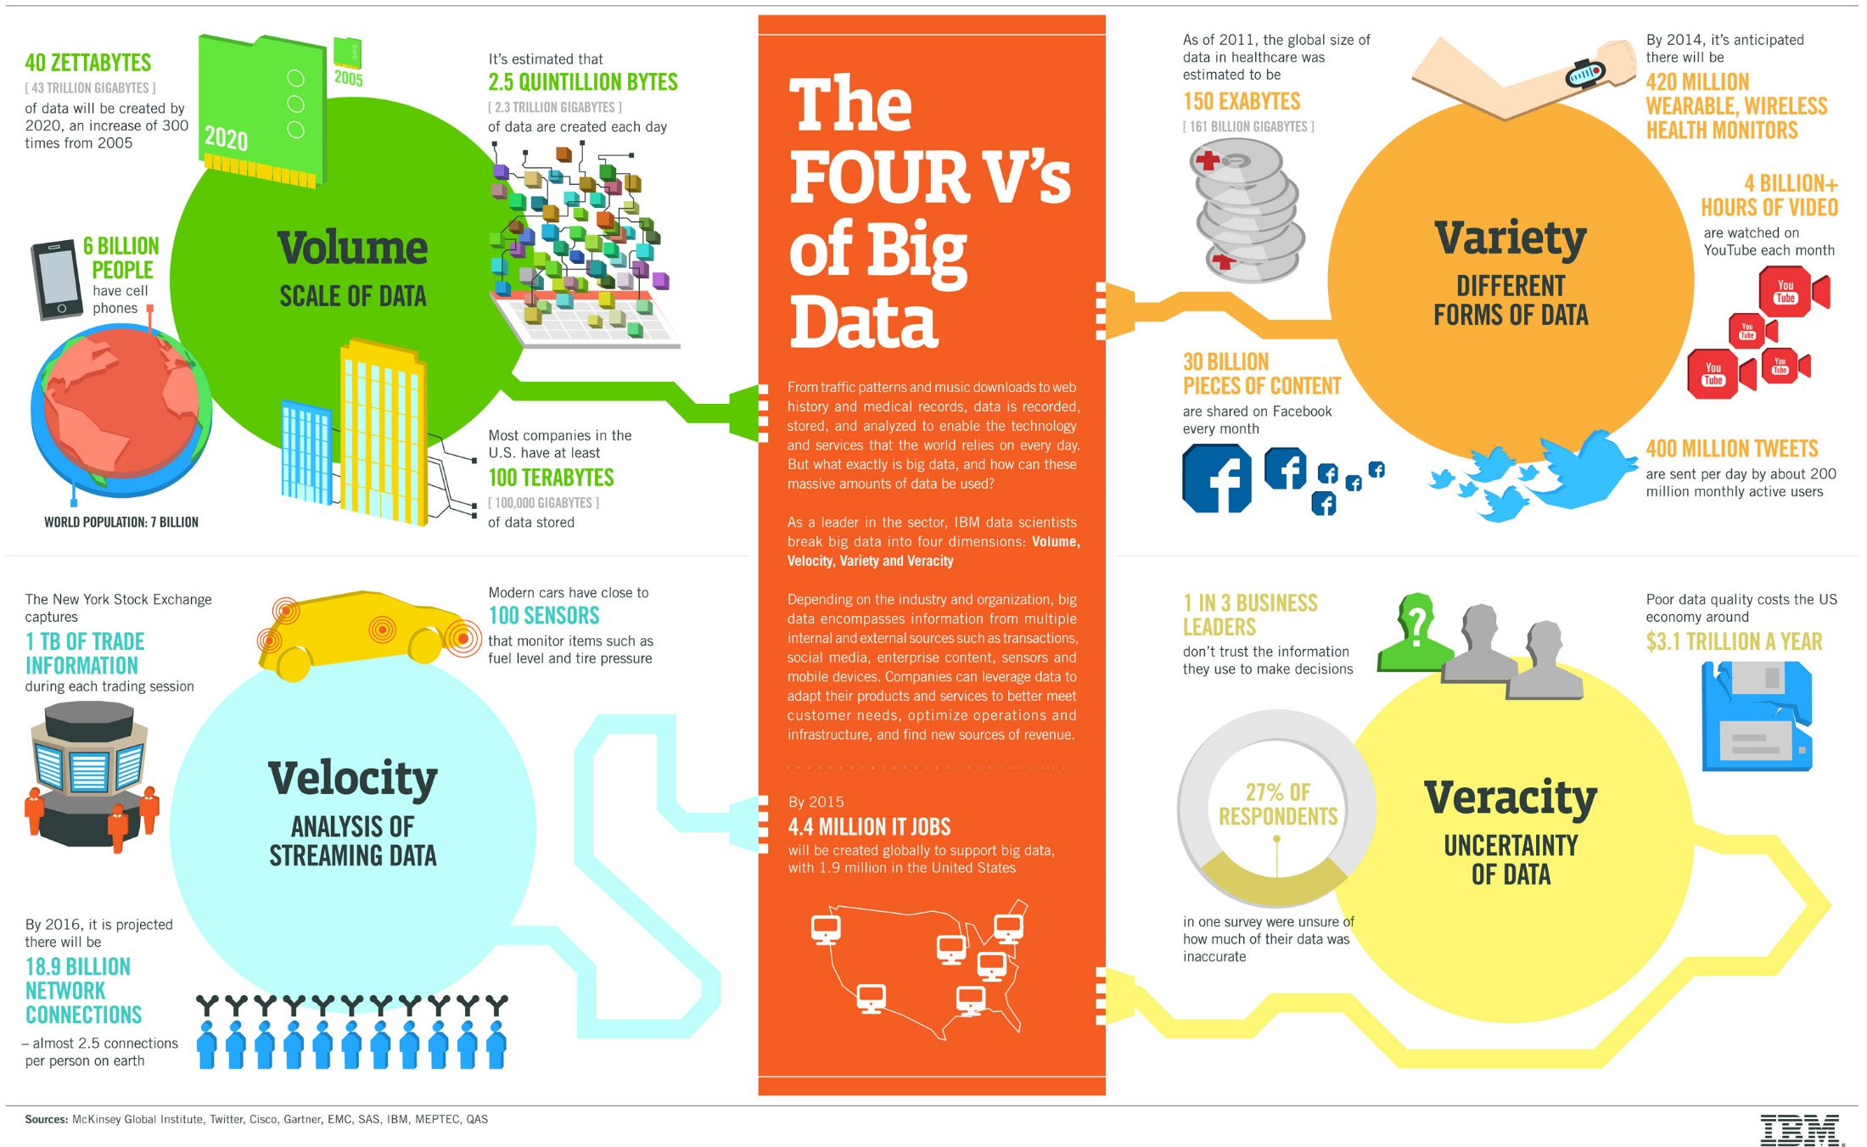
Characteristics of Big Data

Slide 9
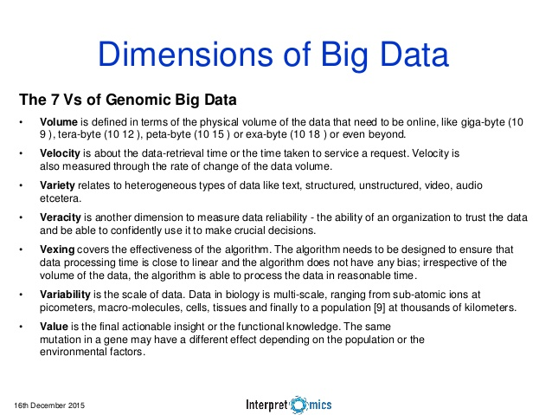
Characteristics of Big Data

Slide 10
Technologies for Big Data

Slide 11
Examples of DS projects
Video search:
http://www.trendintech.com/2017/03/19/video-search-becomes-a-reality-with-googles-machine-learning-api-that-recognizes-objects-in-videos/
The Karma Train: http://cs109.joeong.com/
Recommender Systems: netflix.com, youtube.com, amazon.com
Sentiment Analysis: twitter.com
Summary of news: bcc.news.com
Predicting stock market: bloomberg.com
Increase crop yield, does smoking cause cancer, does streptomycin cure tuberculosis:
datakind.com
…

Slide 12
Where to learn more
Quora
Books:
OpenIntro
Introduction to Statistical Learning
The Data Science Handbook
Machine Learning for Hackers
Information Dashboard Design: Displaying Data for At-a-Glance Monitoring: Stephen Few
Visualize This: The FlowingData Guide to Design, Visualization, and Statistics: Nathan Yau
Learning Spark
Advanced Analytics with Spark
…
Blogs:
KDNuggets - Analytics, Data Mining, and Data Science
SimplyStatistics - http://www.simplystatistics.com
R-bloggers - https://www.r-bloggers.com/
Yhat - ŷhat | Yhat: The Yhat (Pronounced Y-hat) Blog
FastML - FastML
Analytics Vidhya - Home
Edureka - Edureka Blog - Edureka - Discover Learning

Slide 13
Where to learn more
Forums:
Quora
Reddit - http://www.reddit.com (multiple data science forums)
DataTau
Cross Validated
Projects:
Kaggle - Your Home for Data Science
Driven Data – DrivenData
GWC courses:
Practical Machine Learning
Self-Driven Cars
Computer Vision
Natural Language Processing
Data Science in Healthcare and Genomics
…

Slide 14
Conclusions

