Slide 1
Practical Data Science
Installation of environment

Slide 2
InstallatText Editor on Windows
Notepad++ (Vim, Emacs, Notepad, Atom, …)
https://notepad-plus-plus.org/
Go to “download”
Choose your configuration, then download the installation
Install following instructions
!Replace tab by 4 spaces!!!

Slide 3
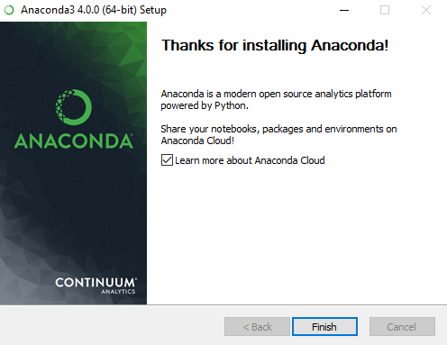
Install Anaconda on Windows
Download the Anaconda installer.
Optional: Verify data integrity with MD5 or SHA-256.
Double click the Anaconda installer and follow the prompts to install to the default location.
NOTE: Install Anaconda into a path that does not contain spaces or unicode characters.
NOTE: Do not install as Administrator unless admin privileges are required.
NOTE: If you encounter any issues during installation, please temporarily disable your anti-virus software during install, then immediately re-enable it. If you have installed for all users, uninstall Anaconda and re-install it for your user only and try again.
After a successful installation you will see output like this:

Slide 4
Install Github on Windows
https://www.youtube.com/watch?v=J_Clau1bYco !!!Use this
https://git-scm.com/
There are also a few ways to install Git on Windows. The most official build is available for download on the Git website. Just go to http://git-scm.com/download/win and the download will start automatically. Note that this is a project called Git for Windows, which is separate from Git itself; for more information on it, go to https://git-for-windows.github.io/.
To get an automated installation you can use the Git Chocolatey package. Note that the Chocolatey package is community maintained.
Another easy way to get Git installed is by installing GitHub for Windows. The installer includes a command line version of Git as well as the GUI. It also works well with Powershell, and sets up solid credential caching and sane CRLF settings. We’ll learn more about those things a little later, but suffice it to say they’re things you want. You can download this from the GitHub for Windows website, at http://windows.github.com.

Slide 5
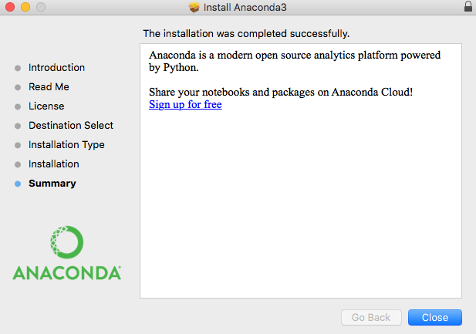
Install Anaconda on Mac
https://docs.continuum.io/anaconda/install
Download the Anaconda installer.
Optional: Verify data integrity with MD5 or SHA-256.
Double click the .pkg file. Answer the prompts on Introduction, Read Me, and License screens.
On Destination Select screen, you must select “Install for me only.”
IMPORTANT: If you get the error message “You cannot install Anaconda in this location”, reselect “Install for me only”.
On “Installation Type” you may choose to install in another location. Standard install will put Anaconda in your home user directory .
NOTE: Advanced users may select “customize” to not add Anaconda to the bash PATH:
Click the Install button.
After a successful installation you will see output like this:

Slide 6
Install Github on Mac
There are several ways to install Git on a Mac. The easiest is probably to install the Xcode Command Line Tools. On Mavericks (10.9) or above you can do this simply by trying to run git from the Terminal the very first time. If you don’t have it installed already, it will prompt you to install it.
If you want a more up to date version, you can also install it via a binary installer. An OSX Git installer is maintained and available for download at the Git website, at http://git-scm.com/download/mac.
You can also install it as part of the GitHub for Mac install. Their GUI Git tool has an option to install command line tools as well. You can download that tool from the GitHub for Mac website, at http://mac.github.com.

Slide 7
Install Anaconda on Linux
In your browser download the Anaconda installer for Linux.
Optional: Verify data integrity with MD5 or SHA-256. more info on hashes
Open a terminal window and type the following:
bash ~/Downloads/Anaconda3-4.3.0-Linux-x86_64.sh
NOTE: Replace ~/Downloads with your actual path and Anaconda3-4.3.0-Linux-x86_64.sh with your actual file name.
NOTE: Accept the default location or select a user-writable install location such as ~/anaconda
NOTE: Install Anaconda as a user unless root privileges are required.
Follow the prompts on the installer screens, and if unsure about any setting, simply accept the defaults, as they can all be changed later.
NOTE: If you select the option to not add the Anaconda directory to your bash shell PATH environment variable, you may later add this line to the file .bashrc in your home directory:
export PATH=“/home/username/anaconda/bin:$PATH”. Replace /home/username/anaconda with your actual path.
The output of a successful installation will include the messages “Installation finished.” and “Thank you for installing Anaconda!”
Finally, close and re-open your terminal window for the changes to take effect.

Slide 8
Install Github on Linux
If you want to install the basic Git tools on Linux via a binary installer, you can generally do so through the basic package-management tool that comes with your distribution. If you’re on Fedora for example, you can use yum:
sudo yum install git-all
If you’re on a Debian-based distribution like Ubuntu, try apt-get:
sudo apt-get install git-all
For more options, there are instructions for installing on several different Unix flavors on the Git website, at http://git-scm.com/download/linux.

Slide 9
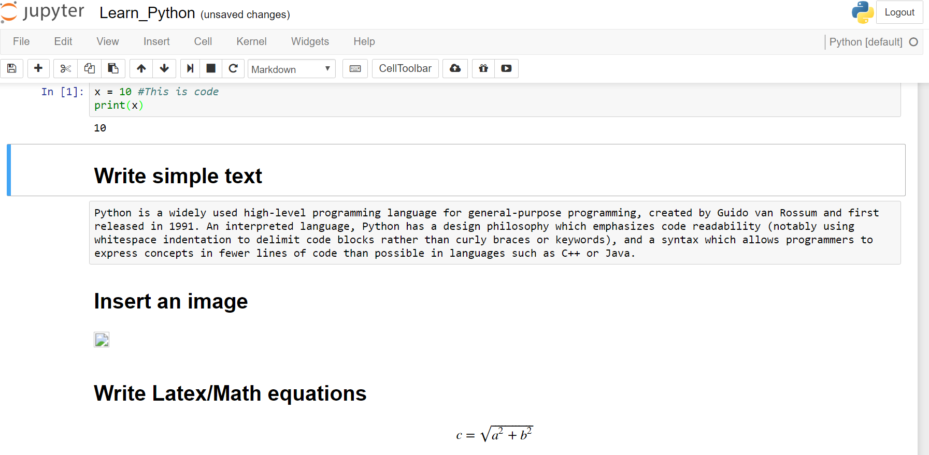
Working with iPython in Jupiter

