Slide 1
Practical Data Science
Data Formats

Slide 2
Types of Data
Structured vs Unstructured
Structured: CSV, XML, JSON
Unstructured: html, pictures(jpeg, bmp, gif, …), video (avi, mpeg4, …)

Slide 3
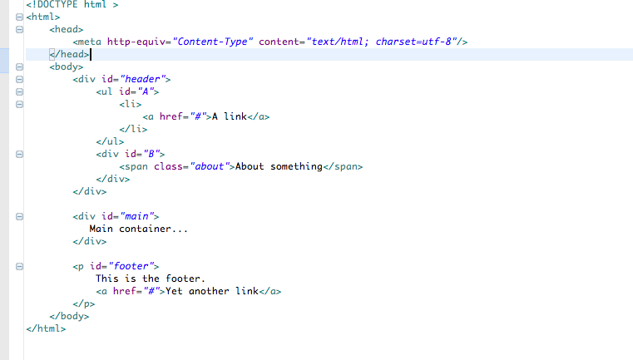
HTML format

Slide 4
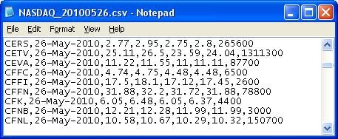
CSV format
import pandas as pd
df = pd.read_csv(“data.csv”, header=None, names=[‘column1’,’column2’], na_values=[‘-’,’N/A’], skiprows=3)

Slide 5
XML format
eXtensible Markup Language (XML)
XML elements:
Start tag
End Tag
Text Content
Attribute
Self Closing Tag
White spaces, tabs are discarded, indentation is only for readability.
Main elements
<Student>
<Name>John</Name>
<Phone type=“intl”>
+1 234 567 8901
</Phone>
<Email hide=“yes”/>
</Student>

Slide 6
XML as a Tree
a
<a>
<b>
<c color=‘red’>X</c>
<d shape=‘square’>Y</d>
</b>
<e>Z</z>
</a>
b
e
b
d
Z
X
Y

Slide 7
XML schema
XML schema description of a legal format of an XML document. Expressed in terms of constraints on the structure and content of document.
XML Schema (use of validator to validate an XML based on schema) (many XML schema languages, like DTD, ISO 8879:1986 SGML, W3C)
W3C in details
XML Schema:
<xs:complexType name=“Student”>
<xs:sequence>
<xs:element name=“Name” type=“xs:string”/>
<xs:element name=“Age” type=“xs:integer”/>
<xs:element name=“DateBorn” type=“xs:date”/>
<xs:element name=“Email” type=“xs:string” minOccurs=“1” maxOccurs=“2”/>
</xs:sequence>
</xs:complexType>
XML Document:
<Student>
<Name>John Doe</Name>
<Age>43</Age>
<DateBorn>02/23/1985</DateBorn>
<Email>jdoe@gmail.com</Email>
<Email>jd@yahoo.com</Email>
</Student>

Slide 8
JSON format
Represent data as nested “lists” or “dictionaries”
import json
data = '''{
"Name" : "John Doe",
"Phone" : {
"Type" : "intl",
"Number" : "+1 925 123 4567"
},
"Email" : {
"hide" : "yes"
}
}''‘
info = json.loads(data)
print("Name: ",info["Name"])
print("Hide: ",info["Email"]["hide"])

Slide 9
JSON format
import json
data = '''[
{ "id" : "1",
"Name" : "John Doe",
"Phone" : "+1 925 123 4567"
},
{ "id" : "2",
"Name" : "Sarah Connor",
"Phone" : "+1 925 456 7890"
}
]
''‘
info = json.loads(data)
print("Student count: ",len(info))
for item in info:
print("ID: ",item["id"])
print("Name: ",item["Name"])
print("Phone: ",item["Phone"])

Slide 10
Graphic formats
Vector formats (polygons to represent image):
CGM (2D)
Gerber (2D)
SVG (Scalable vector graphics, for Web, based on XML, in d3.js)
.3ds (Autodesk 3D Studio)
3DXML (based on XML)
AMF (Additive manufacturing format for 3D Printers)
…
Raster formats (grid of pixels):
JPEG (reduced quality due to compression)
TIFF (can handle device specific color space)
GIF (only 256 colors and a transparent color)
PNG (lossless compression)
BMP (full uncompressed info for each pixel)
…
#Create one row image that has all grey values from 0 to 255
import png
f = open(‘ramp.png’,’wb’)
w = png.Writer(255,1,greyscale=True)
w.write(f,[range(256)]
f.close

Slide 11
Video formats
Structure: Video file consists of a container format (e.g. Matroska) containing video data in a video codding format (e.g. VP9) alongside audio format in an audio codding format (e.g. Opus)
Video codding formats: MPEG-2, MPEG-4, HEVC, Theora, VP9, AV1
Audio codding format: MP3, AAC, Vorbis, Opus, FLAC
import pylab
import imageo
filename = “video.mp4”
vid = imageo.get_reader(filename,’ffmpeg’)
frames = [20, 356]
for frame in frames:
image = vid.get_data(num)
fig = pylab.figure()
fig.suptitle(“image #{}”.format(frame),fontsize=20)
pylab.imshow(image)
pylab.show()

