Slide 1
Practical Data Science
SQL

Slide 2
Relational Database
Relational DataBase (RDB) models data by storing rows and columns in tables. Tables are related to each other by various relationships.
Good data system allows for
Easy retrieval
Easy updating
Accessibility for multiple people at the same time
Data consistency
Space efficiency
Speed
Security

Slide 3
RD terminology
Database contains many tables
Relation (Table) contains tuples and attributes
Tuple (row) a set of fields that generally represents an object, like a person or a course.
Attribute (column) one of possibly many elements of data corresponding to the object represented by the row.
DATABASE
Table1: Rooms
 | # places | Floor
RobotX space | 55 | 3
Building A | 20 | 3
Building B | 30 | 2
Table2: Courses
 | Duration | Lecturer
Practical Data Science | 55 | Roman Nazarov
Practical Machine Learning | 60 | Roman Nazarov
Self-driving cars | 50 | John Doe
Table3: Students
 | Age | Phone
Albert Gore | 55 | 925-123-4567
Donald Trump | 60 | 607-987-6543
Barak Obama | 50 | 123-456-7890
Tuples (Rows) (unique) !no order!
Attributes (Collumns) (uniques) !no order!

Slide 4
Design a Database
Basic Rule: Don’t put the same data twice – use a relationship instead (do not replicate data – use references to a data)
When there is one thing in a “real world” there should be one copy of that thing in the database.
Use integers for keys and references (IDs). Never use logical key as the primary key, because logical key can change. Relationships that are based on matching string fields (a.k.a. logical key) are less efficient than based on integers.
Have a column with unique IDs (preferably integers) for each object.
For each “piece of information” ask the following questions:
Is it an object or an attribute of another object
Once you defined all objects, you need to define relationships between objects

Slide 5
Design a Database
Name | Age | Phone | Course | Room
Barak | 50 | 123-456-7890 | PDS | A
Barak | 50 | 123-456-7890 | PML | B
Donald | 60 | 607-987-6543 | PDS | A
Donald | 60 | 607-987-6543 | PML | B
Donald | 60 | 607-987-6543 | SDC | B
Albert | 55 | 925-123-4567 | PML | B
Albert | 55 | 925-123-4567 | SDC | B
Unique entries in each table
Table2: Course
 | Duration
PDS | 55
PML | 60
SDC | 50
Table1: Room
Table3: Student
 | # places | Floor
RobotX space | 55 | 3
A | 20 | 3
B | 30 | 2
 | Age | Phone
Albert Gore | 55 | 925-123-4567
Donald Trump | 60 | 607-987-6543
Barak Obama | 50 | 123-456-7890

Slide 6
ER Diagram
Now we need to add relationships
Attributes: unique measurements for each entity (columns)
Unique attribute (underlined). In a table it is a column which allows to link tables together.
StudentID
Student Name
CourseID
infinity
min, max
(10,M)
Attends
Entity
Student
Course
Phone
Relationship
Name
Each course must be attended by at least 1 student ( ) but it may be attended by many ( ) students
Each student may attend 0 courses ( ) but he can attend many ( ) courses.
Entity instance – a single occurrence of an entity (row)

Slide 7
Relational schema
StudentID
Name
CourseID
Attends
Student
Course
Phone
Name
Unique key (may have null values)
Student
Course
Logical key (what the outside world uses for lookup.
Primary key (cannot have null values)
ID
Name
Phone
ApplicationNumber (U)
CourseID (FK)
ID
Name
Foreign key ()

Slide 8
KEYS
Types of keys:
Primary key
Logical key
Foreign key
Composite key = (Foreign key1,Foreign key2)
Weak key = (Primary key, Foreign key) = (room#, building#)

Slide 9
RELATIONSHIPS
One-to-one
One-to-many
Many-to-many
Student
Course
Member
ID
Name
Phone
ApplicationNumber (U)
ID
Title
StudentID (FK)
CourseID (FK)
Composite key = (StudentID,CourseID)

Slide 10


RDB systems

Slide 11





















SQLite
Used in many softwares:
SQLite browser (http://sqlitebrowser.org/)

Slide 12
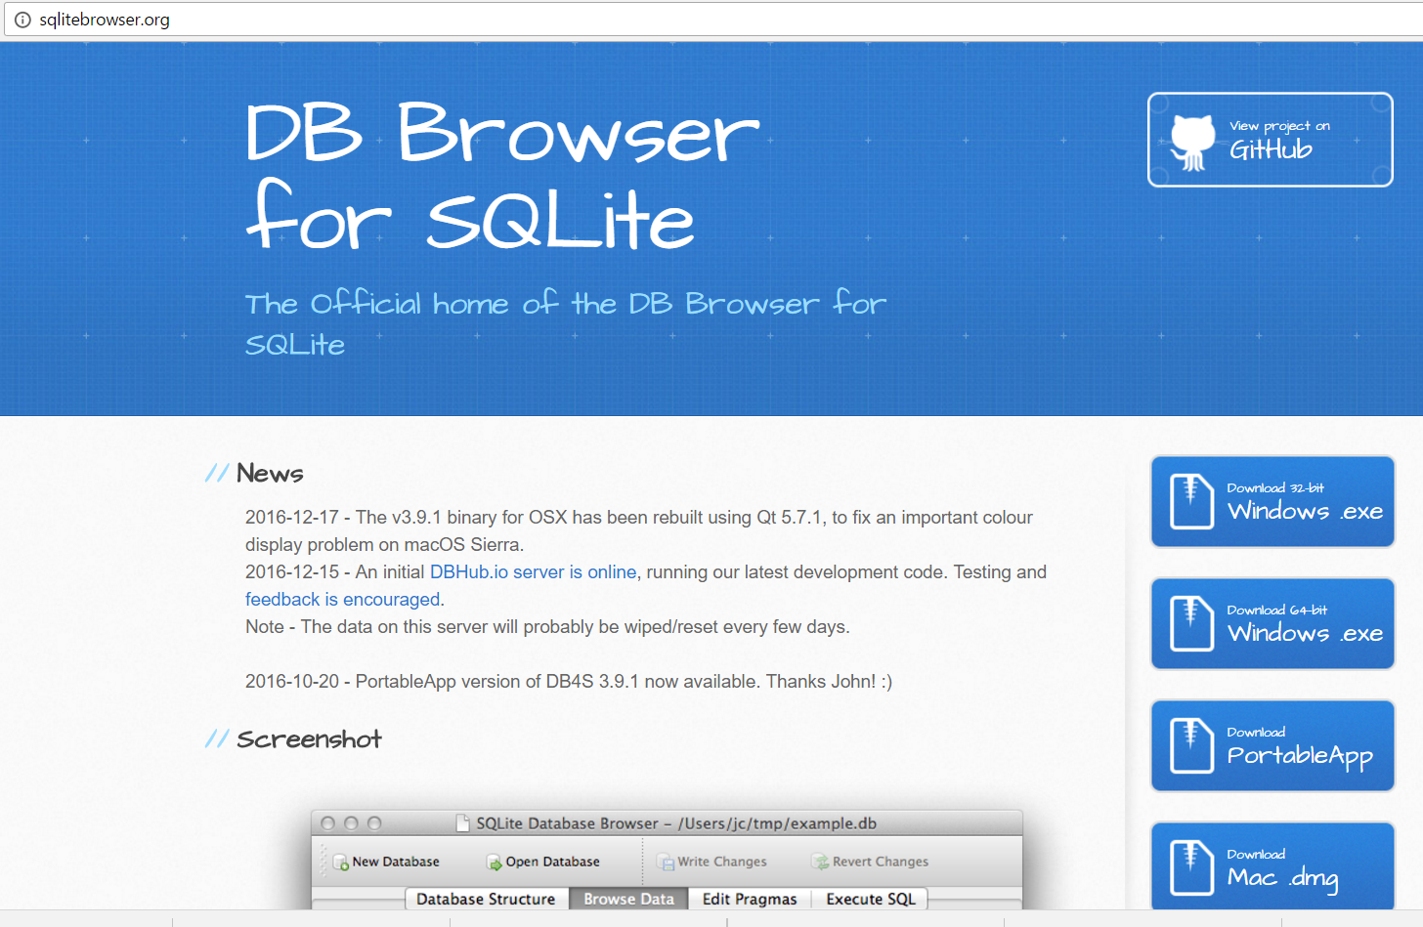
SQLite Browser

Slide 13
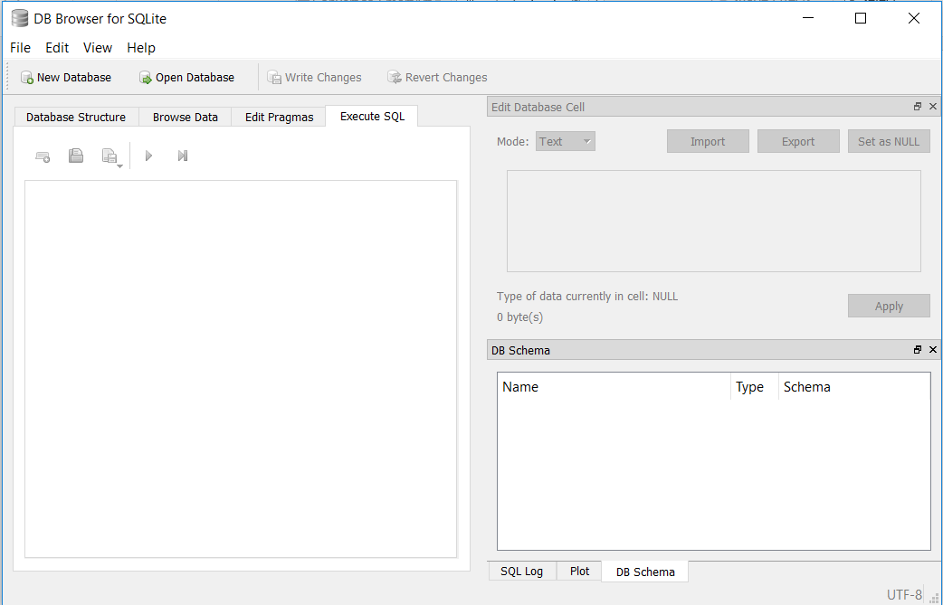
SQLite Browser

Slide 14
SQL
[Sequel] or [S-Q-L]?
SQL was initially developed at IBM by Donald Chamberlin and Raymond Boyce. It was initially called “Structured English Query Language” (SEQUEL) and pronounced [sequel]. Latter its name was shortened to “Structured Query Language” (SQL).
ISO Standard: SQL, as [S-Q-L].
Structured Query Language is the language used to issue commands to the database:
Create table
Insert data
Update data
Delete data
Retrieve data

Slide 15
CREATE Tables
CREATE TABLE Student(
StudentID
Name VARCHAR(128),
Phone VARCHAR(128)
)
CREATE TABLE Student(
StudentID INTEGER NOT NULL PRIMARY KEY AUTOINCREMENT UNIQUE,
Name TEXT,
Phone TEXT,
CourseID INTEGER
)
CREATE TABLE Course(
CourseID INTEGER NOT NULL PRIMARY KEY AUTOINCREMENT UNIQUE,
Titel TEXT,
Duration INTEGER,
StudentID INTEGER
)

Slide 16
INSERT
INSERT INTO Student(StudentID,Name,Phone) VALUES(‘3’,’John Doe’,’925-222-3333’)
DELETE
DELETE FROM Student WHERE Name=‘John Doe’
UPDATE
UPDATE Student SET Name=‘Charles Doe’ WHERE Phone=‘925-222-3333’

Slide 17
Retrieve records
SELECT the data you want
FROM these databases and tables
WHERE these conditions are met, and
GROUP (BY) this field
HAVING this property, then
ORDER (BY) this field or list;
Requered!
SELECT * FROM Student #Gives full Students table
SELECT * FROM Student WHERE Phone=‘925-222-3333’ #Gives only records with specific Phone number

Slide 18
ORDER BY
SELECT * FROM Student ORDER BY Phone
SELECT * FROM Student ORDER BY Name
GROUP BY
SELECT * FROM Member GROUP BY StudentID

Slide 19
Aggregation functions
COUNT, SUM, AVG, MAX, MIN
SELECT SUM(CourseID),AVG(Score) FROM Member GROUP BY StudentID

Slide 20
MANY-TO-MANY
Student
Course
Member
ID
Name
Phone
ApplicationNumber (U)
ID
Title
StudentID (FK)
CourseID (FK)
Composite key = (StudentID,CourseID)
CREATE TABLE Student (
ID INTEGER NOT NULL PRIMARY KEY AUTOINCREMENT UNIQUE,
Name TEXT UNIQUE,
Phone TEXT)
CREATE TABLE Course (
ID INTEGER NOT NULL PRIMARY KEY AUTOINCREMENT UNIQUE,
Title TEXT UNIQUE)
CREATE TABLE Member (
StudentID INTEGER,
CourseID INTEGER,
Role INTEGER,
PRIMARY KEY (StudentID, CourseID))

Slide 21
MANY-TO-MANY
INSERT INTO Member (StudentID,CourseID,Role) VALUES (1,3,0)
INSERT INTO Member (StudentID,CourseID,Role) VALUES (2,2,1)
SELECT Student.Name, Member.Role, Course.Title
FROM Students JOIN Member JOIN Courses
ON Member.StudentID=Student.ID AND Member.CourseID=Course.ID
ORDER BY Course.Title, Member.Role DESC, Student.Name

Slide 22
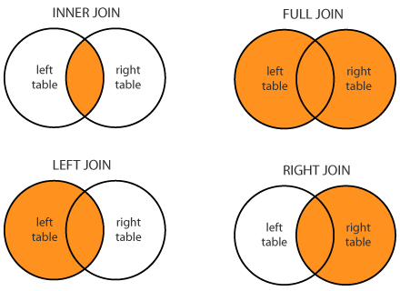
JOINS
Types of joins:
Inner
Outer
Left outer
Right outer (=left outer when two tables are exchanged)

Slide 23
INNER JOIN
Student
Course
StudentID | Name | CourseID
1 | Sarah | 1
2 | Donald | 1
3 | Jessica | 3
4 | Albert | NULL
CourseID | Title
1 | PDS
2 | PML
NULL | SDC
INNER JOIN
StudentID | Name | CourseID | Title
1 | Sarah | 1 | PDS
2 | Donald | 1 | PDS

Slide 24
OUTER JOIN
Student
Course
StudentID | Name | CourseID
1 | Sarah | 1
2 | Donald | 1
3 | Jessica | 3
4 | Albert | NULL
CourseID | Title
1 | PDS
2 | PML
NULL | SDC
OUTER JOIN
StudentID | Name | CourseID | Title
1 | Sarah | 1 | PDS
2 | Donald | 1 | PDS
3 | Jessica | 3 | NULL
4 | Albert | NULL | NULL
NULL | NULL | 2 | PML
NULL | NULL | NULL | SDC

Slide 25
LEFT OUTER JOIN
Student
Course
StudentID | Name | CourseID
1 | Sarah | 1
2 | Donald | 1
3 | Jessica | 3
4 | Albert | NULL
CourseID | Title
1 | PDS
2 | PML
NULL | SDC
LEFT OUTER JOIN
StudentID | Name | CourseID | Title
1 | Sarah | 1 | PDS
2 | Donald | 1 | PDS
3 | Jessica | 3 | NULL
4 | Albert | NULL | NULL

Slide 26
INNER JOIN
Student
Course
StudentID | Name | CourseID
1 | Sarah | 1
2 | Donald | 1
3 | Jessica | 3
4 | Albert | NULL
CourseID | Title
1 | PDS
2 | PML
NULL | SDC
RIGHT OUTER JOIN
StudentID | Name | CourseID | Title
1 | Sarah | 1 | PDS
2 | Donald | 1 | PDS
NULL | NULL | 2 | PML
NULL | NULL | NULL | SDC

Slide 27
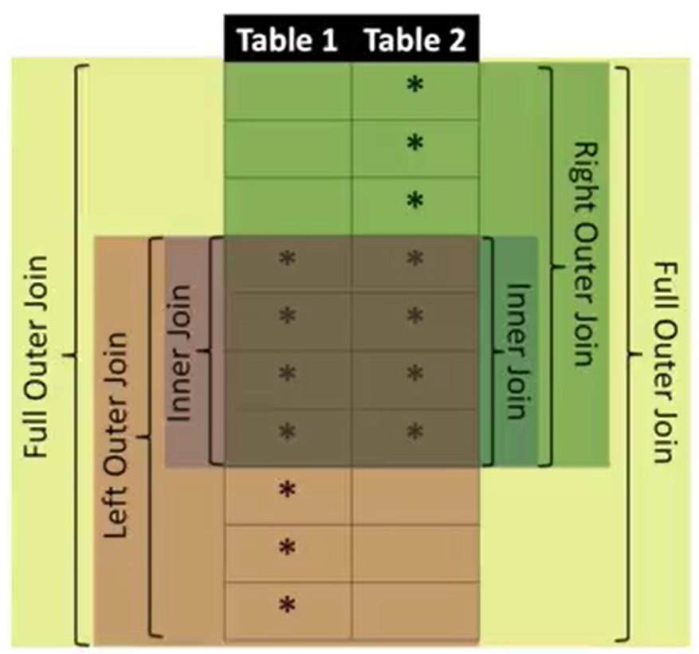
JOINS

Slide 28

JOINS in SQL

Slide 29
MANY-TO-MANY JOINS
Student
StudentID | Name | CourseID
1 | Sarah | 1
2 | Donald | 1
3 | Jessica | 3
4 | Albert | NULL
RESULT 1
Member
StudentID | CourseID
1 | 2
2 | 1
1 | 1
RESULT 2
Course
CourseID | Title
1 | PDS
2 | PML
NULL | SDC
!Multiplication of rows when joining tables with duplicated rows!

Slide 30
JOIN DATABASES in SQLite
SELECT Student.Name, Course.Name
FROM Student JOIN Course ON
Student.CourseID=Course.ID
← What we want to see
← The Tables that hold the data
← How the Tables are linked
SELECT Student.Name, Student.CourseID,Course.ID, Course.Name
FROM Student JOIN Course ON
Student.CourseID=Course.ID
SELECT Student.Name, Course.Name
FROM Student JOIN Course
← Joining two tables without an ON clause gives all possible combinations of rows
SELECT Student.Name, Course.Name, Building.Name
FROM Student JOIN Course JOIN Buildings ON
Student.CourseID=Course.ID AND Course.BuildingID=Building.ID
← What we want to see
← The Tables that hold the data
← How the Tables are linked

Slide 31
PYTHON TO INTERACT WITH SQLite
import sqlite3 #Load SQLite module in Python
conn = sqlite3.connect(‘university.sqlite’) #Open university.sqlite file for writing
cur = conn.cursor() #Establish a connection via a cursor
cur.execute(‘’’
CREATE TABLE IF NOT EXIST Student (
ID INTEGER NOT NULL PRIMARY KEY AUTOINCREMENT UNIQUE,
Name TEXT UNIQUE,
Phone TEXT
)’’’)
We can insert data ourselves or we can import it from other formats, e.g. CSV, XML, JSON, etc..

Slide 32
Conclusions
What we learned:
How relational databases are organized
RDB systems
SQLite
How to design own database
How to create tables in a database.
How delete, update, insert records in tables
How to query information we need from a database
How to make complex querying
How to create and process a database from Python
How to convert various formats to a relational database

